Slide 1
The Obesity Epidemic and Changes in the Food Environment
Andrew Rundle, Dr.P.H.
Associate Professor of Epidemiology
Co-Director of the Mailman School Obesity
Prevention Initiative
Mailman School of Public Health
Columbia University
agr3@cumc.columbia.edu

Slide 2
Obesity Among U.S. Adults, 1994 and 2010
1994
2010
Prevalence of Obesity
<10% 10%–14% 15%–19% 20%–24% 25%-29% ≥30
(BMI ≥30, or ~ 30 lbs. overweight for 5’ 4” person)
Note: 1994 is the first year that all States reported obesity data to the CDC’s BRFSS
Notes:
Finally in 2010 Colorado also falls
This is a telephone interview – “what is your height and weight”?
Most people fudge a little on weight and height
All this is thought to be an underestimate
Stroke belt – bible belt

Slide 3
Prevalence of Overweight and Obesity among Children and Adolescents from 1971–1974 to 2011-2012

Slide 4
Average Daily Calories per Capita Available from the U.S. Food System has Increased (1970-2010)¹
1. Adjusted for spoilage and other waste
In 2000 the number of companies reporting vegetable oil production increased
Source – USDA Economic Research Service.

Slide 5
Percent Increase in Average Daily per Capita Calories Available¹ from 1970 – 2010 by Food Category
1. Adjusted for spoilage and other waste
Source – USDA Economic Research Service.

Slide 6
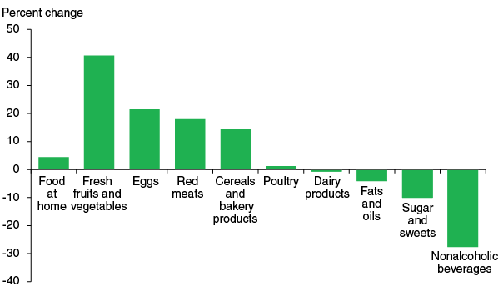
Cost of Fruit and Vegetables has Increased and Cost of Sugars and Fats has Decreased
Percent change in prices¹ 1985 - 2014
1. Using inflation adjusted prices.

Slide 7
Calories/Serving in Classic Recipes¹ from The Joy of Cooking: 1975 & 2006
1. Apple Pie, Barbeque Chicken, Beef Pot Roast, Cheeseburger, Chili con Carne, Corn Muffins, Lasagna, Mashed Potatoes, Meat Loaf, Pancakes, Sloppy Joes, and Tuna Casserole.
[Cereijido et al., 2009]

Slide 8
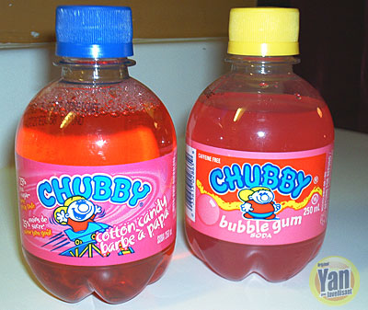
Products are Now Marketed to Children
"Launched in September 1993, CHUBBY is first carbonated soft drink to be developed and targeted specifically at children under the age of 12. Its success has been phenomenal.”
Chubby Investor Relations Materials

Slide 9
Eating Out is On the Rise
Share of total food expenditure (%)
Since the 1960s, expenditures for food eaten outside the home have steadily increased.
On average meals eaten outside the home are less healthy than meals prepared at home.
Source: USDA, Economic Research Service
At home
Away from home
Notes:
9
In the U.S.., food expenditures spent on foods eaten away from home has increased steadily, along with obesity rates.

Slide 10
McDonald’s Serving Sizes 1955 & 2002
2002
[Young et al., 2003]

Slide 11
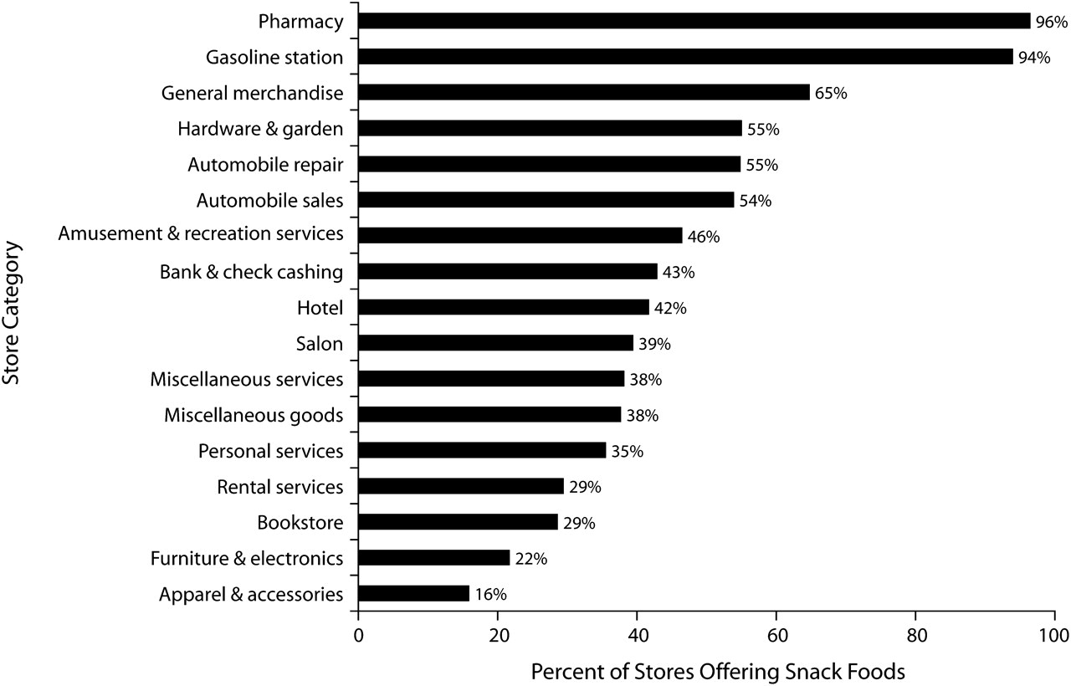
Snack Foods are Now Everywhere
[Farley TA, et al., AJPH, 2010].
Notes:
One does not have to go to a restaurant to find energy-dense snack foods.

