Slide 1
Principles of Addiction Medicine:
Overview of 2015-2016
Friday April 15, 2016
Sarah Wakeman MD, FASAM
(No Disclosures)
Joshua D Lee MD MSc, FASAM
(Study Drug In-Kind: Indivior, Alkermes)

Slide 2
Outline and Total Articles Reviewed (89 articles)
1. Neurobiology 4 articles
2. Epidemiology 8
3. Pharmacology 2
4. Diagnosis and Early Intervention: 5
5. Overview of Treatment 1
6. Special Issues 8
7. Management of Intoxication and WD 0
8. Pharmacological Interventions 18
9. Behavioral Interventions 8
10. 12-Step 3
11. Medical Disorders of Addiction 10
12. Co-Occurring Psyche 4
13. Pain and Addiction 6
14. Children & Adolescents 3
15. Ethical and Policy Considerations 8

Slide 3
Search Methods, 2015 calendar year:
1. Highest impact clinical medicine journals for addiction search terms:
  NEJM (Impact Factor = 55), Lancet (45), JAMA (35)
2. ‘ASAM’-iest journals for most downloaded or discussed articles:
  Addiction (4), J Add Med (1.7), JSAT (3), Drug Alc Dep (3.2), Sub Abuse (2.1), Add Sci Clin Prac (0), Am J Add (1.9)
3. ASAM Weekly Top 10 2015 Articles, Boston University’s Alcohol, Other Drugs, and Health 2015, NEJM Journal Watch 2015:
  JAMA Psych (12.7), Am J Psych (13.5), Proc N Acad Sci (9.7), Am J Med (5), Lancet Psyche (0), Drug Alc Rev (2.3), Addict Behave (2.7), Annals Int Med (17.8), JAMA Int Med (15), BMJ (17), Cochrane Rev (6), Am J Emerg Med (1.7)
4. Sarah and Josh’s Editorial Intuition…

Slide 4
Broad ‘Newsmaker’ Themes
E-Cigarettes, Smoking Cessation
Cannabis, Trends and Policies
Opioid, Heroin, Overdose Epidemic
Buprenorphine 3.0
Screening and Brief Intervention
Moderate Alcohol Consumption and Health

Slide 5

1. Neurobiology (CNS Studies): Cannabis Effects
J
Pagliaccio D, JAMA Psychiatry 2015:
“Shared Predisposition in the Association Between Cannabis Use and Subcortical Brain Structure”
Prior studies associating cannabis (MJ) use w structural brain changes
Design: Twin cohort study with MJ discordance
Differences in brain and amygdala volume in cannabis users were attributable to common pre-dispositional factors, genetic or environmental in origin
Little support for causal influences (MJ use itself)

Slide 6
1. Neurobiology (CNS Studies): Alcohol in Adolescents
J
Squeglia LM, Am J Psych 2015:
“Brain development in heavy-drinking adolescents”
This longitudinal study examined gray and white matter volume trajectories in 134 adolescents (75 who transitioned into heavy drinking and 59 who remained light to non-drinkers over roughly 3.5 years).
Findings: accelerated typical volume decline in frontal and temporal cortical volumes and attenuated growth in principal white matter structures in adolescents who started to drink heavily.

Slide 7
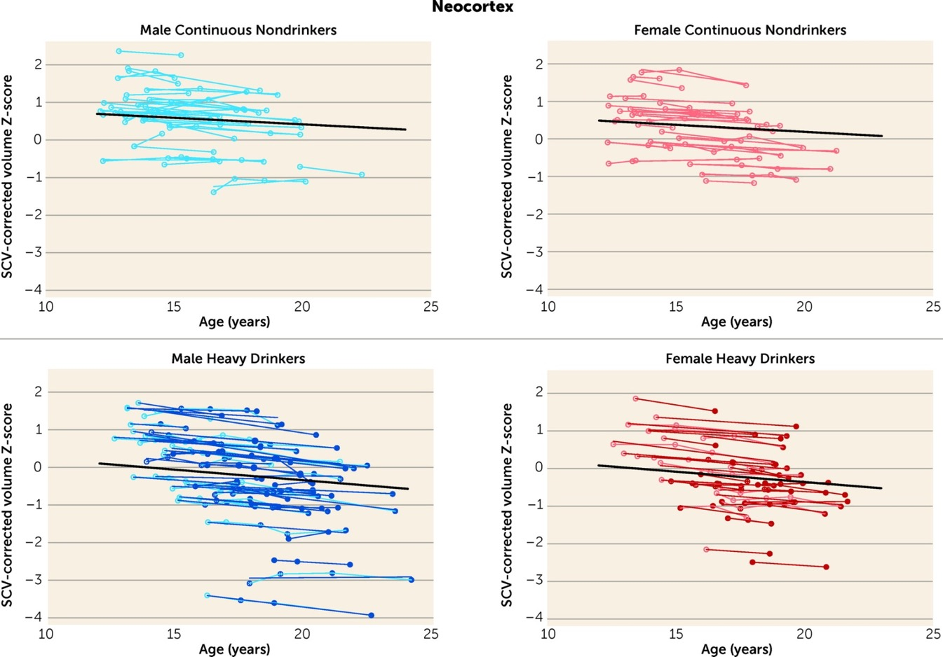

J
Relative to nondrinking adolescents, heavy drinkers exhibited greater volume reduction in the total neocortex (p=0.01) and specifically in the frontal (p=0.02), lateral frontal
(p=0.01), and temporal cortices.
Am J Psychiatry. 2015; 172(6): 531-542. doi: 10.1176/appi.ajp.2015.14101249
Notes:
INSERT PLOTS OF VOLUME CHANGES (FIG 5)

Slide 8
2. Epidemiology: US Midlife White Mortality
J
Case A, Deaton A, Proc Natl Acad Sci 2015 (Altmetric #40):
“Rising morbidity and mortality in midlife among white non-Hispanic Americans in the 21st century”
A marked increase in the all-cause mortality of middle-aged white non-Hispanic men and women in the United States between 1999 and 2013
Largely accounted for by increasing death rates from drug and alcohol poisonings, suicide, and chronic liver diseases and cirrhosis.
Those with less education saw the most marked increases
Mediators: self-reported declines in health, mental health, and ability to conduct activities of daily living, and increases in chronic pain and inability to work, as well as clinically measured deteriorations in liver function, all point to growing distress in this population

Slide 9
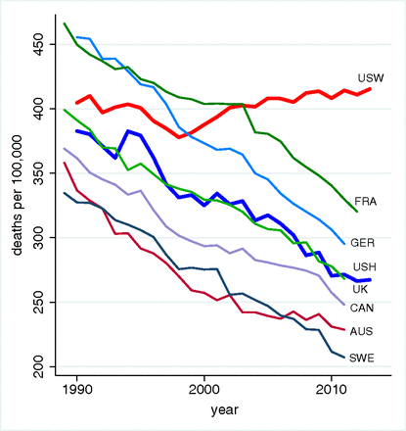
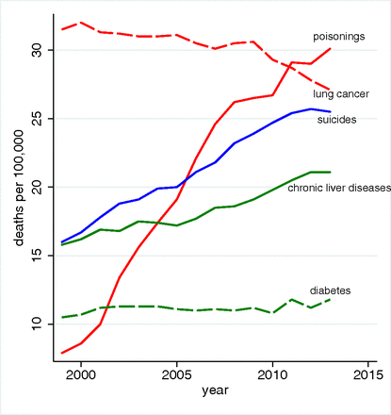

J
After 1998, reversal of the decline in midlife mortality for US white
non-Hispanics
Midlife mortality in the US has risen by .5% per year since, unlike
any other rich country (they continue to decline by 2% per year)
Suicides, drug/alcohol poisonings, and chronic
liver diseases account for the US white non-
Hispanic mortality reversal
PNAS. 2015; 112(49):15078-15083. doi: 10.1073/pnas.1518393112

Slide 10
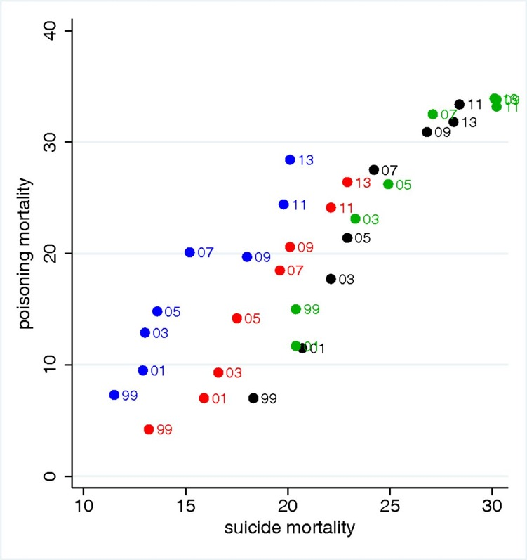
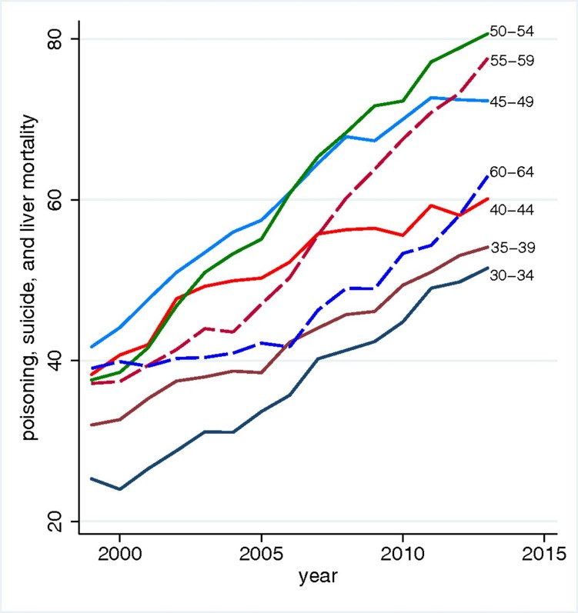
J
In each census region, increase in suicide mortality of 1 per 100,000 was matched by a 2 per 100,000 increase in poisoning mortality in white non-Hispanics aged 45-54.
Northeast
Midwest
South
West
Groups between 30–64 have witnessed similarly large increases in poisoning, suicide, and liver mortality; there was a greater increase amongst middle-aged (45-54) men and women.
White non-Hispanics
by 5-year age group
PNAS. 2015; 112(49):15078-15083. doi: 10.1073/pnas.1518393112

Slide 11
2. Epidemiology: US Prescription Opioid Misuse
S
Compton W, JAMA 2015:
“Nonmedical Prescription Opioid Use and Use Disorders Among Adults Aged 18 Through 64 Years in the United States, 2003-2013”
During the 2003-2013 years, among adults aged 18 through 64 years, the percentage of nonmedical use of prescription opioids decreased. In contrast, the prevalence of prescription opioid use disorders, frequency of use, and related mortality increased
Dart R, NEJM 2015:
“Trends in opioid analgesic abuse and mortality in the United States“
Post-marketing surveillance indicates that the diversion and abuse of prescription opioid medications increased between 2002 and 2010 and plateaued or decreased between 2011 and 2013, however deaths from heroin increased.

Slide 12
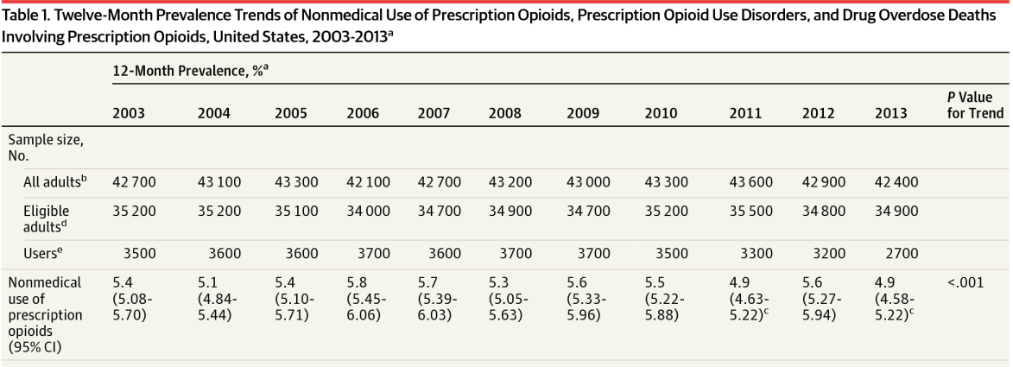
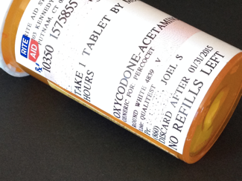

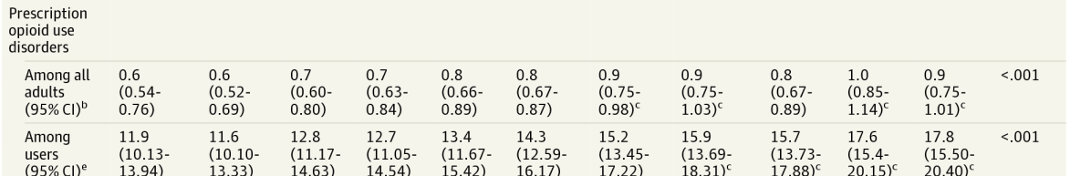

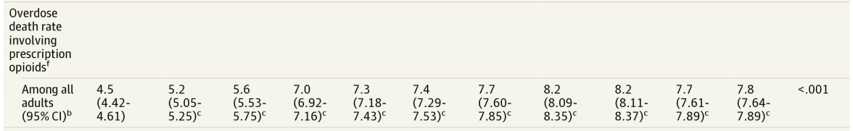
S
JAMA. 2015;314(14):1468-1478. doi:10.1001/jama.2015.11859.

Slide 13
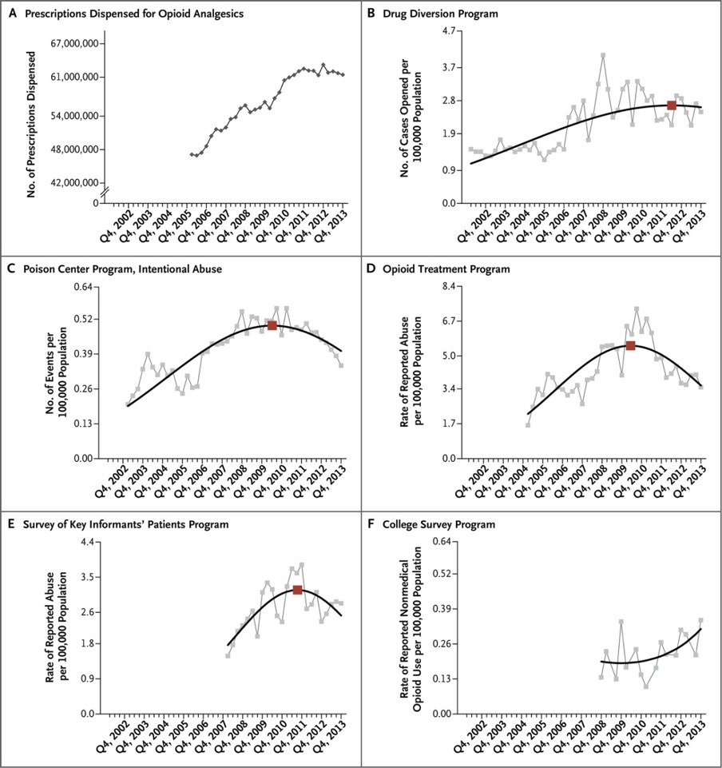
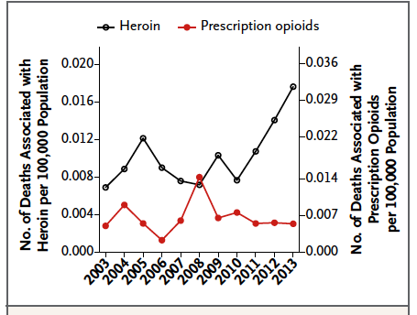

S
Number of opioid analgesic prescriptions peaked in 2012, then trended slightly downward from 2011-2013.
Before 2010, rate of diversion or abuse increasing in each program, but trended downward by 2013. The only exception was the College Survey Program, where nonmedical use nearly tripled by 2013.
Plateau/decrease in rates of prescription
opioid diversion or abuse since 2010 associated with increasing heroin-related mortality.
NEJM. 2015; 372:241-248.

Slide 14
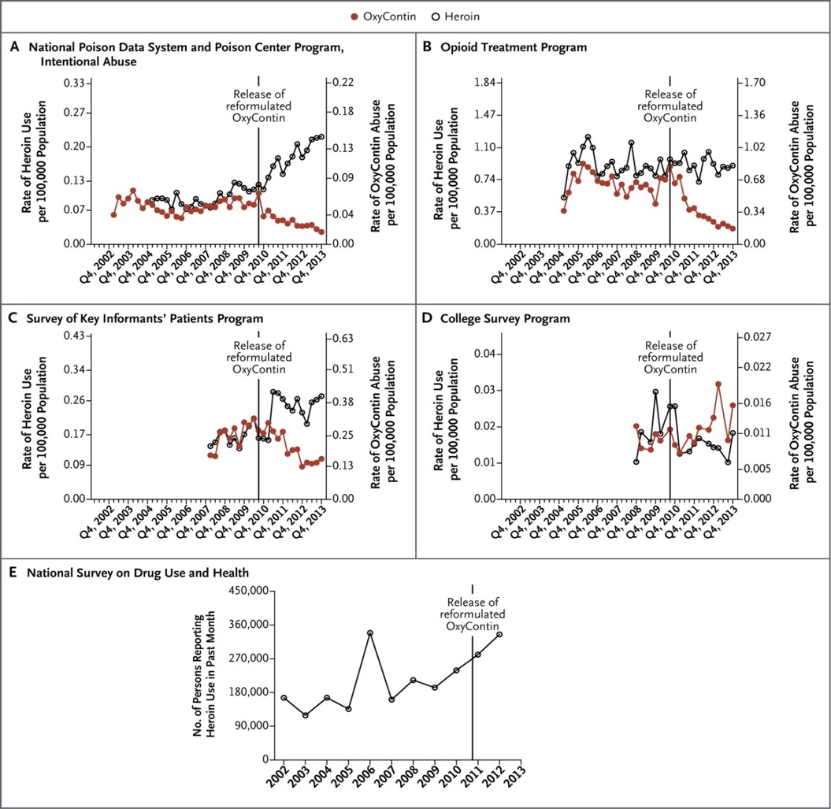
S
Overall, in conjunction with increasing heroin use, Oxycontin abuse decreased substantially after it was reformulated (A-C).
Yet in the College Survey Program, the rate of heroin use was generally flat, whereas rate of abuse of reformulated Oxycontin edged upward (D).
The rate of heroin-related cases started increasing in 2006 and appeared to accelerate in late 2010.
NEJM. 2015; 372:241-248.

Slide 15
2. Epidemiology: Cannabis and Global Risk (Altmetric #66)
S
Lachenmeier DW, Sci Rep, 2015:
“Comparative risk assessment of alcohol, tobacco, cannabis and other illicit drugs using the margin of exposure approach”
The margin of exposure (MOE) is defined as the ratio between toxicological threshold (benchmark dose) and estimated human intake.
For individual exposure the four substances alcohol, nicotine, cocaine and heroin fall into the “high risk” category with MOE < 10, the rest of the compounds except THC fall into the “risk” category with MOE < 100.
On a population scale (EUROPE ONLY), only alcohol would fall into the “high risk” category, and cigarette smoking would fall into the “risk” category. All other agents (opiates, cocaine, amphetamine-type stimulants, ecstasy, and benzodiazepines) had MOEs > 100, and cannabis had a MOE > 10,000.

Slide 16
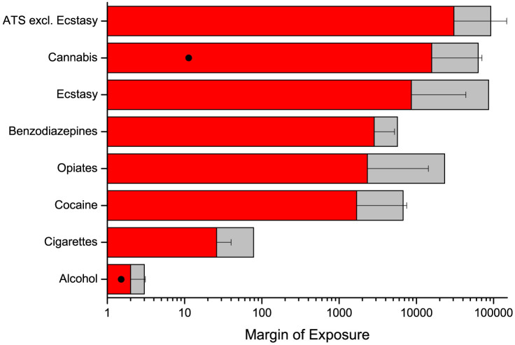

S
On a population scale, only alcohol and cigarettes would fall into the “high-risk” and “risk” categories, respectively.
margin of exposure = ratio of toxicological threshold to
estimated human intake.
Sci Rep. 2015; 5: 8126.doi: 10.1038/srep08126

Slide 17
2. Epidemiology: US High School Cannabis Prevalence
S
Johnson RM, Drug Alc Dep 2015:
“Past 15-year trends in adolescent marijuana use: Differences by race/ethnicity and sex”
Despite considerable changes in state marijuana policies over the past 15 years, marijuana use among high school students has largely declined.

Slide 18
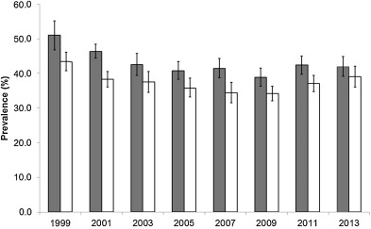
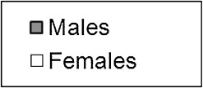

S
Male-female differences in adolescent marijuana use have declined over time
Marijuana use has largely declined
amongst adolescents since 1999
National estimate of the percentage of lifetime marijuana use among high school students, by year
Drug & Alc Depend. 2015; 155:8 – 15.
doi: 10.1016/j.drugalcdep.2015.08.025

Slide 19
3. Pharmacology: Synthetic Cannabinoids and Potency
J
Wiley JL, J Pharmacol Exp Ther 2015 :
“AB-CHMINACA, AB-PINACA, and FUBIMINA: Affinity and Potency of Novel Synthetic Cannabinoids in Producing Δ9-Tetrahydrocannabinol-Like Effects in Mice”
Synthetic cannabinoids bound to and activated CB1 and CB2 receptors, produced locomotor suppression, antinociception, hypothermia, and catalepsy.
Potency correlated with CB1 receptor-binding affinity, and all three compounds were full agonists compared with the partial agonist Δ(9)-THC
Higher efficacy than most known full agonists of the CB1 receptor.

Slide 20
4. Diagnosis, Assessment, Early Intervention: Brief Motivational Interview for Domestic Violence and Drinking
J
Rhodes KV, JAMA 2015:
“Brief Motivational Intervention for Intimate Partner Violence and Heavy Drinking in the Emergency Department: A Randomized Clinical Trial”
For women experiencing IPV and heavy drinking, the use of a brief motivational intervention in the ED compared with assessed and no-contact controls did not significantly reduce the days of heavy drinking or incidents of IPV

Slide 21
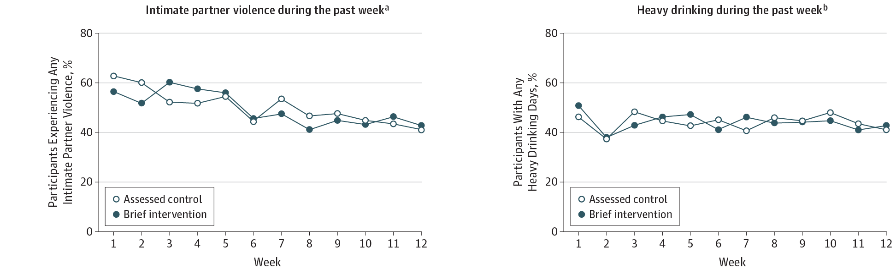
J
IPV was measured as a binary outcome of any violence experienced; brief motivational intervention did not have
an effect on either IPV or heavy drinking outcomes
JAMA. 2015;314(5):466-477. doi:10.1001/jama.2015.8369

Slide 22
5. Special Issues :
Medical Marijuana and Efficacy/Effectiveness
J
Hill KP, JAMA 2015:
“Medical Marijuana for Treatment of Chronic Pain and Other Medical and Psychiatric Problems: A Clinical Review”
Use of marijuana for chronic pain, neuropathic pain, and spasticity due to multiple sclerosis is supported by high-quality evidence.
Six trials that included 325 patients examined chronic pain, 6 trials that included 396 patients investigated neuropathic pain, and 12 trials that included 1600 patients focused on multiple sclerosis.
Several of these trials had positive results, suggesting that marijuana or cannabinoids may be efficacious for these indications.

Slide 23
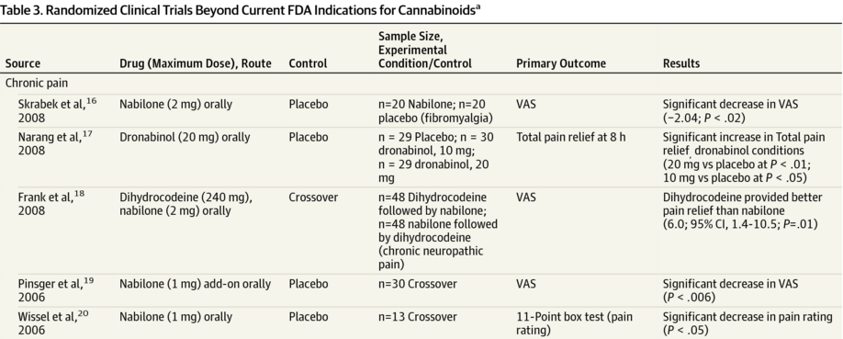
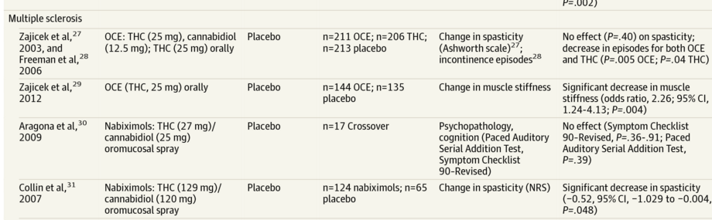
J
relief from chronic pain,
relief from neuropathic pain
VAS, pain rating, episodes
of multiple sclerosis (i.e.
muscle stiffness, spasticity)
JAMA. 2015;313(24):2474-2483.
doi:10.1001/jama.2015.6199.

Slide 24
5. Special Issues :
Housing First, Mental Illness, Homelessness
S
Stergiopoulos V, JAMA 2015:
“Effect of Scattered-Site Housing Using Rent Supplements and Intensive Case Management on Housing Stability Among Homeless Adults With Mental Illness”
Homeless adults with mental illness in 4 Canadian cities
Scattered site housing with ICM services compared with usual access to existing housing and community services
Results: increased housing stability over 24 months, but did not improve generic quality of life (EQ5D)

Slide 25
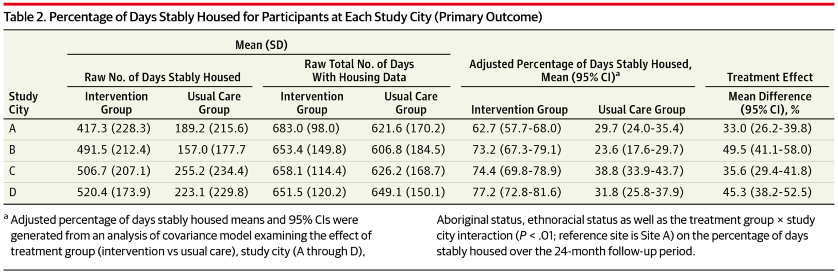
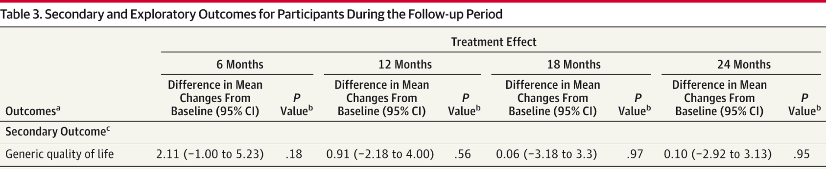
S
Rent supplements
and intensive case
management (ICM)
interventions resulted in increased housing stability over two years
No differences
in overall
QOL
JAMA. 2015;313(9):905-915. doi:10.1001/jama.2015.1163

Slide 26
6. Management of Intoxication and WD
S
Fattore L, Biol Psychiatry 2016:
“Synthetic Cannabinoids—Further Evidence Supporting the Relationship Between Cannabinoids and Psychosis”
Synthetic cannabinoids (SCs) may either exacerbate previously stable psychotic symptoms (in vulnerable individuals) or trigger new-onset psychosis (in individuals with no previous history of psychosis)
SCs induce stronger physiologic and psychoactive effects than THC, such as seizures, collapses, cardiac toxicity, and acute kidney failure (might be because SCs are potent, full agonists of the CB₁ receptor whereas THC is a weak, partial agonist)
No controlled data on the effect of full CB₁R agonism in humans, limited knowledge is based mainly on reports from Poison Control Centers and surveys

Slide 27
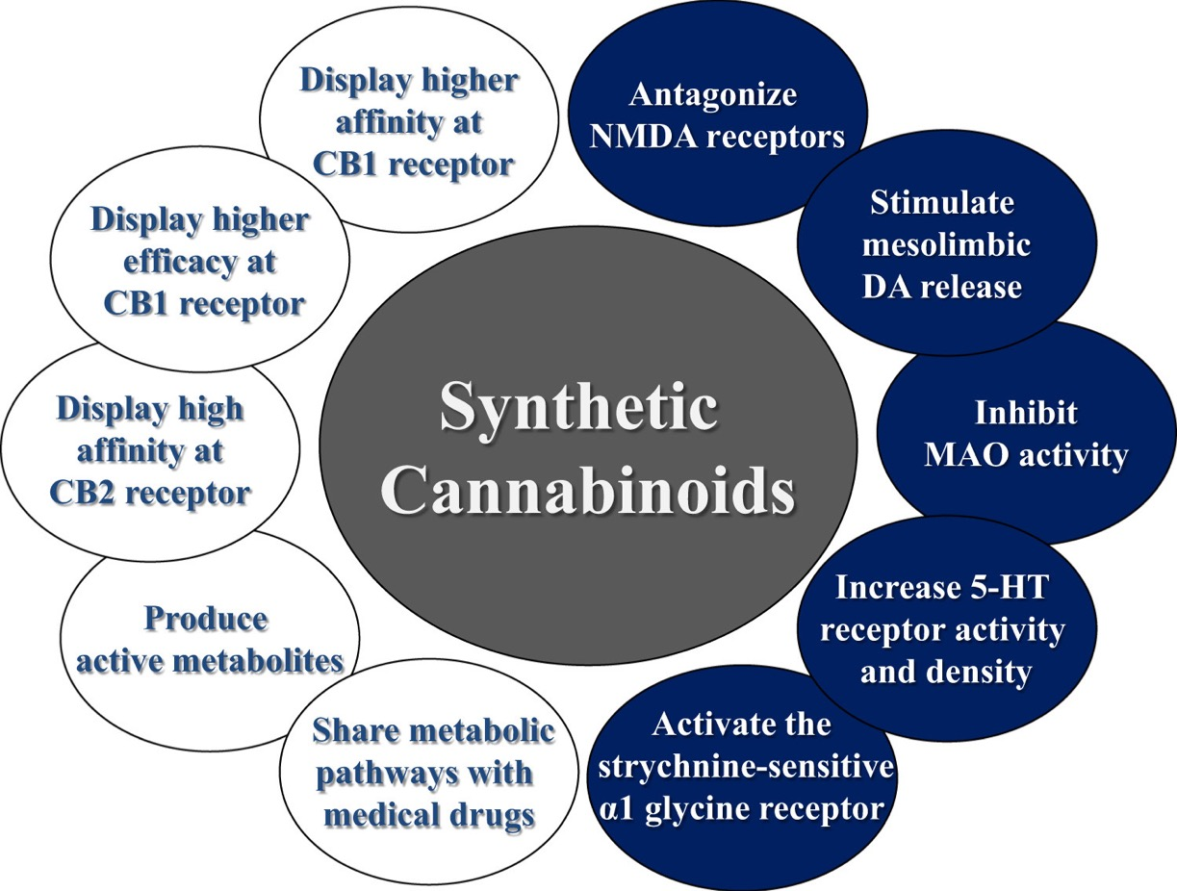

S
THC receptor interactions (white circles)
partly explain SC intoxication behaviors
But SCs have been found to interact with
other, non-cannabinoid receptors and
neurotransmitter systems as well (blue
circles), causing significant and often unpredictable intoxication
Further investigation may help clarify
central and peripheral actions of SCs
Biol Psychiatry. 2015; 79(7): 539-548. doi: 10.1016/j.biopsych.2016.02.001

Slide 28
6: Management of Withdrawal
S
Linn DD, Ann Pharmacother 2015 :
“Dexmedetomidine for Alcohol Withdrawal Syndrome ”
Systematic review of 1 RCT, 1 prospective observational study, and 6 retrospective reviews of dexmedetomidine for AWS.
RCT found that addition of dexmedetomidine decreases benzodiazepine requirements more than placebo.
Overall, dexmedetomidine appears to lower benzo requirements and decreases the sympathomimetic response, however no convincing evidence that it improves clinical endpoints, such as need for ventilation, ICU care, or hospital LOS.

Slide 29
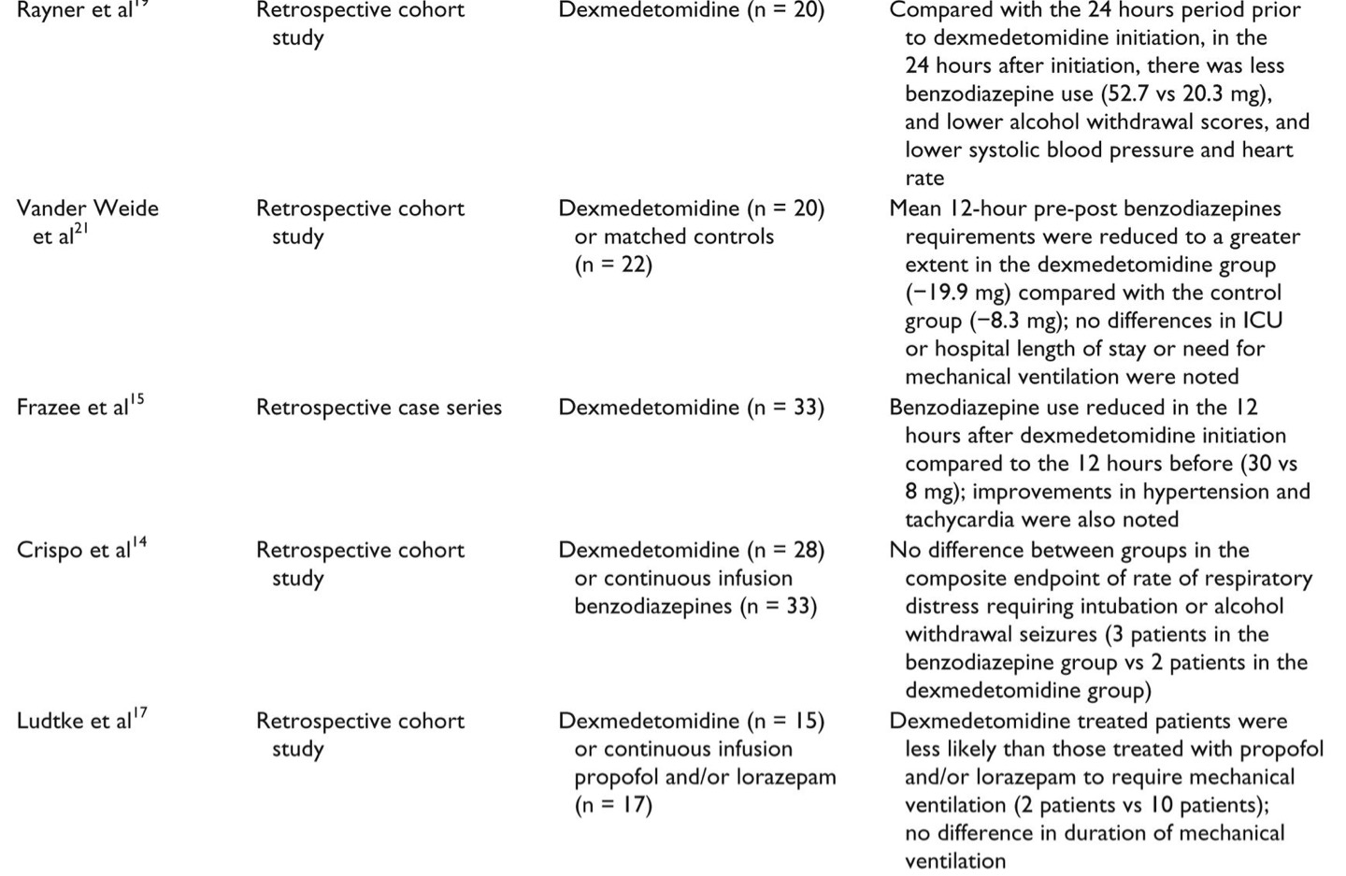

S
use of benzos
Ann Pharmacother 2015;49:1336-1342. doi: 10.1177/1060028015607038

Slide 30
7. Pharmacological Interventions: ED-Buprenorphine
J
D’Onofrio G, JAMA 2015:
“Emergency department-initiated buprenorphine/naloxone treatment for opioid dependence: a randomized clinical trial”
Opioid-dependent patients, RCT of ED-initiated buprenorphine treatment vs brief intervention vs. referral
BUP significantly increased engagement in addiction treatment at 30 days (BUP or other, outpatient or inpatient):
  78% in the buprenorphine group were engaged in treatment vs. 37% in the referral group vs. 45% in the brief intervention group (P < .001).

Slide 31
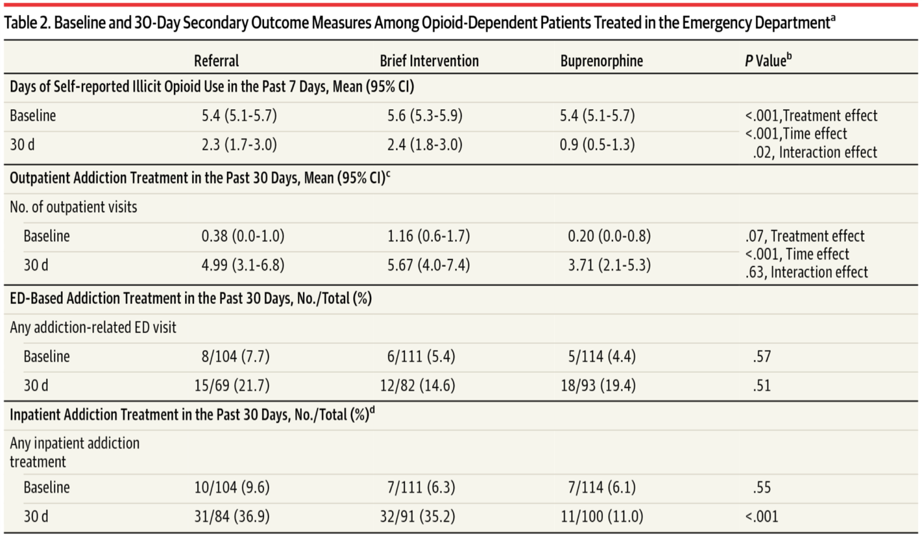
J
illicit opioid use
(self-report)
inpatient
treatment
JAMA. 2015;313(16):1636-1644. doi:10.1001/jama.2015.3474

Slide 32
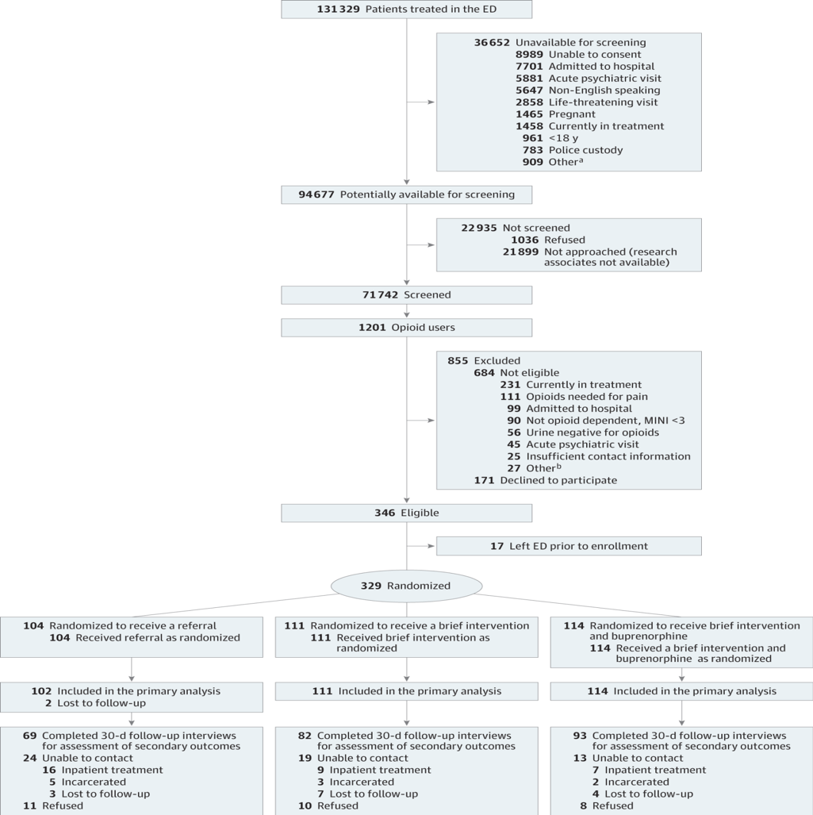
ED Buprenorphine Initiation
n = 71742 Screened
n = 1201 (1.7%) Opioid Users
N = 329 (27% of 1201) Randomized
n = 177 (54% of 329) treated at 30 d
If BUP-ED for all:
n= 256 (78% x 329)

Slide 33
7. Pharm: Massachusetts CCM (Nurse)
J
Labelle C, J Subst Abuse Treat 2015
“Office-Based Opioid Treatment with Buprenorphine (OBOT-B): Statewide Implementation of the Massachusetts Collaborative Care Model in Community Health Centers”
The expansion of OBOT to the fourteen CHCs increased the number of physicians who were "waivered" (i.e., enabling their prescribing of buprenorphine) by 375% within 3years.
During this period the annual admissions of OBOT patients to CHCs markedly increased.
collaborative care model with a central role for nursing enabled effective treatment while effectively engaging primary care physicians

Slide 34
7. Pharmacological Interventions :
Mortality in and out of Opioid Treatment
J
Evans E, Addiction 2015:
“Mortality among individuals accessing pharmacological treatment for opioid dependence in California, 2006-10.”
Mortality risk was higher:
  (1) when individuals were out-of-treatment (SMR = 6.1) than in-treatment (SMR = 1.8)
  (2) during detoxification (SMR = 2.4) than during MMT (SMR = 1.8)
    especially in the 2 weeks post-treatment entry, SMR = 5.5 versus SMR = 2.5

Slide 35
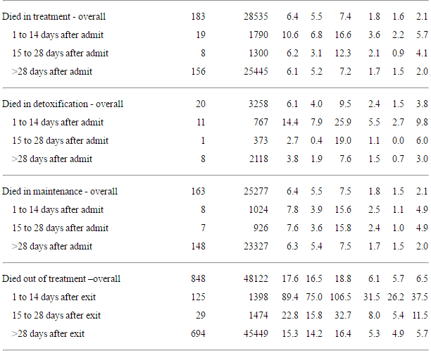

J
Relative mortality risk out of MMT was
significantly higher than in MMT
  greatest risk was in the two weeks
  immediately post-treatment exit (30x
  greater risk than general
  population).
Risk greater when in detox than in MMT
  greatest difference in risk between
  these two groups was during the two
  weeks post treatment entry
Implications for pharmacological treatment
for opioid dependence without time restraints
Addiction.2015; 110(6): 996–1005. doi: 10.1111/add.12863

Slide 36
7. Pharmacological Interventions :
Long-term outcomes after a buprenorphine trial for Prescription Opioid Dependence
S
Weiss R, Drug Alc Depend 2015:
“Long-term outcomes from the National Drug Abuse Treatment Clinical Trials Network Prescription Opioid Addiction Treatment Study”
At 42 months, 32% were abstinent not on OAT, 30% were abstinent on OAT, 8% were still using while on OAT, and 31% were still using not on OAT.
OAT was associated with greater likelihood of abstinence.
Heroin use at baseline associated with greater likelihood of meeting OUD criteria at 42 months.

Slide 37
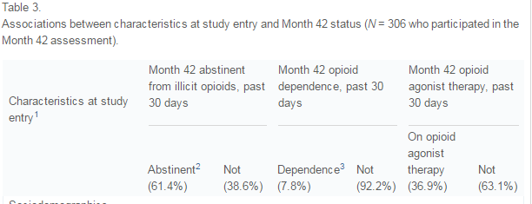
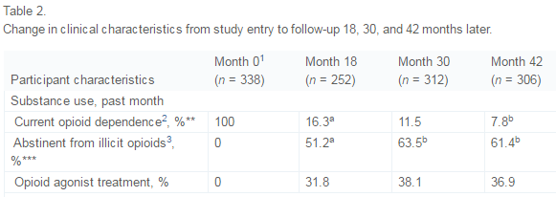

S
Drug Alc Depend. 2015;150:112-9.
doi: 10.1016/j.drugalcdep.2015.02.030
Notes:
Josh – is this the correct table? I’m having trouble finding the numbers that are cited on the previous slide….

Slide 38
7. Pharmacological Interventions :
Smoking Cessation: Varenicline
S
Ebbert J, JAMA 2015:
“Effect of varenicline on smoking cessation through smoking reduction: a randomized clinical trial”
Participants were randomized to either varenicline or placebo and asked to use a reduce-to-quit approach: reduce baseline smoking rate by 50%+ by week 4 and by 75%+ by week 8, with the goal of quitting by week 12. Counseling was provided consistent with USDHHS recommendations.
The group provided varenicline was significantly more abstinent than the placebo group during weeks 15-24 (37.8% vs. 12.5%).
This study demonstrates that a reduce-to-quit approach using varenicline can be effective.

Slide 39
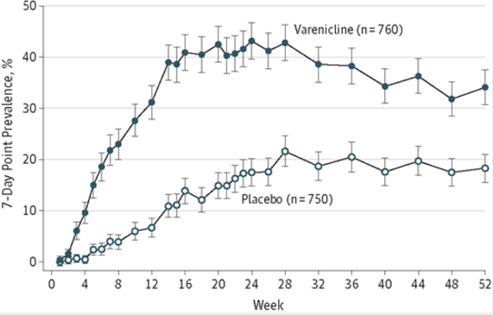

S
Varenicline as part of a reduce-to quit method vs. placebo significantly improves abstinence at the end of treatment and 28 weeks post-treatment
Results with varenicline mimicked
abstinence rates similar to smokers who want to quit after the first week, even though they enrolled not ready to quit for more than one month
JAMA. 2015;313(7):687-694. doi:10.1001/jama.2015.280.

Slide 40
8. Behavioral Interventions :
Alcohol e-health interventions
S
Dedert E, Ann Intern Med 2015:
“Electronic Interventions for Alcohol Misuse and Alcohol Use Disorders: A Systematic Review”
In 28 unique trials, the modal e-intervention was brief feedback on alcohol consumption.
Available data suggested a small reduction in consumption (approximately 1 drink per week) in adults and college students at 6 months but not at 12 months.

Slide 41
8. Behavioral Interventions :
Smoking and Contingency Management
S
Halpern S, NEJM 2015:
“Randomized trial of four financial-incentive programs for smoking cessation”
Reward-based programs were much more commonly accepted than deposit-based programs, leading to higher rates of sustained abstinence from smoking.
Group-oriented incentive programs were no more effective than individual-oriented programs.

Slide 42
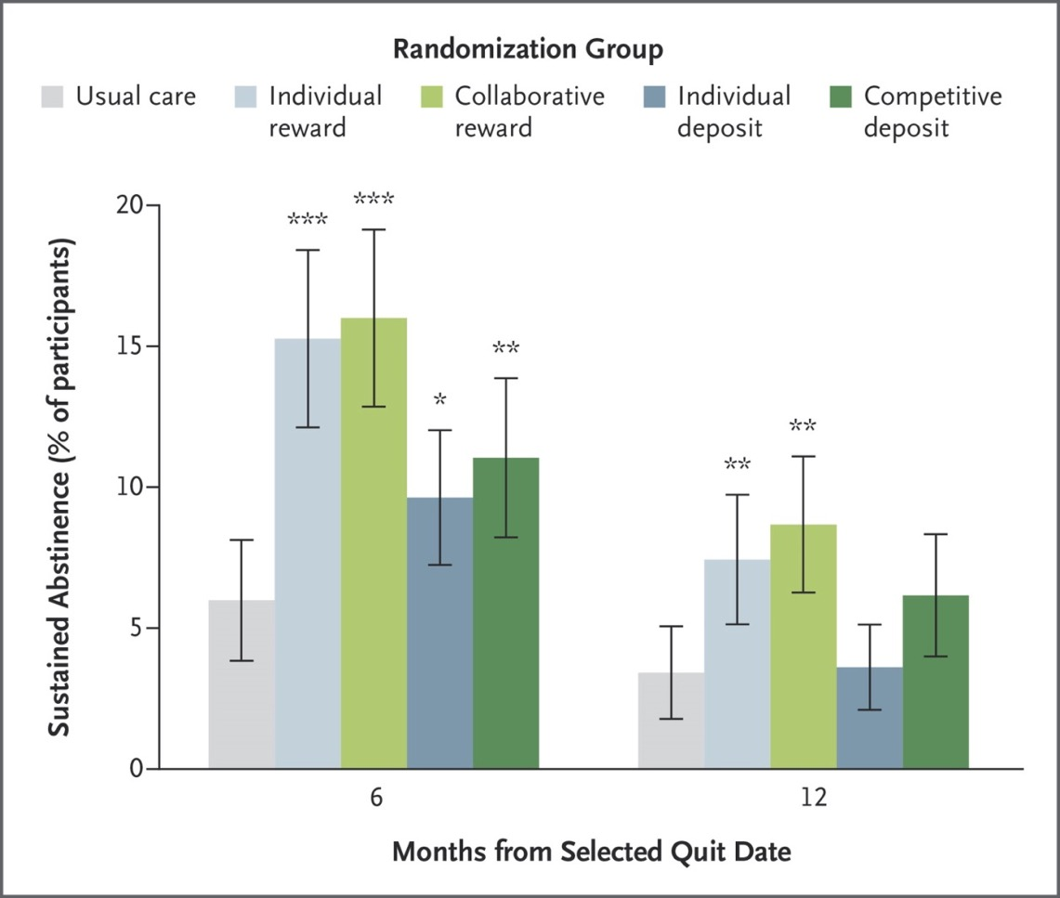
S
Rates of Sustained Abstinence
from Smoking at 6 and 12
months after Target Quit Date
Rewards increased abstinence from
smoking significantly more than deposits
did
No difference between group- or
individual-based reward programs
90% of reward-based group
participants accepted the tasks, vs.
14% acceptance in the deposit-
based group participants
Halpern SD et al. N Engl J Med 2015;372:2108-2117

Slide 43
9: Mutual Help
S
Monico LB, J Subst Abuse Treat 2015:
“Buprenorphine Treatment and 12-step Meeting Attendance: Conflicts, Compatibilities, and Patient Outcomes”
Mixed-methods analysis of African Americans in BMT.
Twelve-step meeting attendance was associated with better outcomes for BMT patients over the first 6 months of treatment.
However, there was no benefit to requiring meeting attendance as a condition of treatment, and qualitative analysis highlighted patients' strategies for managing dissonant viewpoints on BMT and disclosing BMT status in community 12-step meetings

Slide 44

S
AOR (95% CI) | p | AOR (95% CI) | p
Gender | 0.80 (0.47–1.38) | 0.43 | 1.06 (0.59–1.92) | 0.84
Age | 0.99 (0.96–1.04) | 0.91 | 1.06 (1.01–1.11) | 0.01
Treatment site | 1.44 (0.81–2.58) | 0.22 | 1.02 (0.53–1.94) | 0.96
Group counseling attendance | 0.83 (0.69–0.99) | 0.048 | 0.91 (0.72–1.14) | 0.4
Number of NA meetings in prior 6 months | 1.02 (1.01–1.03) | < .001 | 1.01 (1.00–1.02) | 0.005
Counselor requires AA/NA attendance | 0.70 (0.37–1.35) | 0.29 | 0.70 (0.36–1.37) | 0.3
Treatment retention |  |  | 6.97 (3.19–15.22) | < .001
Multivariate logistic
regression predicting
6-month treatment
retention and
abstinence
Number of NA meetings in the
past 6 months was proportional
to treatment retention in this study .
J Subst Abuse Treat. 2015;57:89-95. doi: 10.1016/j.jsat.2015.05.005

Slide 45
10. Medical Disorders of Addiction:
Alcohol Consumption and Cancer Risk
J
Cao Y, BMJ 2015:
“Light to moderate intake of alcohol, drinking patterns, and risk of cancer: results from two prospective US cohort studies”
Light to moderate drinking is associated with minimally increased risk of overall cancer.
For men who have never smoked, risk of alcohol related cancers is not appreciably increased for light and moderate drinking (up to two drinks per day).
However, for women who have never smoked, risk of alcohol related cancers (mainly breast cancer) increases even within the range of up to one alcoholic drink a day.

Slide 46
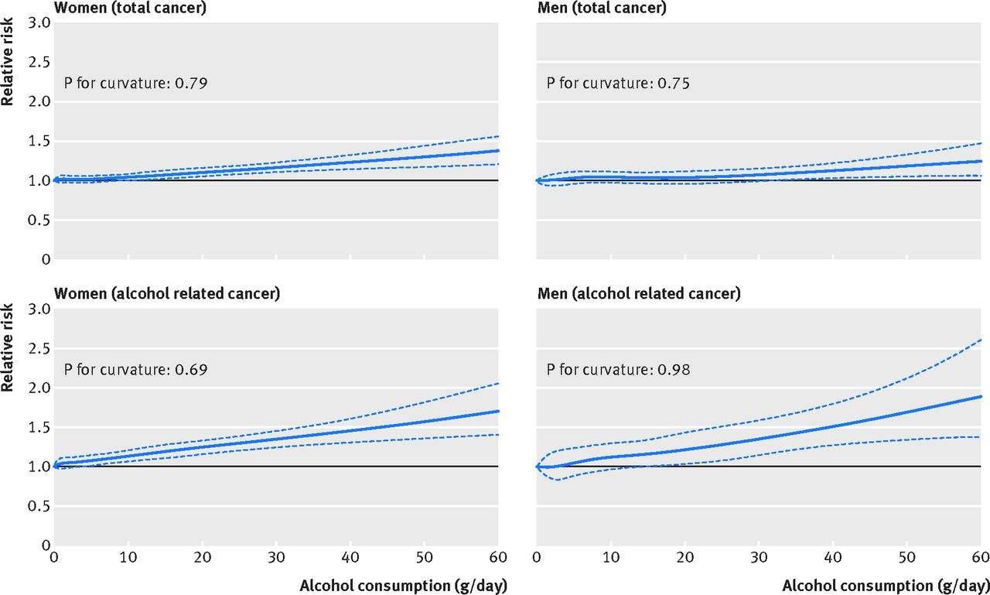

J
Light to moderate drinking was associated with a small increase in cancer risk in both
sexes.
For women, even one drink per day was associated with
increase in alcohol-
related cancers
such as breast
cancer.
Blue lines=
relative risk
Dotted
lines = CIs
Yin Cao et al. BMJ 2015;351:bmj.h4238

Slide 47
10. Medical Disorders of Addiction:
Alcohol Consumption and Health Risks: Depends on the Country’s Income
J
Smyth A, BMJ 2015:
“Alcohol consumption and cardiovascular disease, cancer, injury, admission to hospital, and mortality: a prospective cohort study”
Compared with never drinkers, there were significantly reduced hazards for the composite outcome for current drinkers in high income countries (HICs) and upper middle income countries (UMICs) (HR 0·84 [0·77-0·92])
This effects was not present in lower middle income countries (LMICs) and lower income countries (LICs), for which we identified no reductions in this outcome (HR 1·07 [0·95-1·21]; pinteraction<0·0001)

Slide 48
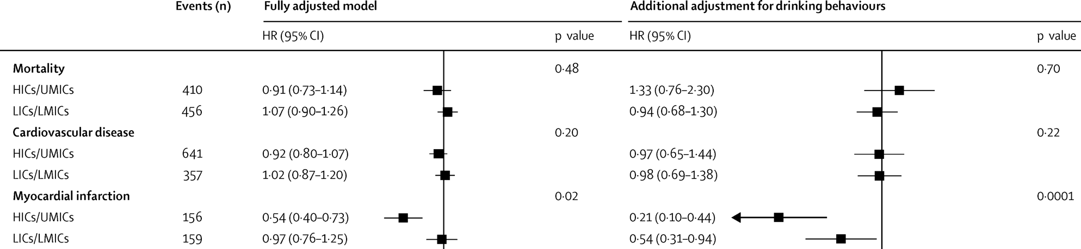

J
In HICs/UMICs, current drinking
was associated with reduced hazard
of myocardial infarction, which we
did not see in LICs/LMICs
The Lancet. 2015; 386: 1945-1954. doi: 10.1016/S0140-6736(15)00235-4.

Slide 49
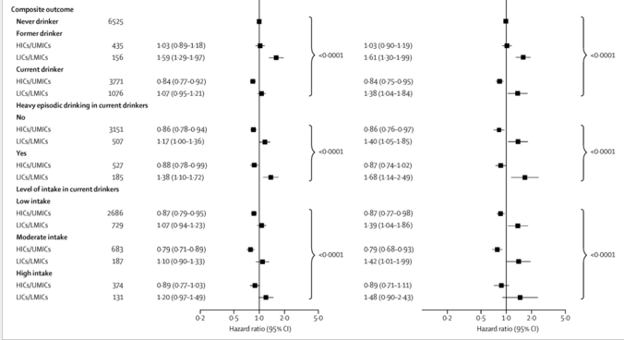
J
Current drinking was associated
with reduced hazard of the composite
outcome in HICs/UMICs, but not in
LICs/LMICs
The Lancet. 2015; 386: 1945-1954. doi: 10.1016/S0140-6736(15)00235-4.

Slide 50
10. Medical Disorders of Addiction:
Smoking and CVD Risk
J
Mons U, BMJ 2015:
“Impact of smoking and smoking cessation on cardiovascular events and mortality among older adults: meta-analysis of individual participant data from prospective cohort studies of the CHANCES consortium”
This study shows that smoking is a strong independent risk factor of cardiovascular events and mortality even at older age, advancing cardiovascular mortality by more than five years.
It demonstrates that smoking cessation in older age groups is still beneficial in reducing the excess risk.

Slide 51
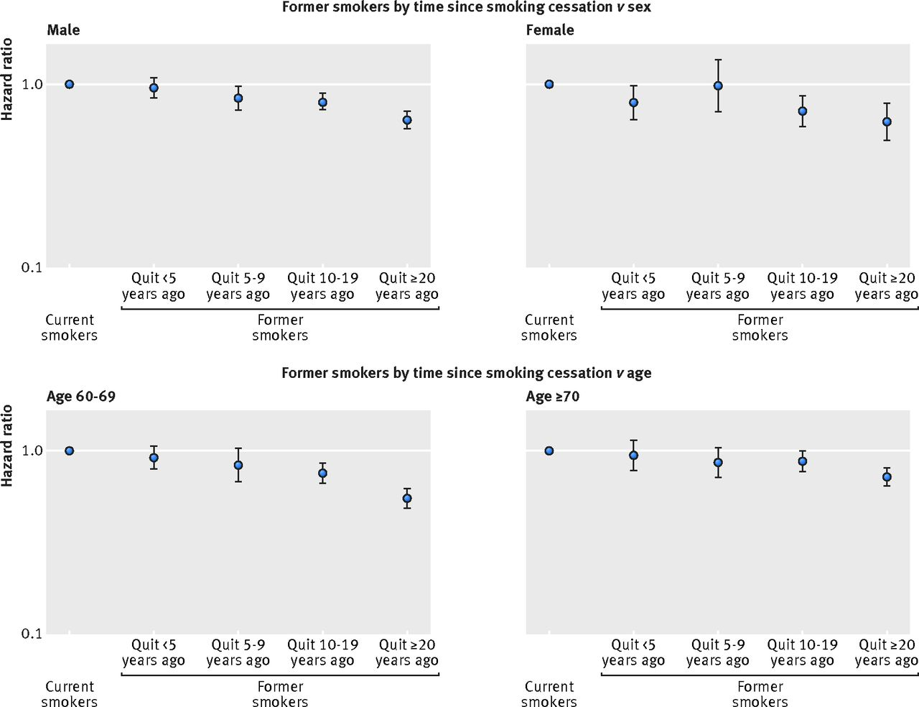
J
Cardiovascular mortality
summary estimates of
hazard ratios for
categories of time since
smoking cessation by sex
and age
Clear decline of mortality risk with
time since smoking cessation, even
in the oldest age group
BMJ. 2015;350. doi: 10.1136/ bmj.h1551

Slide 52
10. Medical Disorders of Addiction:
Acute Alcoholic Hepatitis: Prednisone vs. Pentoxifylline
S
Thursz M, NEJM 2015:
“Prednisolone or pentoxifylline for alcoholic hepatitis”
Pentoxifylline did not improve survival in patients with alcoholic hepatitis.
Prednisolone (glucocorticoid) was associated with a reduction in 28-day mortality that did not reach significance and with no improvement in outcomes at 90 days or 1 year.

Slide 53
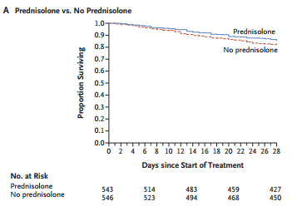
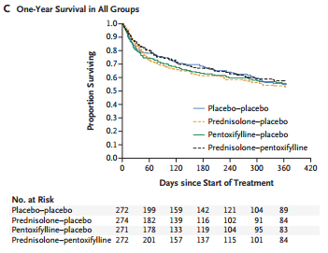
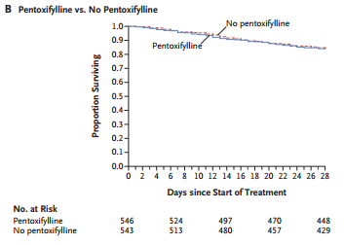
J
No differences in mortality rates or outcomes between groups
at 28-days, 90 days, or 1 year
N Engl J Med 2015; 372:1619-1628April 23, 2015DOI: 10.1056/NEJMoa1412278

Slide 54
10. Medical Disorders of Addiction:
Treatment of Acute Low Back Pain
S
Friedman BW, JAMA 2015:
“Naproxen With Cyclobenzaprine, Oxycodone/Acetaminophen, or Placebo for Treating Acute Low Back Pain: A Randomized Clinical Trial”
Among patients with acute, nontraumatic, nonradicular LBP presenting to the ED, adding cyclobenzaprine or oxycodone/acetaminophen to naproxen alone did not improve functional outcomes or pain at 1-week follow-up.
These findings do not support use of these additional medications in this setting.

Slide 55
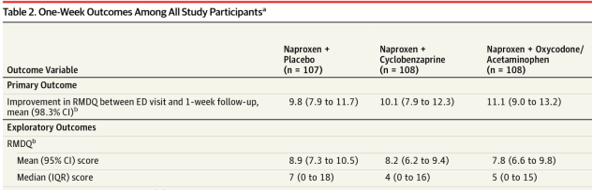
S
Some benefit of adding Naproxen + Oxycodone
but….there were no real differences between any group
vs. placebo
suggest combination therapy is not better than monotherapy
JAMA. 2015;314(15):1572-1580. doi:10.1001/jama2015.13043

Slide 56
11. Co-occurring psych
S
Saunders EC, Am J Addict 2015:
“The impact of addiction medications on treatment outcomes for persons with co-occurring PTSD and opioid use disorders”
MAT plus Integrated Cognitive Behavioral Therapy (ICBT) resulted in significantly decreased odds of a positive urine drug screen, compared to non-MAT patients receiving standard care alone (OR = .07, 95% CI = .01, .81, p = .03).
For PTSD symptoms, MAT patients had comparable declines in PTSD symptoms regardless of psychosocial treatment type (F(2, 88) = 4.74, p = .011).
Non-MAT patients in ICBT had greatest reduction in PTSD symptoms.

Slide 57
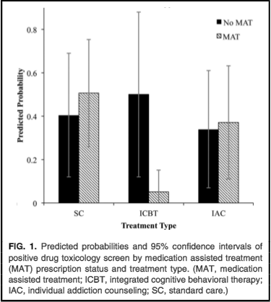
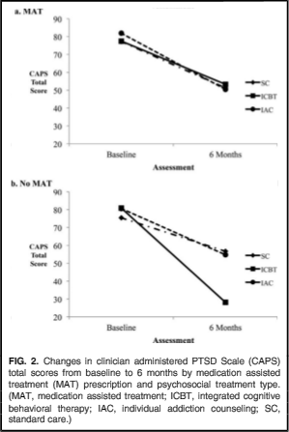
S
MAT + ICBT had lowest
# positive drug screens
MAT patients had reduced
PTSD symptoms
regardless of psychosocial
treatment type
Non-MAT in ICBT
had largest reduction
in PTSD symptoms
Am J Addict 2015 Dec 21;24(8):722-31.

Slide 58
12. Pain & Addiction
J
Ilgen MA, Addiction 2016:
“A randomized trial of a pain management intervention for adults receiving substance use disorder treatment”
RCT of VA patients with SUD and chronic pain evaluating impact of a cognitive behavioral therapy and acceptance-based approach to pain management (ImPAT) vs. a Supportive Psycho-educational attention Control (SPC) condition
The psychological pain management intervention (ImPAT) reduced pain intensity and alcohol use and improves pain-related functioning over 12-months relative to the matched-attention control condition.

Slide 59
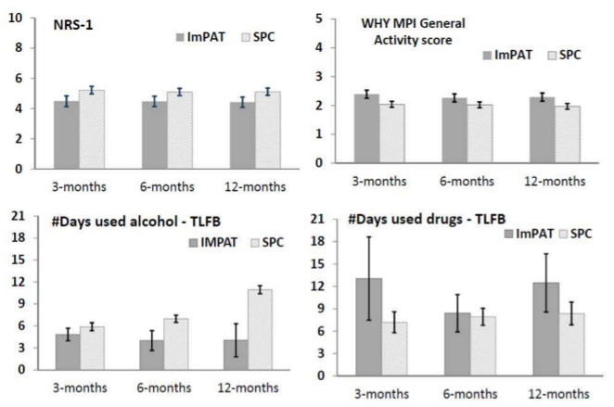

J
Measures of pain
intensity and pain-
related functioning
Over 12 months,
the intervention (ImPAT)
had improved functionality and reduced alcohol use
Addiction. 2016; 1360-0443.
doi:10.1111/add.13349

Slide 60
13. Children and Adolescents:
E-Cigarettes, Adolescents, Smoking Initiation
J
Leventhal A, JAMA 2015:
“Association of Electronic Cigarette Use With Initiation of Combustible Tobacco Product Smoking in Early Adolescence”
Among high school students in Los Angeles, those who had ever used e-cigarettes at baseline compared with nonusers were more likely to report initiation of combustible tobacco use over the next year

Slide 61
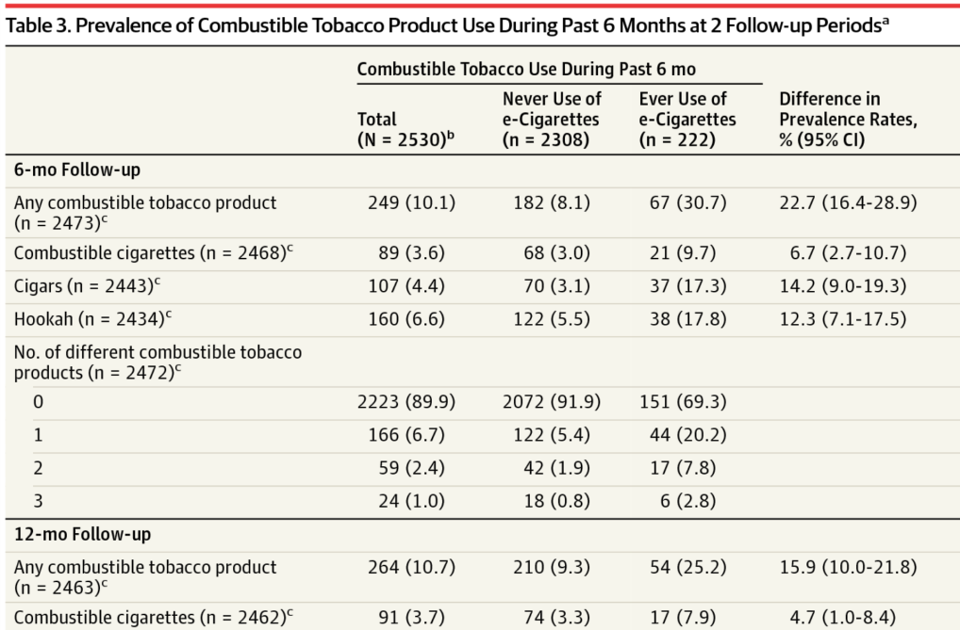
J
In baseline never smokers of combustible tobacco products vs. baseline e-cigarette ever users, the latter were more likely to report past 6-month use of any combustible tobacco product at the 6-month and 12-month follow-up.
JAMA. 2015;314(7):700-707. doi:10.1001/jama.2015.8950

Slide 62
14. Ethical & policy considerations
S
Rich JD, Lancet 2015:
“Methadone continuation versus forced withdrawal on incarceration in a combined US prison and jail: a randomised, open-label trial”
Among prisoners randomly assigned to continued methadone versus forced withdrawal, those maintained on methadone were more than twice as likely to continue in community methadone treatment after release.
There were no differences in serious adverse events between groups.

Slide 63
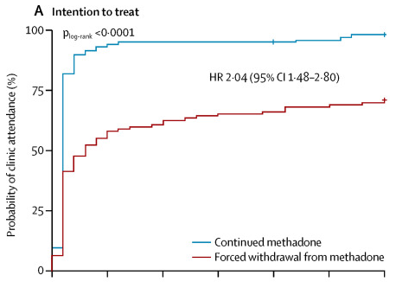
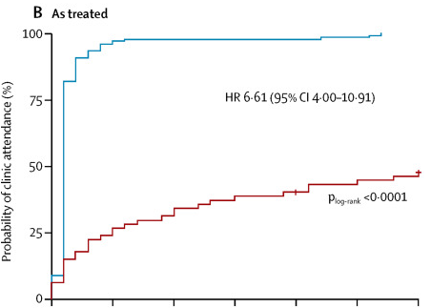

S
Receiving methadone while incarcerated (vs. forced-withdrawal) more than doubled post-release treatment entry
The Lancet 2015 386, 350-359. doi: 10.1016/S0140-6736(14)62338-2.
Notes:
Josh – confused about the difference between ‘intention to treat’ and ‘as treated’, I think we should explain those differences in a text box

Slide 64
Ethics and Language
S
Saitz R, J Add Med 2015:
“Things that Work, Things that Don't Work, and Things that Matter-Including Words”
“International Statement Recommending Against the Use of Terminology
That Can Stigmatize People”
Use precise respectful clinical language, e.g. person-first (“patient with alcohol use disorder”), avoid “abuse/abuser”, define “dependence” when used, “medication” not “drug” where appropriate, “opioid agonist treatment” not “medication-assisted treatment”, “positive/negative” not “dirty/clean”
Avoid imprecise terms for use that doesn’t meet criteria for a disorder, “misuse” or “inappropriate use”, instead use “at-risk” or “risky”

Slide 65
Late-breaking 2016:
CDC Opioids for Chronic Pain Guidelines
S
Dowell D, JAMA March 2016:
“CDC Guidelines for Prescribing Opioids for Chronic Pain”
Reviewed scientific evidence from 2008-2014 and classified into 4 types based on limitations of the studies
No evidence shows a long-term benefit of opioids in pain and function versus no opioids
Extensive evidence shows the possible harms of opioids (including opioid use d/o and overdose)
Non-pharmacologic therapy and non-opioid pharmacologic therapy are preferred for chronic pain
Notes:
S

Slide 66
Late-breaking 2016:
Prescription Opioids Continue after OD
S
Larochelle M, Ann Int Med 2016:
“Opioid Prescribing After Nonfatal Overdose and Association With Repeated Overdose: A Cohort Study”
2848 patients who had an opioid overdose during long-term therapy for noncancer pain followed for a median duration of 299 days (123-639) after an index overdose
Overdose did not prompt changes in PO prescribing.
91% received 1 or more opioid prescriptions after the overdose.
After the overdose, 2/3 of patients had an active opioid dispensing and 1/3 were receiving high dosages, which was associated with increased risk for repeated overdose.
Notes:
S

Slide 67
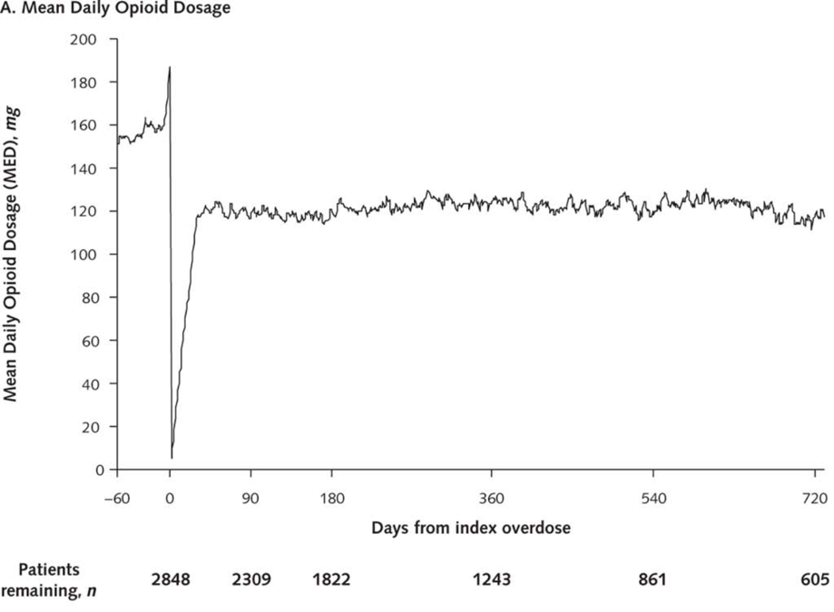
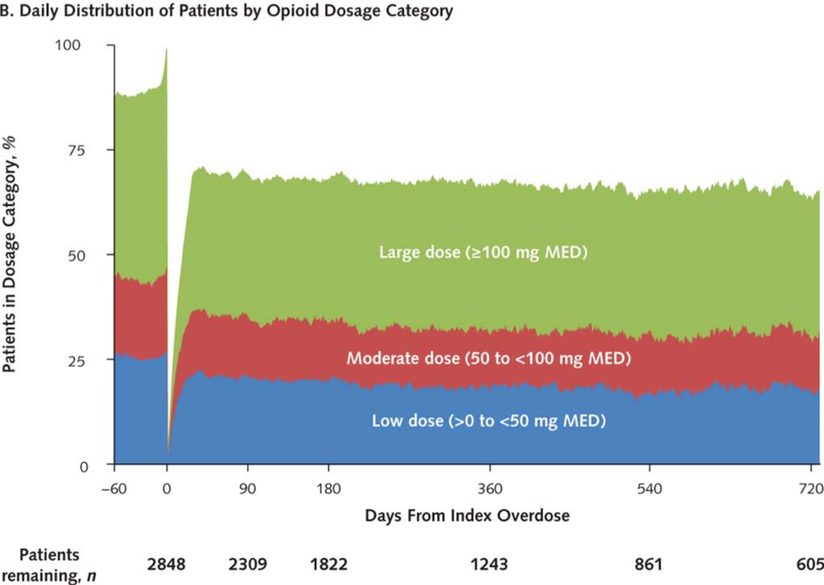

S
MED = morphine-equivalent dose.
In the week before the overdose, dosage increased rapidly and peaked the day before the overdose.
After the overdose, 91% of patients received 1 or more opioid dispensings.
31-36% of patients received high daily opioid dosages after post-overdo day 30.
Ann Intern Med. 2016;164(1):1-9. doi:10.7326/M15-0038
Notes:
S

Slide 68
Late-breaking 2016:
Benzodiazepines and OD Mortality
J
Bachhuber MA, Am J Pub Health 2016:
“Increasing Benzodiazepine Prescriptions and Overdose Mortality in the US 1996-2013”
The percentage of adults filling a benzo prescription increased from 4.1% (1996) to 5.6% (2013) with an annual percent change of 2.5%.
The quantity of benzos filled increased from 1.1 to 3.6kg lorazepam equivalents per 100,000 adults with an annual percent change of 9%.
The overdose death rate increased from 0.58% to 3.07 per 100,000 adults, with a plateau seen after 2010.
Notes:
Josh

Slide 69
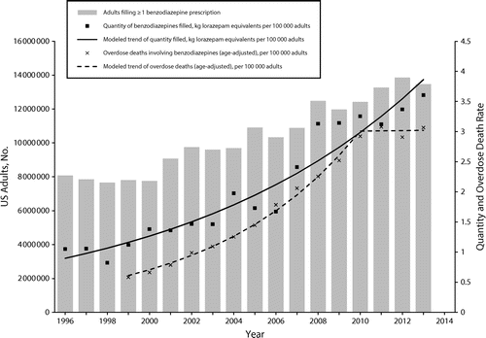

J
Between 1996 and 2013,
# adults filling at least one
benzo prescription increased
67%, from 4.1% of the
population
to 5.6%, with an annual
percent change of 2.5%
Rates of overdose deaths
involving benzos increased
more than four-fold, but
appeared to plateau
after 2010
AJPH. 2016; 106(4). doi: 10.2105/ajph.2016.303061
Notes:
Josh

Slide 70
Thank You!
Questions?

