Slide 1
Barnard’s Magnolia Tree
Caroline Lange
Making Barnard History
May 4, 2015

Slide 2
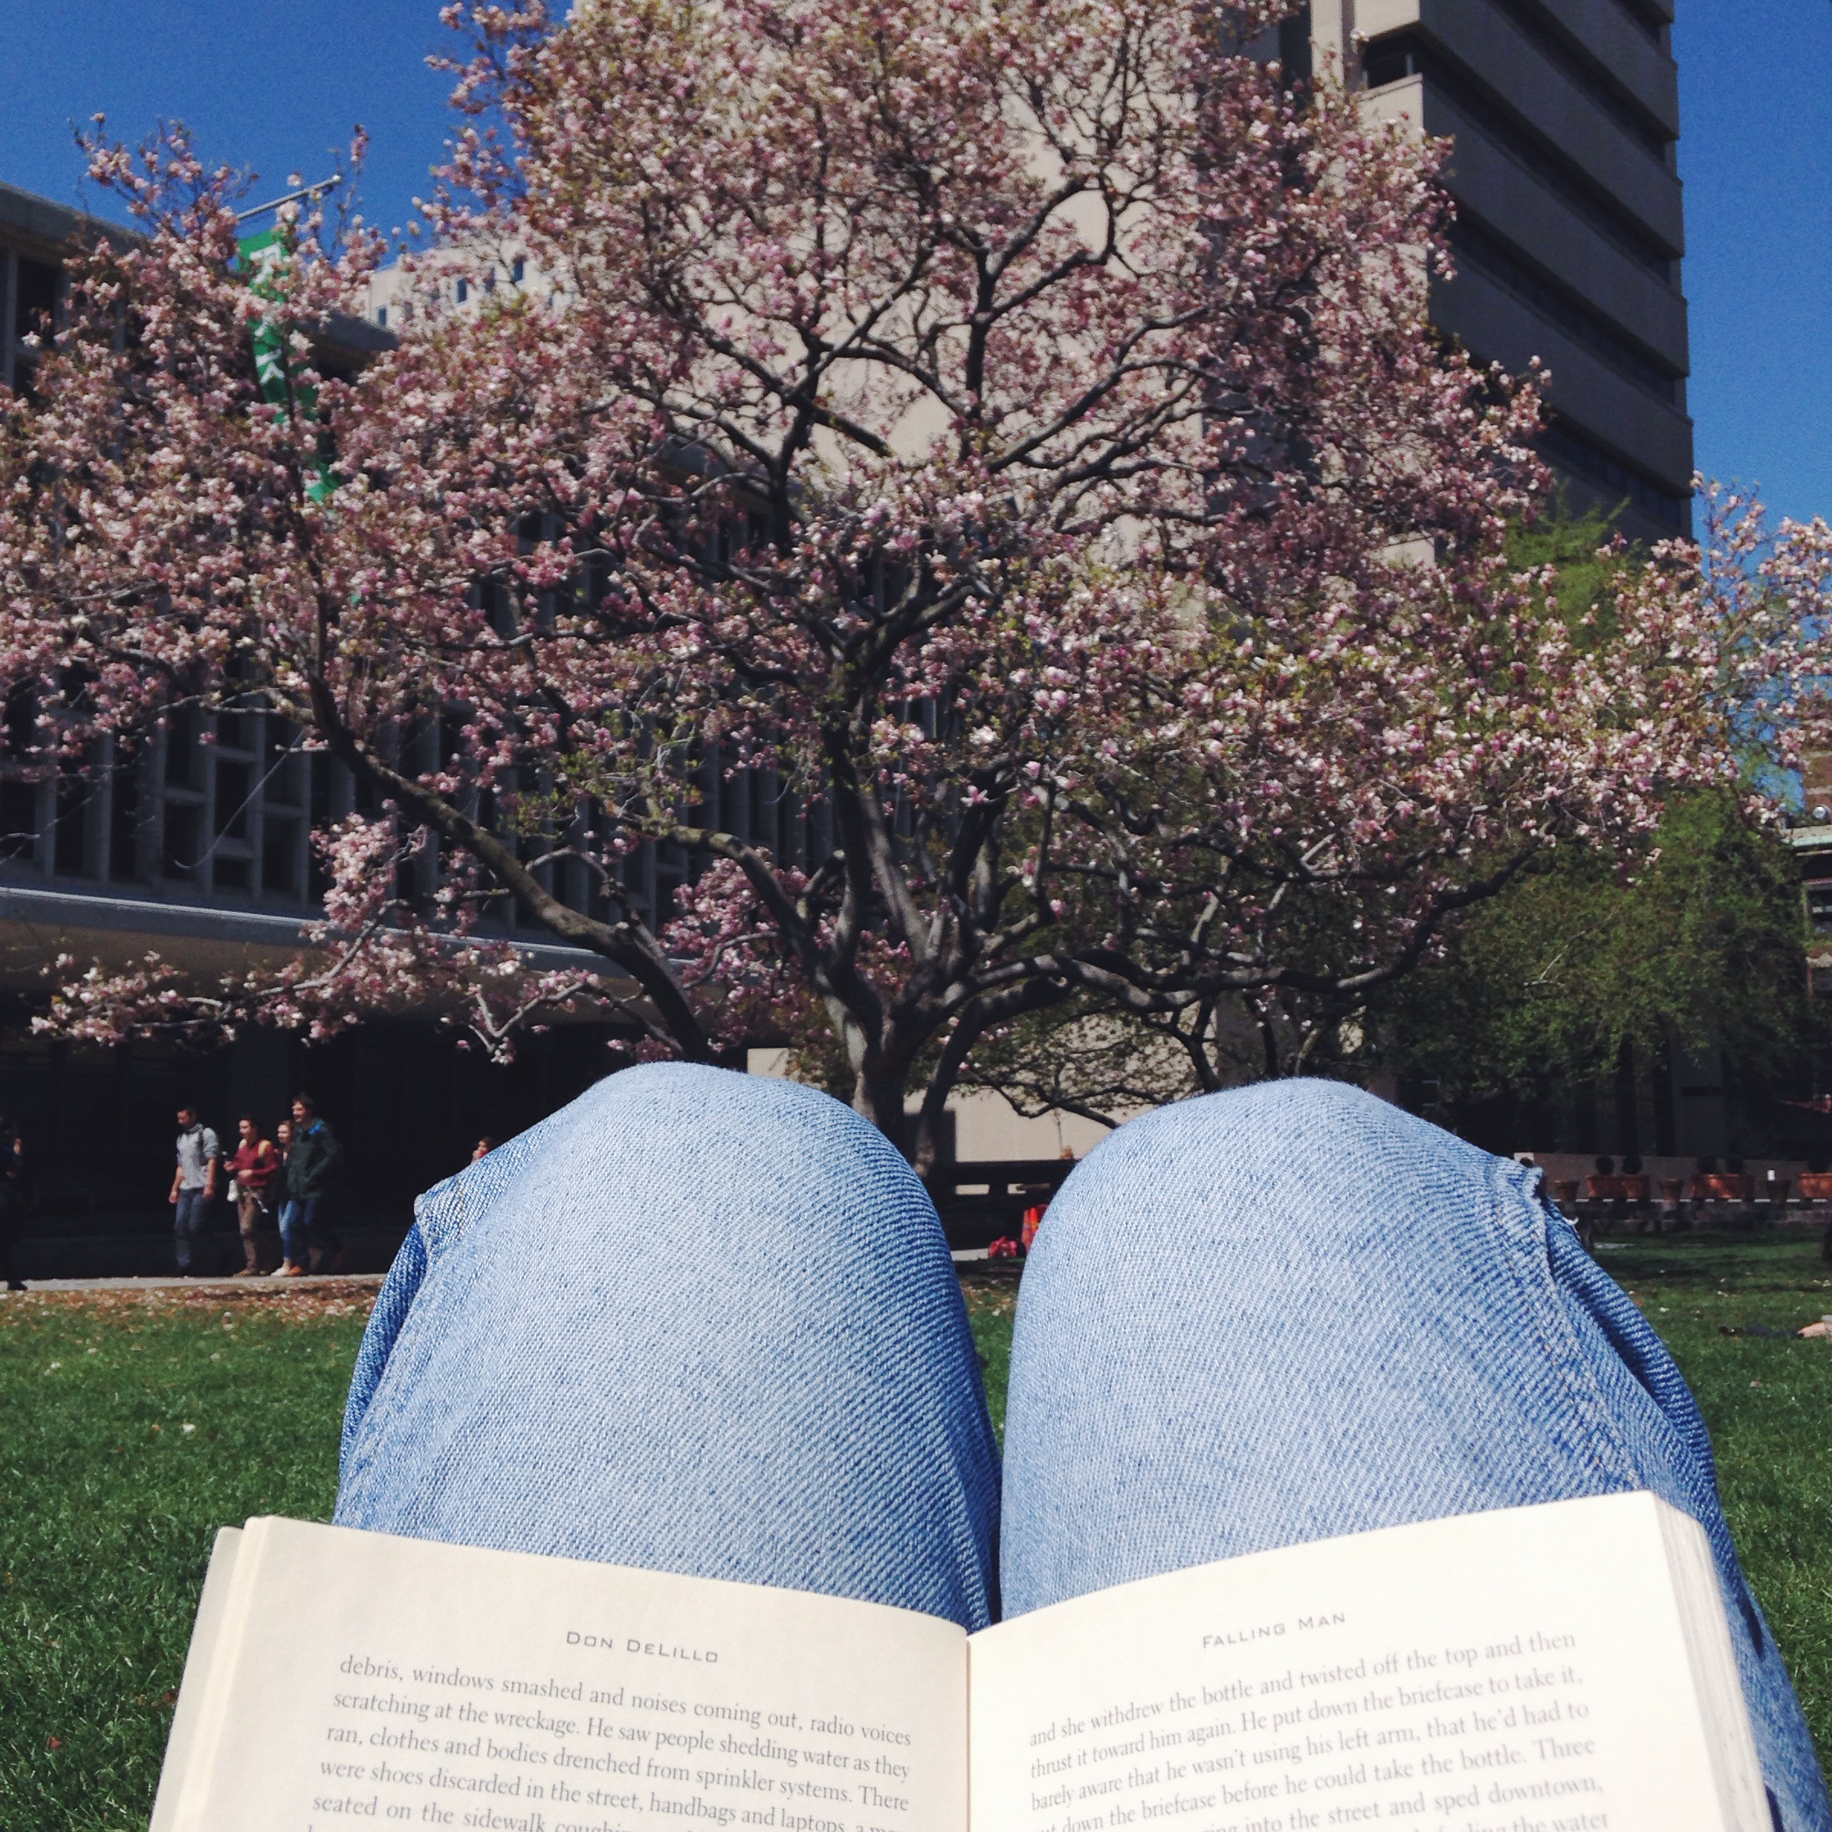
“The flowering of the magnolia tree on Lehman Lawn has long been synonymous with springtime at Barnard.” — “Barnard’s Blooming Magnolia”

Slide 3
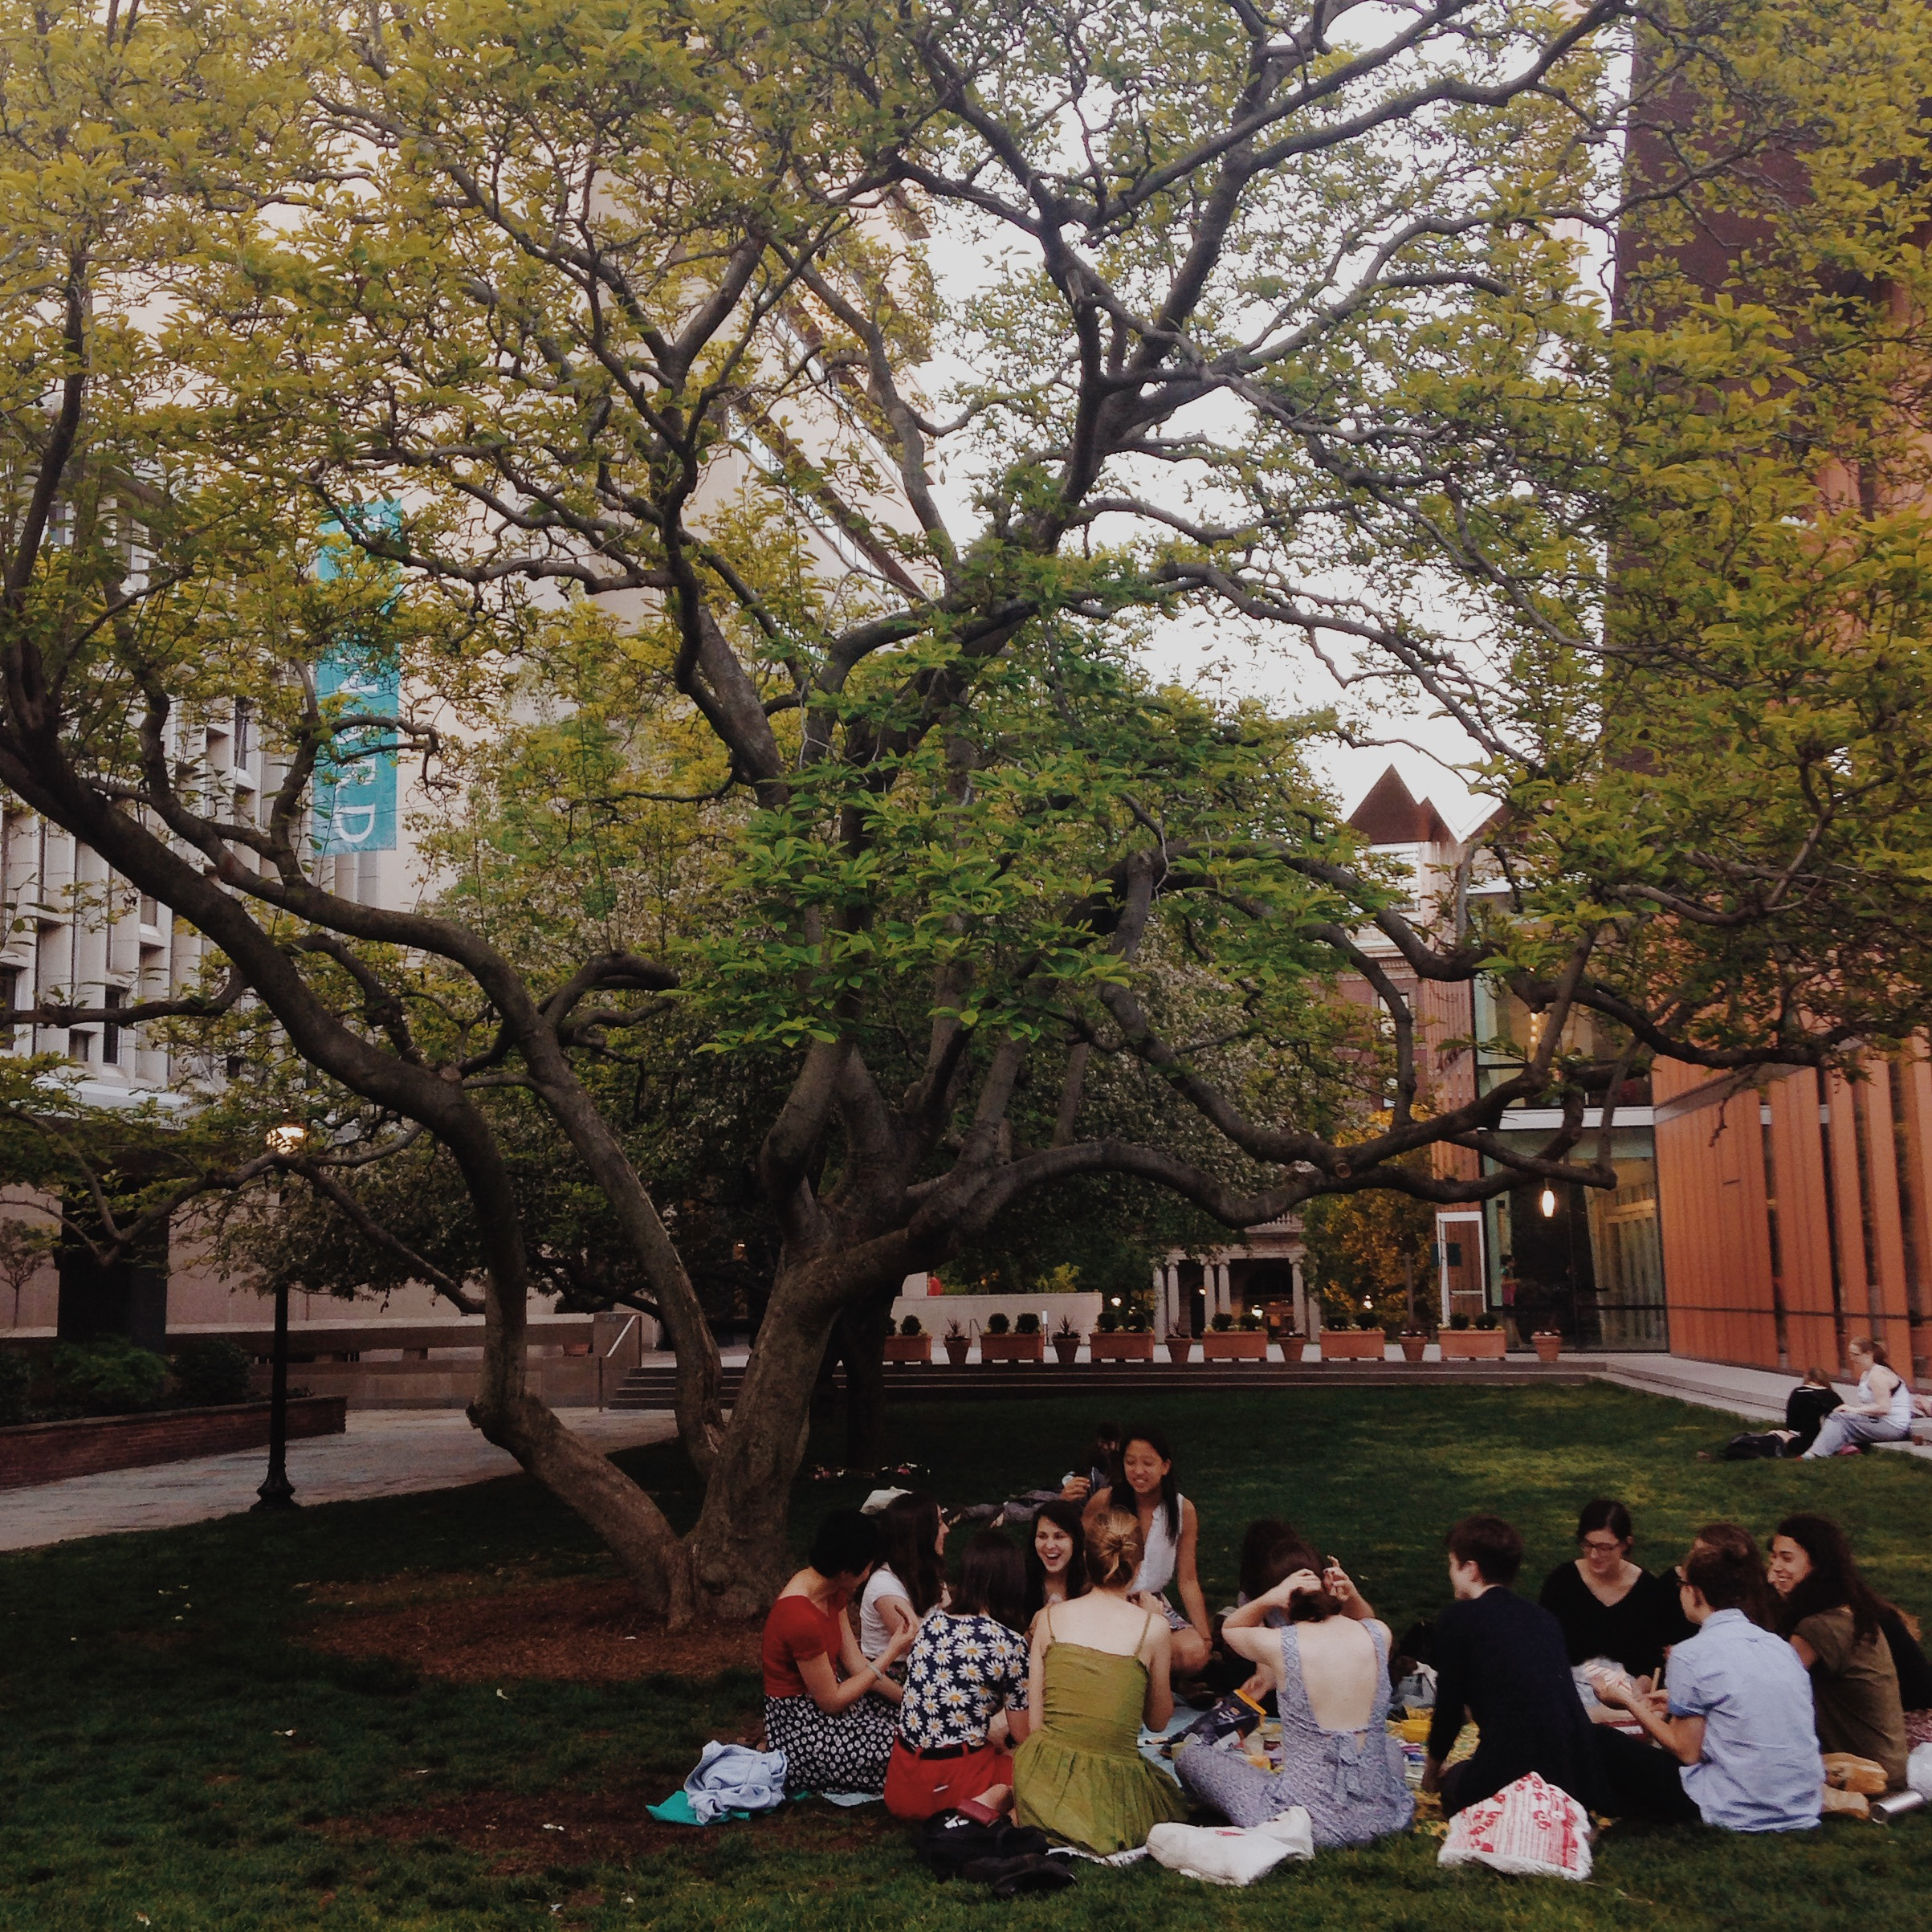
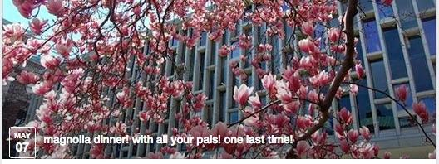
(a Facebook event)
2014-2015
Notes:
It is a gathering place

Slide 4
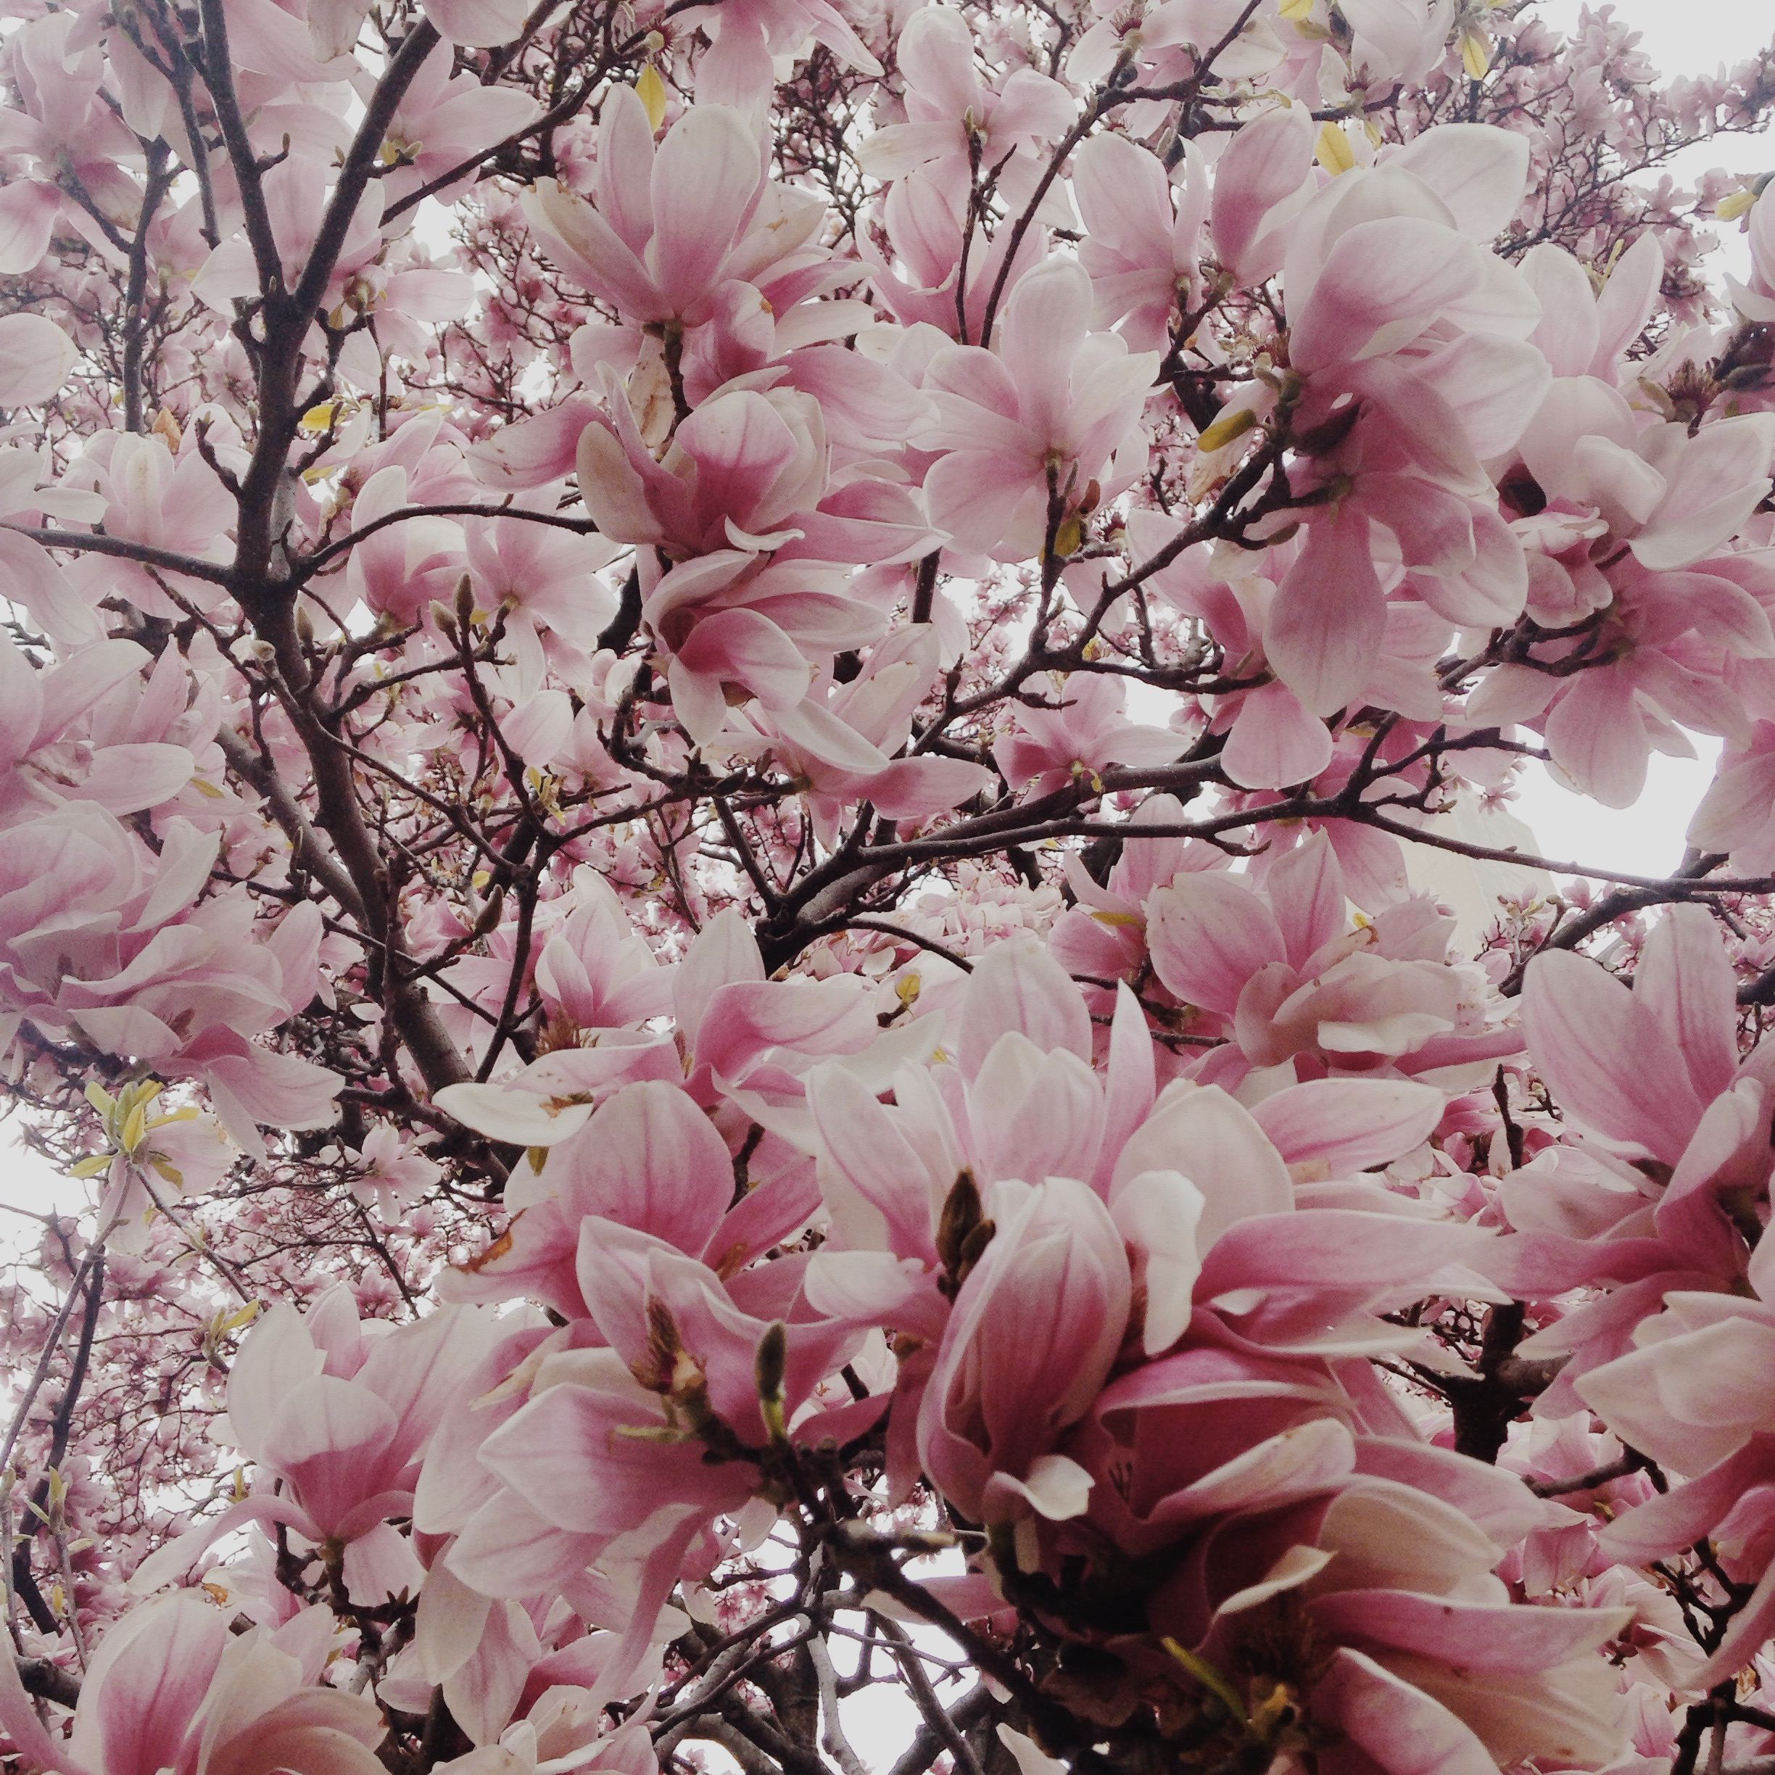
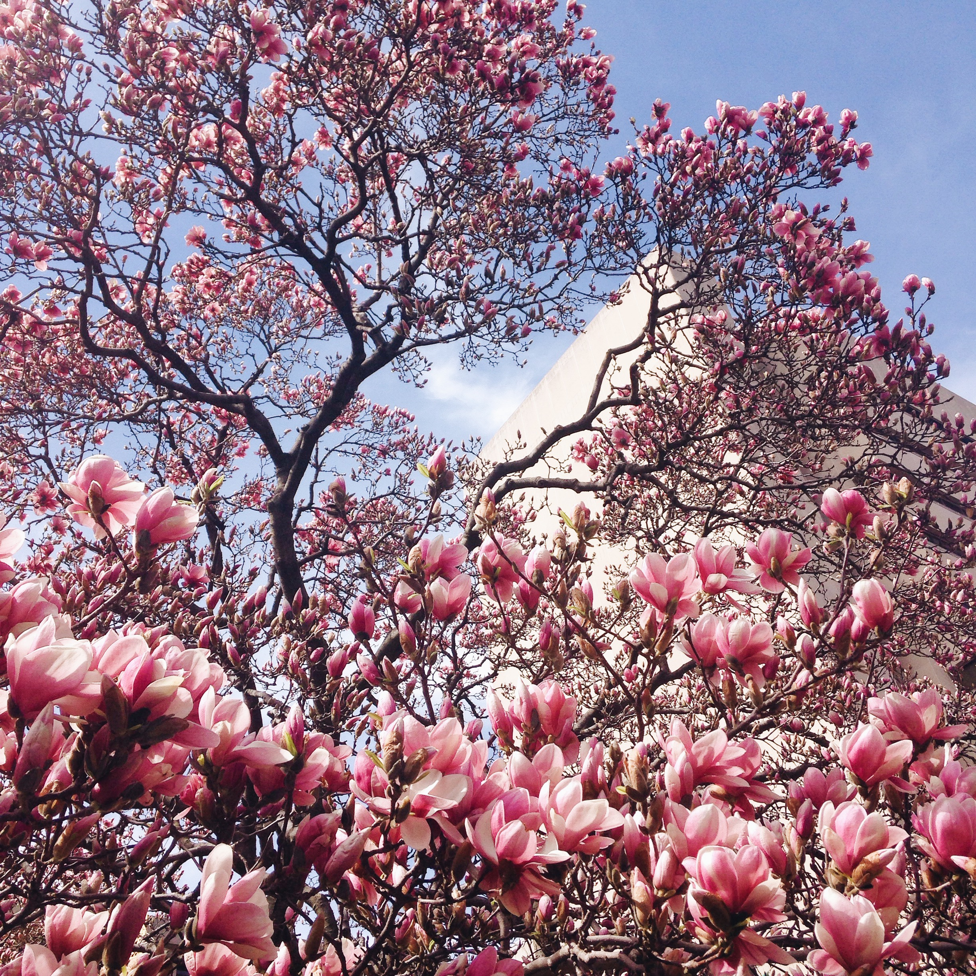
2014-2015
Notes:
It is the subject of much photography

Slide 5
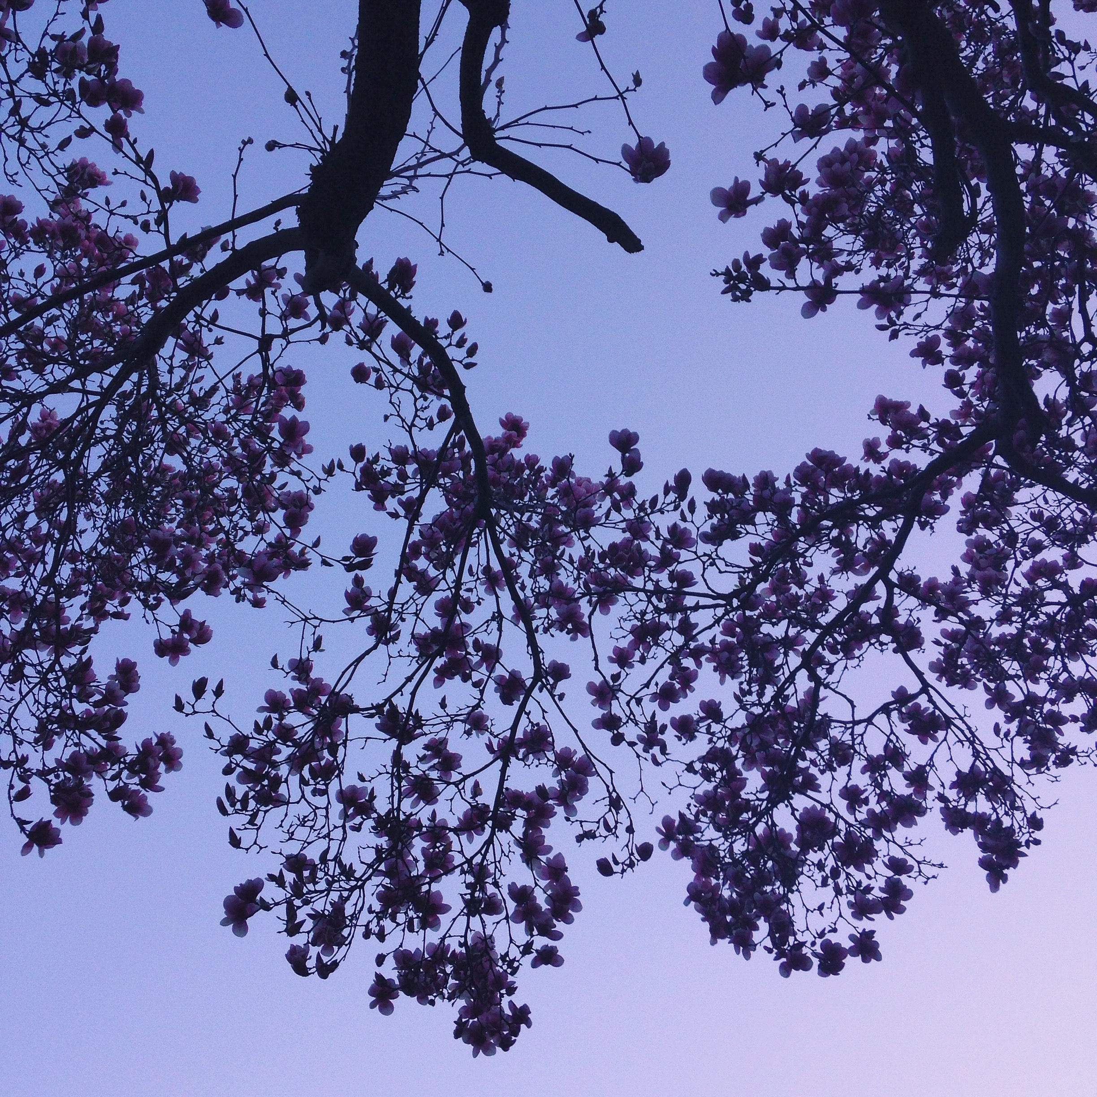
Professor Hilary Callahan of the Biological Sciences department occasionally uses the tree as a case study: her students observe the tree’s growth in her “Plant Evolution and Diversity” course. (“Barnard’s Blooming Magnolia”)
2014-2015

Slide 6
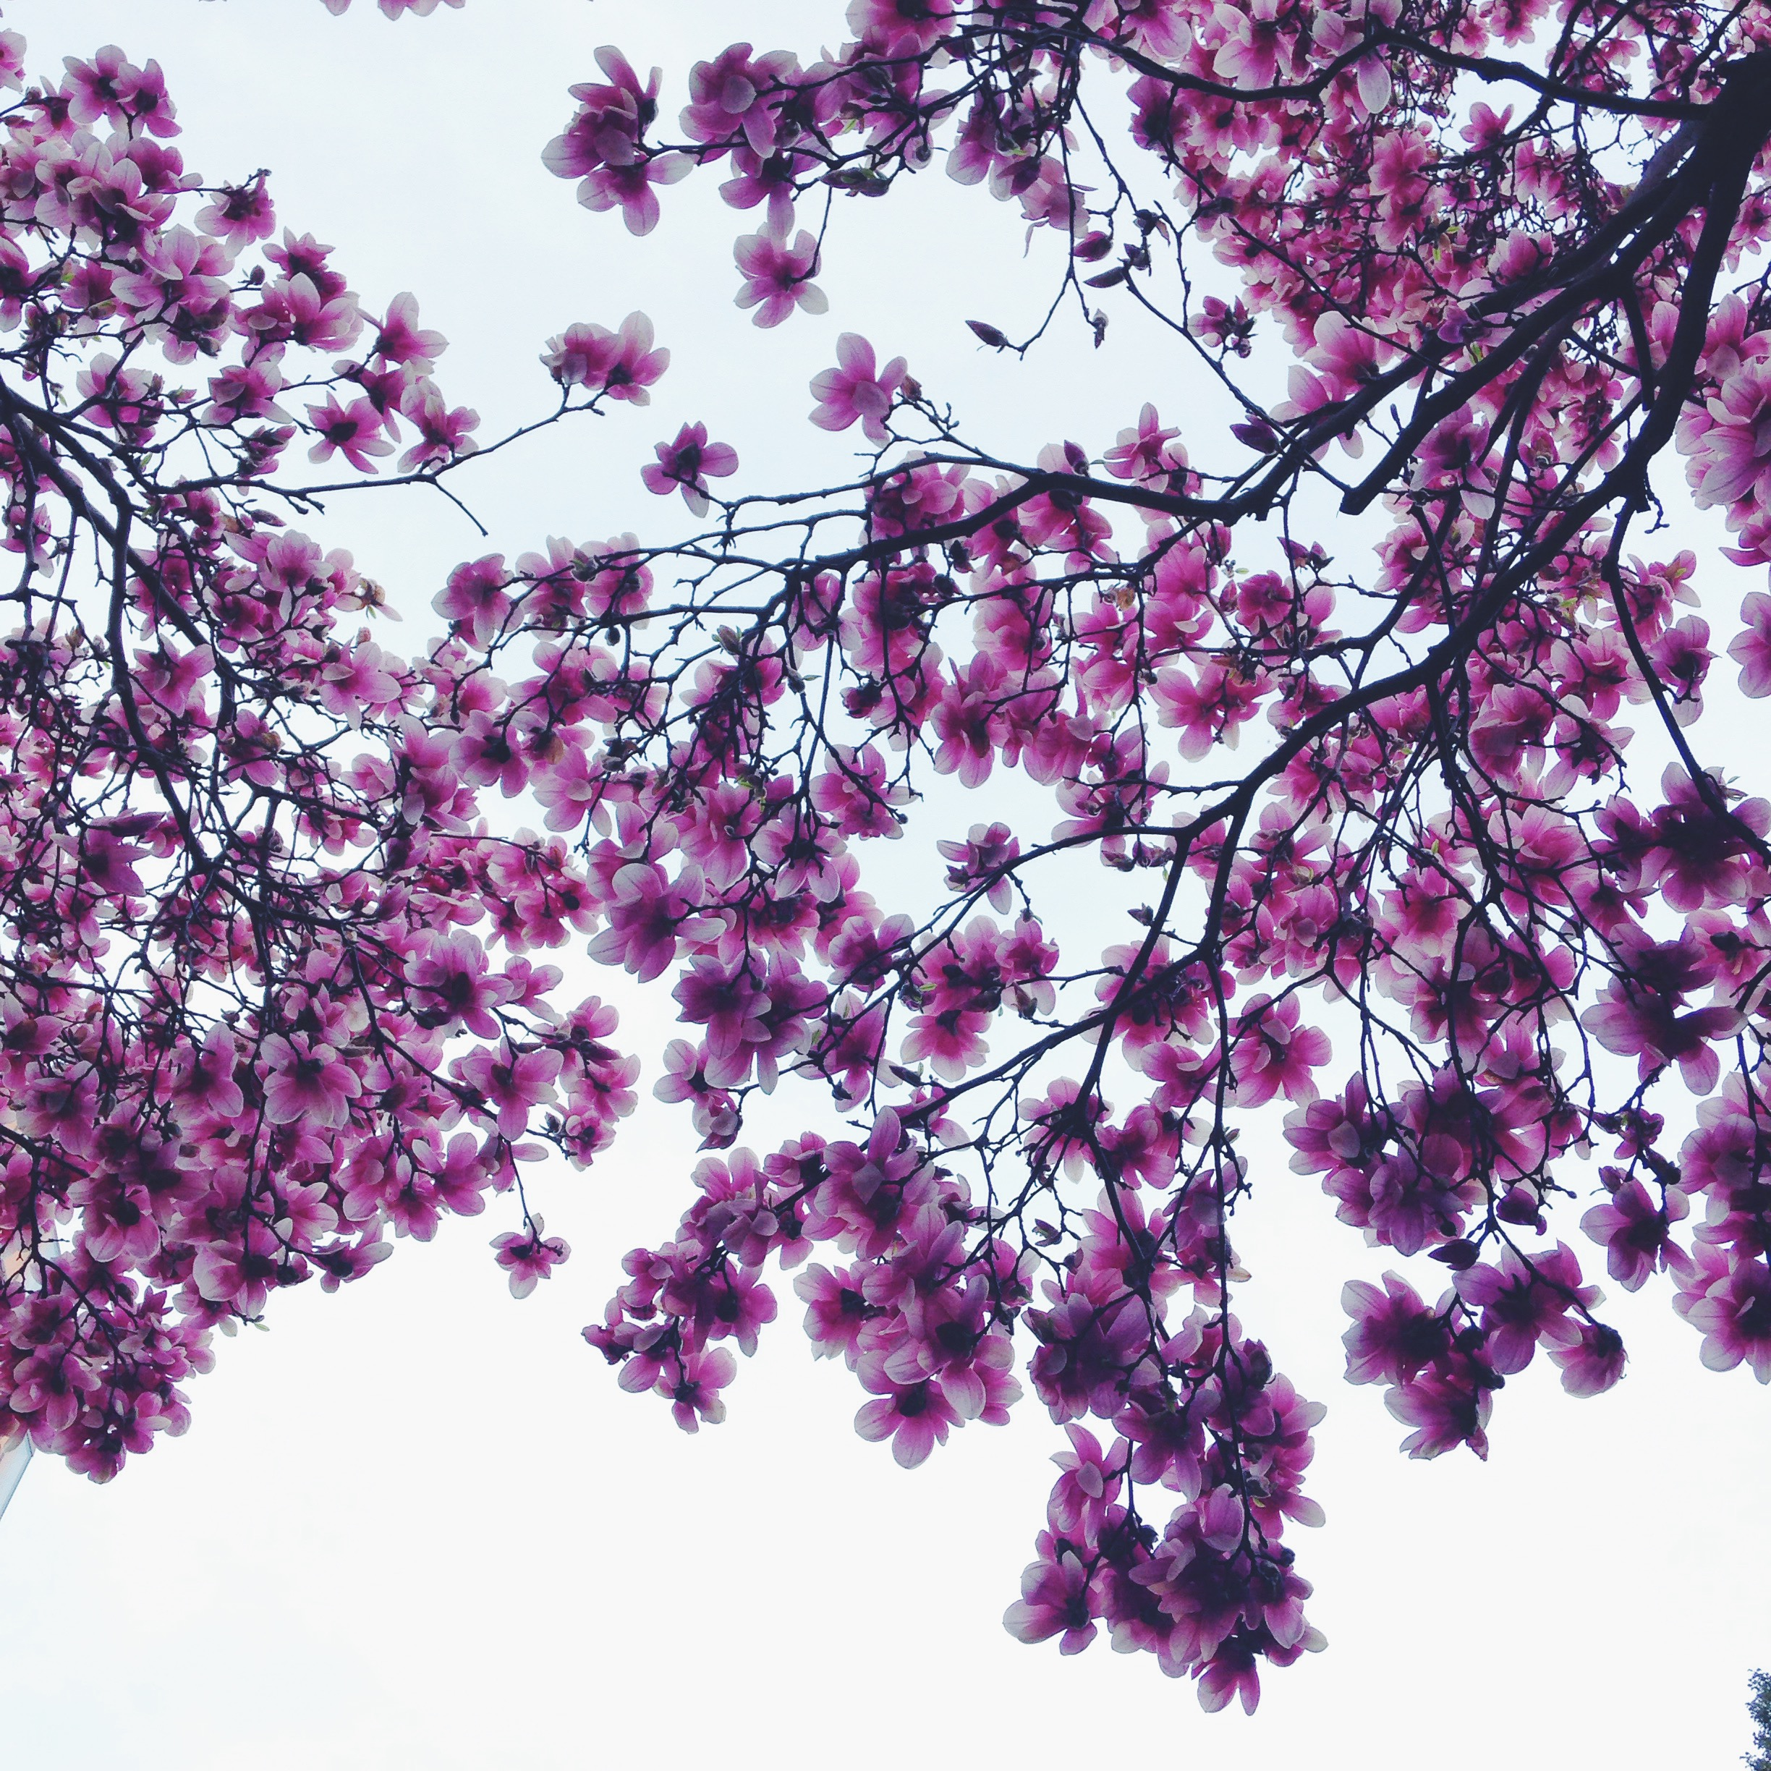
Our magnolia is a saucer magnolia (Magnolia x soulangeana).
It can grow to be about 30 feet tall and up to 150 years old.
Saucer magnolias typically are “multi-trunk or low-branching specimen” — that is, they have a low, forked trunk like ours.
They have large, fragrant flowers that range from pink to white to purple.
2014-2015

Slide 7
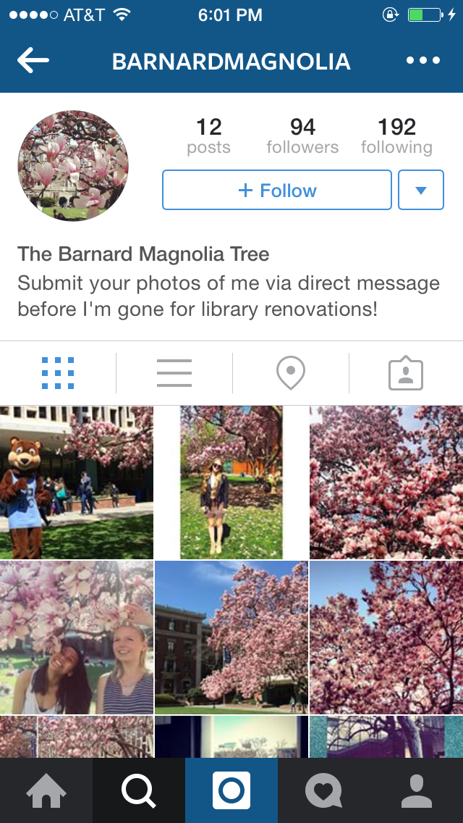
@BarnardMagnolia
Notes:
It has its own Instagram

Slide 8
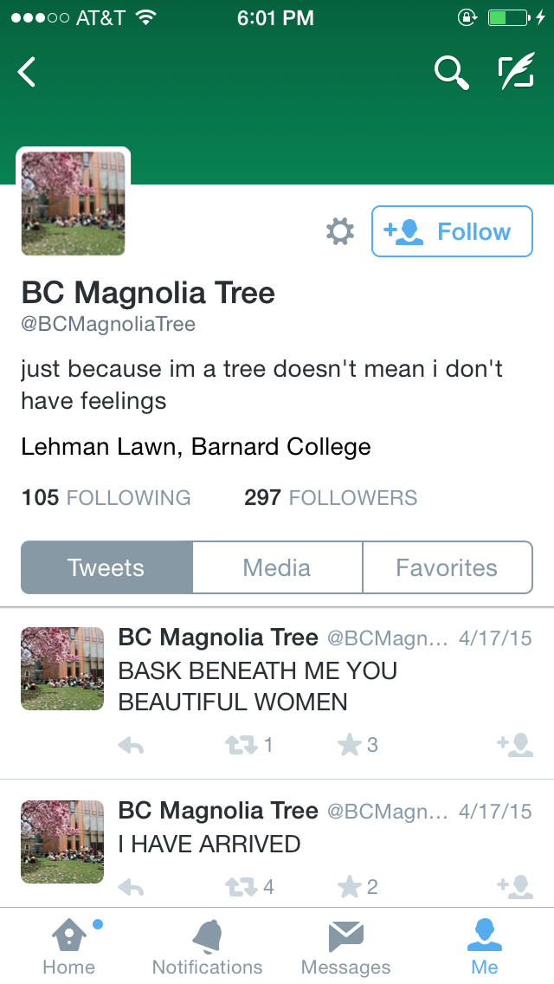
@BCMagnoliaTree
Notes:
and its own Twitter account

Slide 9
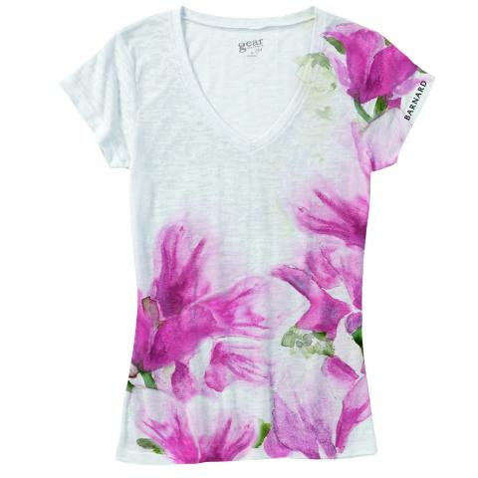
Notes:
It even has its own limited-edition themed apparel in the Barnard Store

Slide 10
But before,

Slide 11
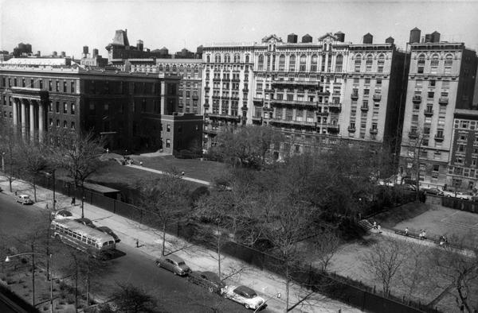
The Jungle!
1950s

Slide 12
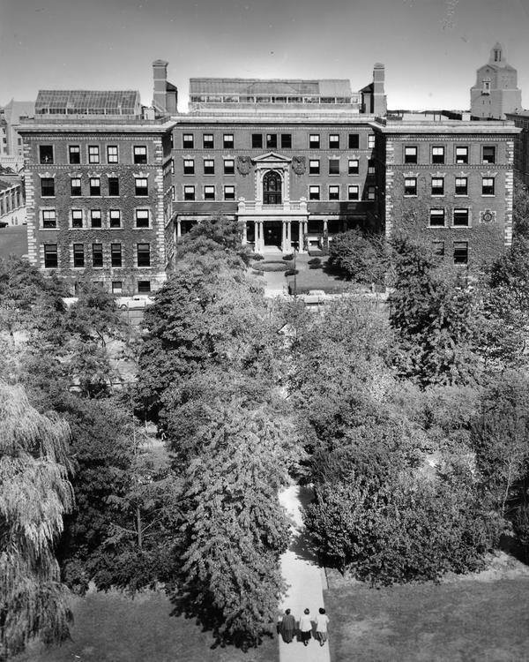
Milbank
Future site of MacIntosh/Diana
Future sites of Altschul and Lehman
1944-1950

Slide 13
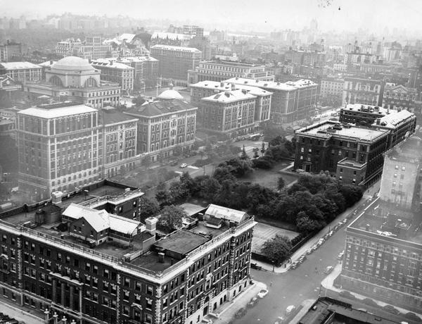
Not yet “Lehman” Lawn
Barnard Hall
The Jungle
Tennis courts
Milbank
1949-1956

Slide 14
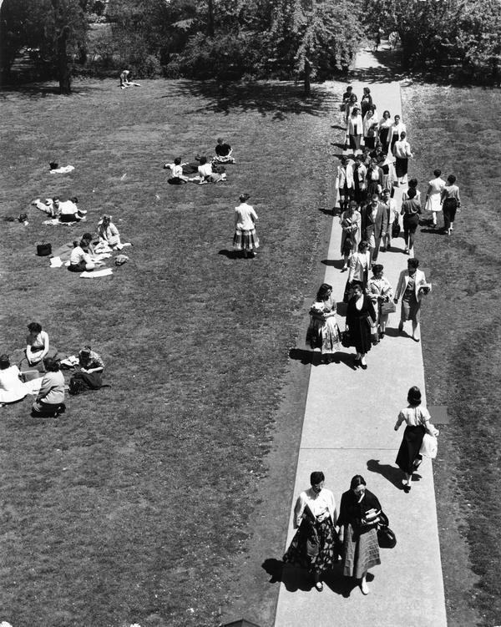
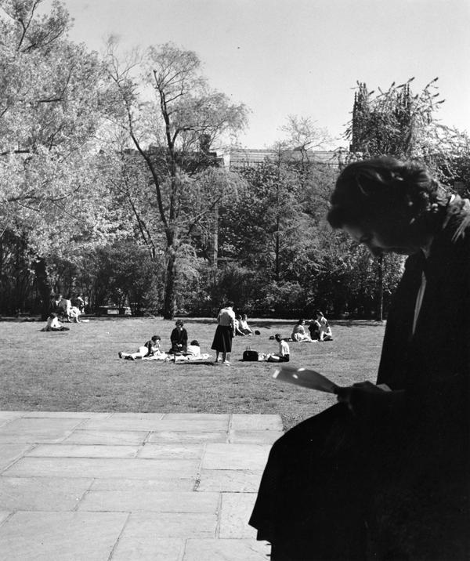
The Jungle
1956

Slide 15
1956:
no magnolia tree
Notes:
There are lots of photographs of what would become Lehman Lawn from 1956. None of them include the magnolia.

Slide 16
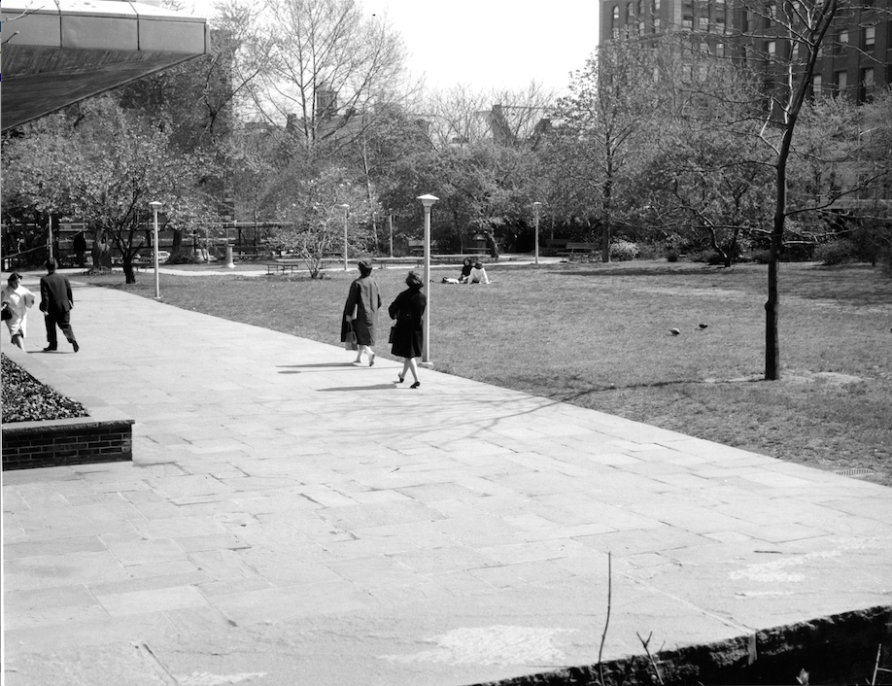
But then!
1960s
Forked trunk + fat magnolia buds!

Slide 17
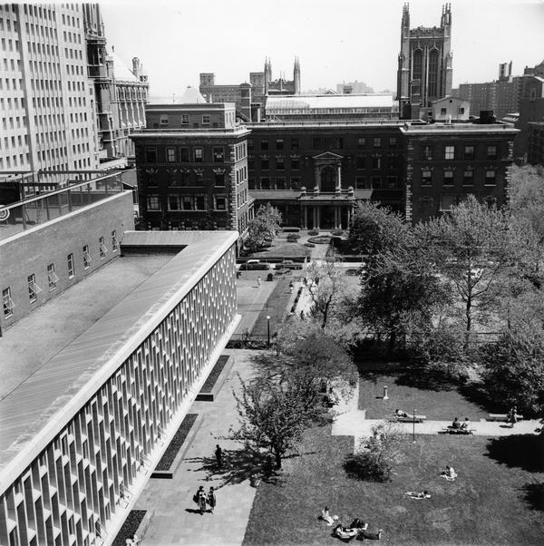
1961

Slide 18
So:
the magnolia was planted sometime between 1956-1961

Slide 19
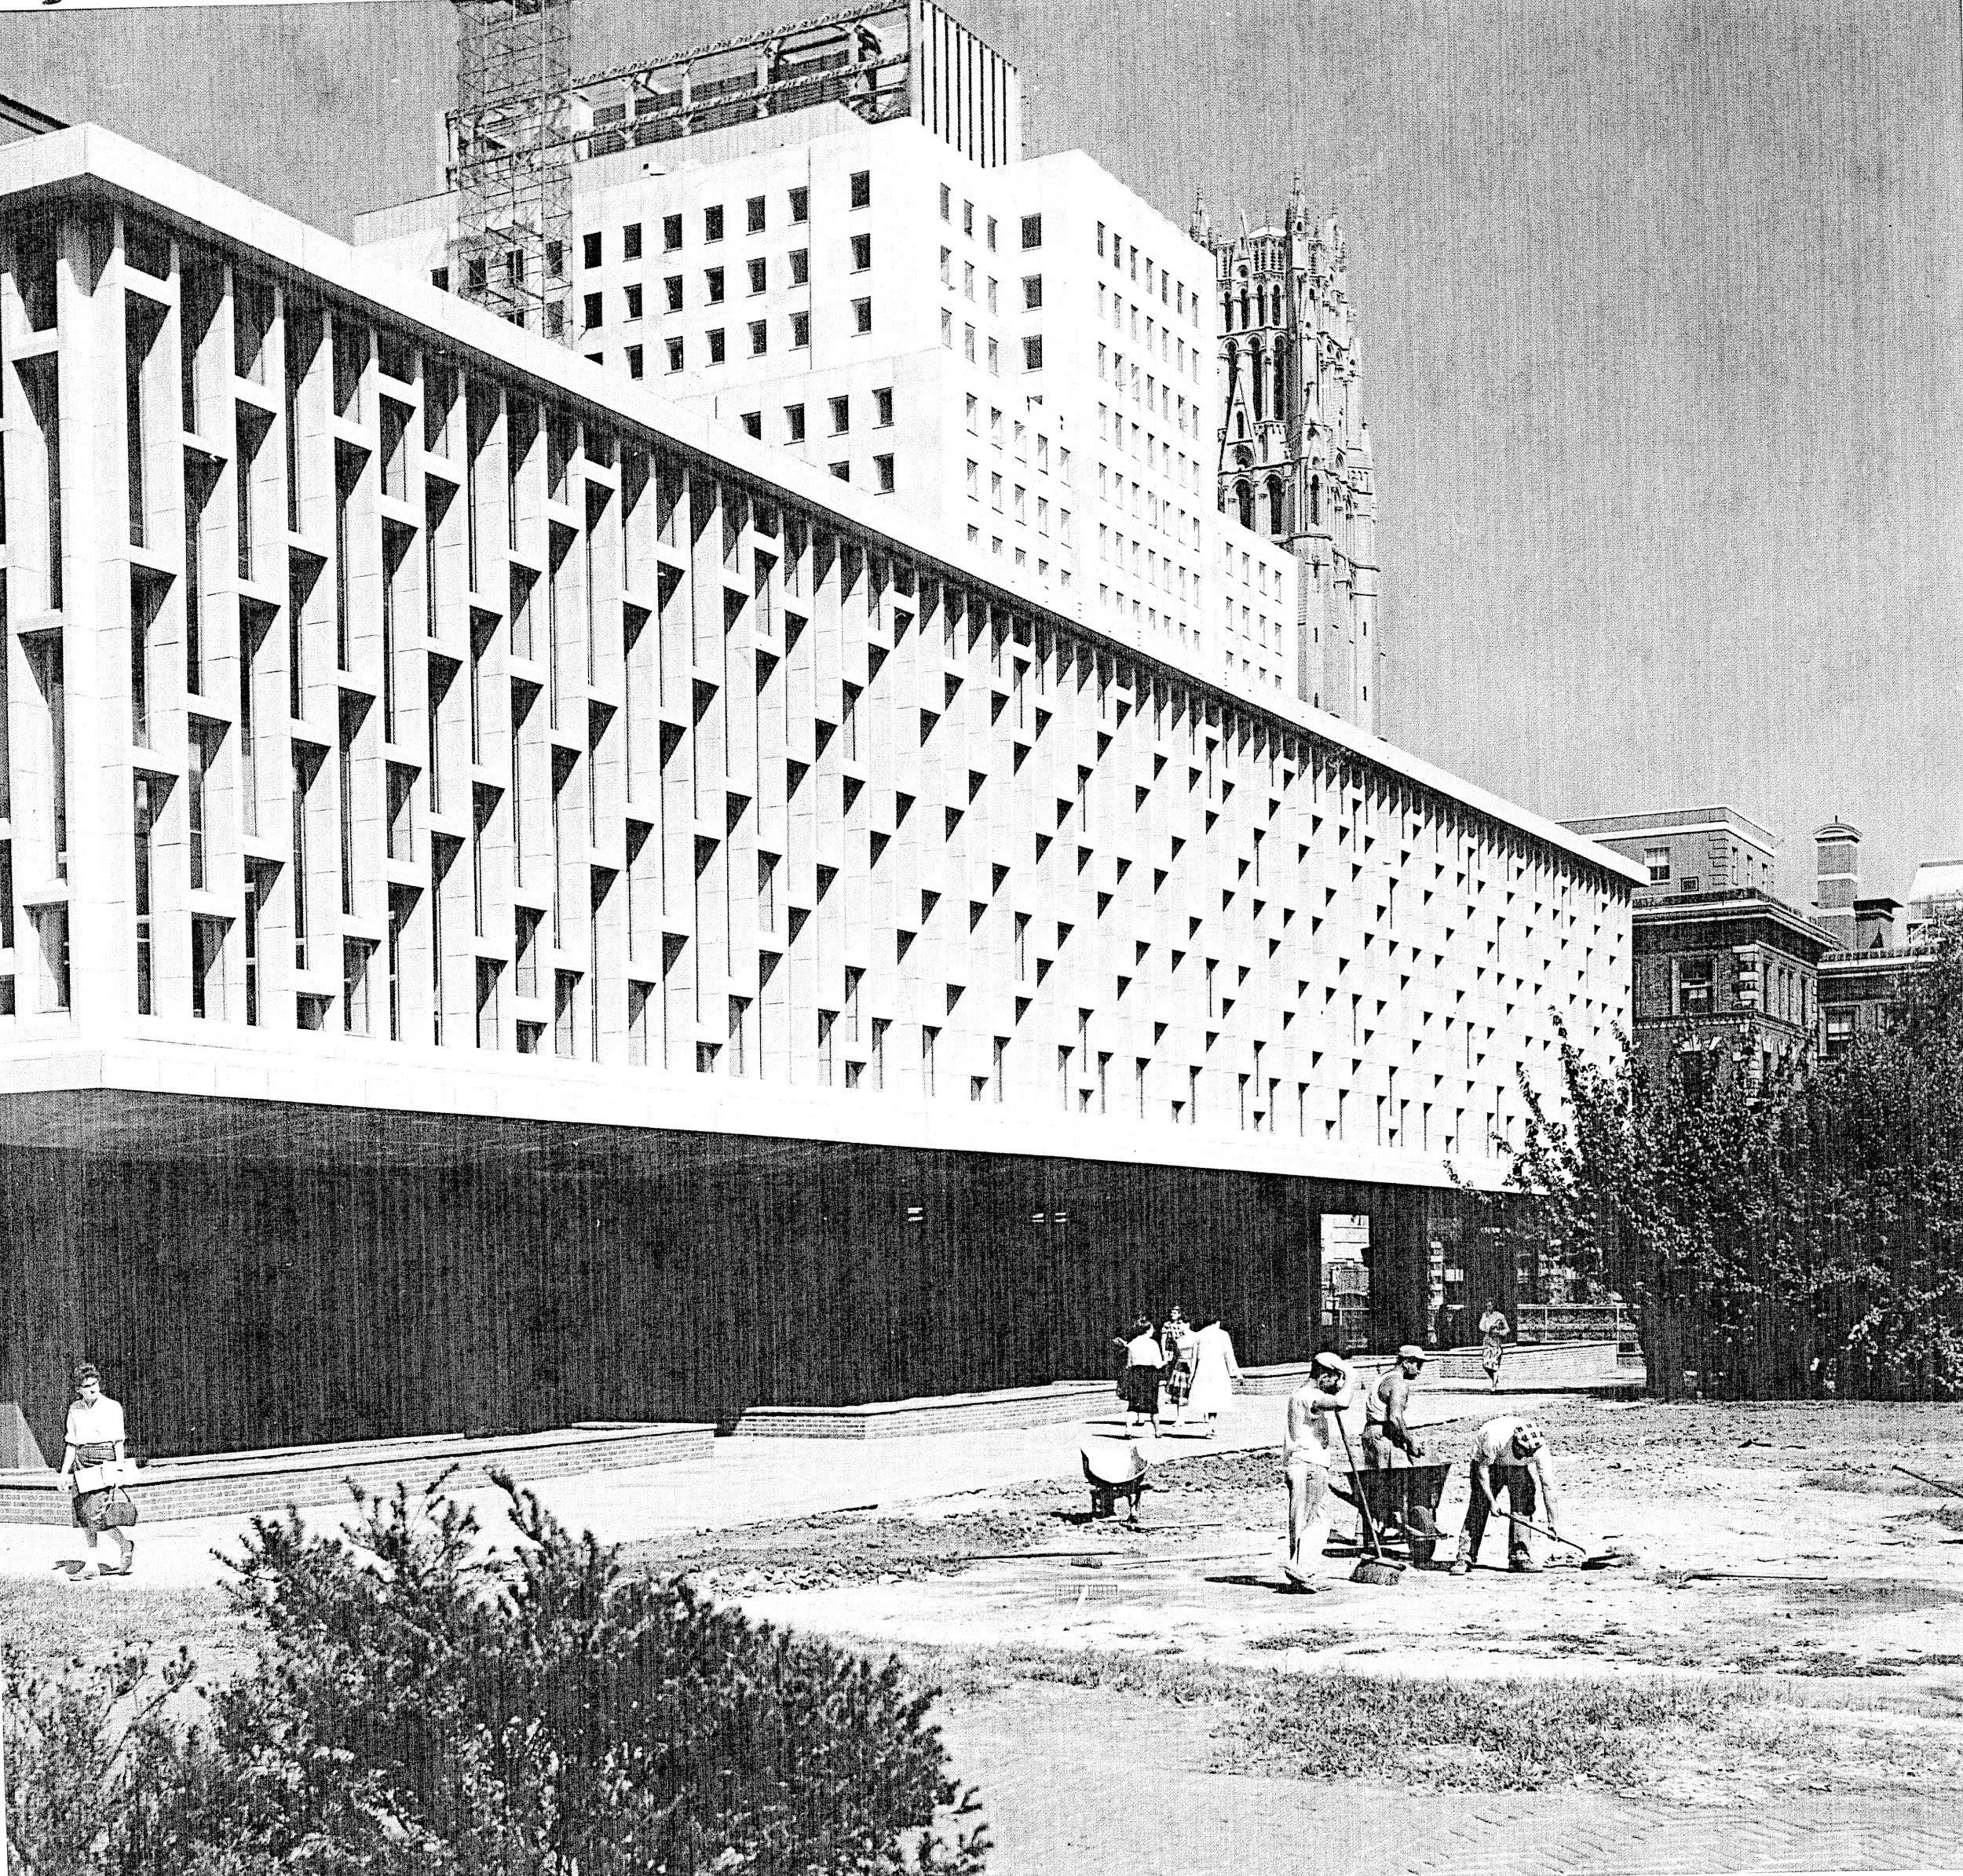
1960
Notes:
My guess is during the landscaping of Lehman Lawn. I don’t know much about what they were doing here, but it seems like a good opportunity to plant a tree. It does not seem to have been donated by or in memory of an alumna. It is a fairly common ornamental tree.

Slide 20
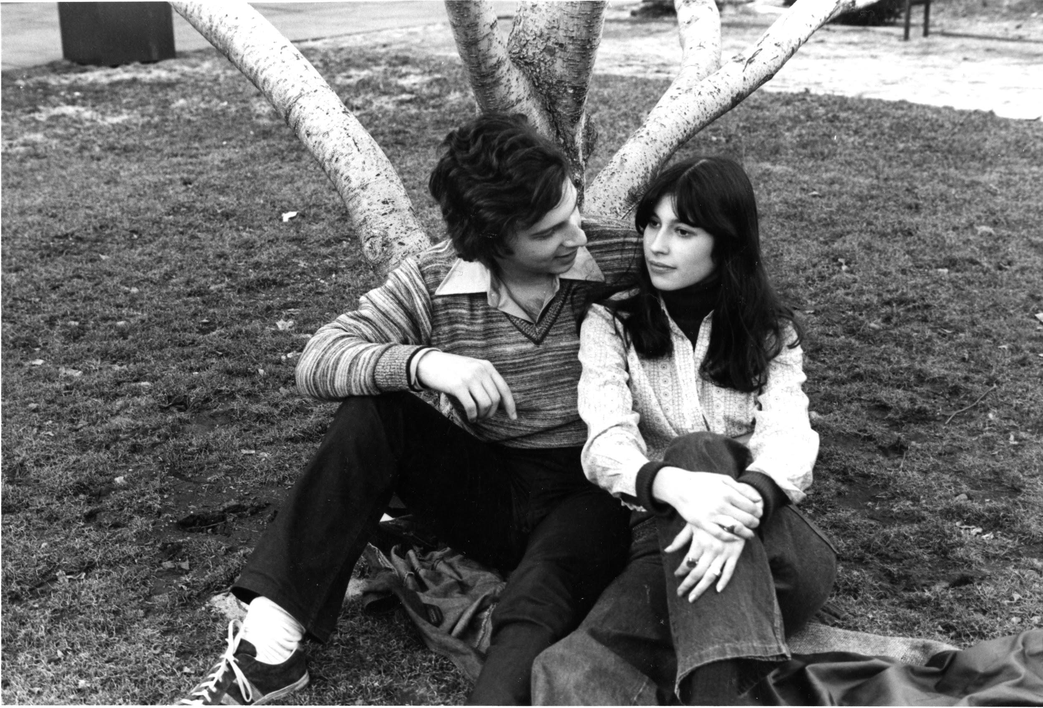
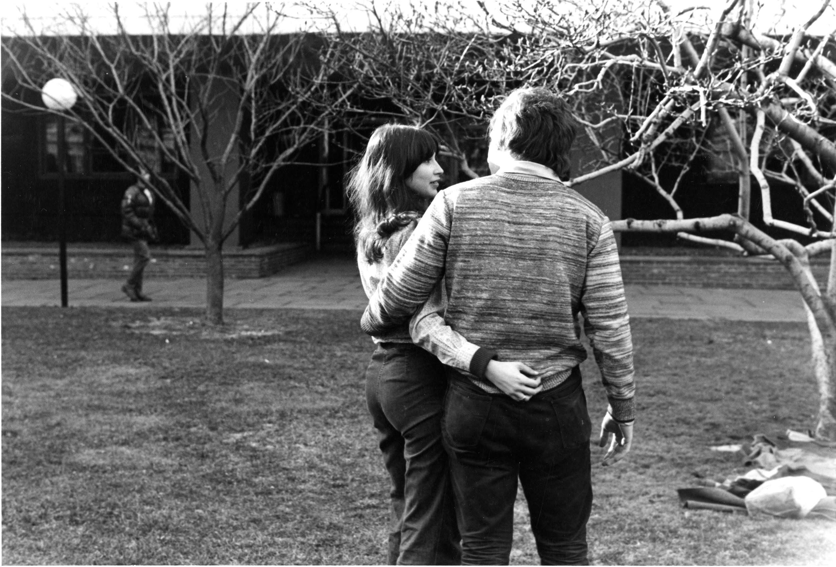
1970s
Notes:
By the early 1970s, it’s already the subject of much photography.

Slide 21
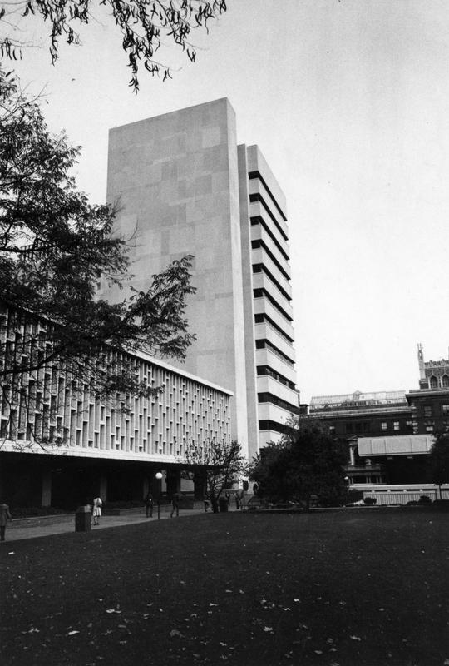
1972

Slide 22
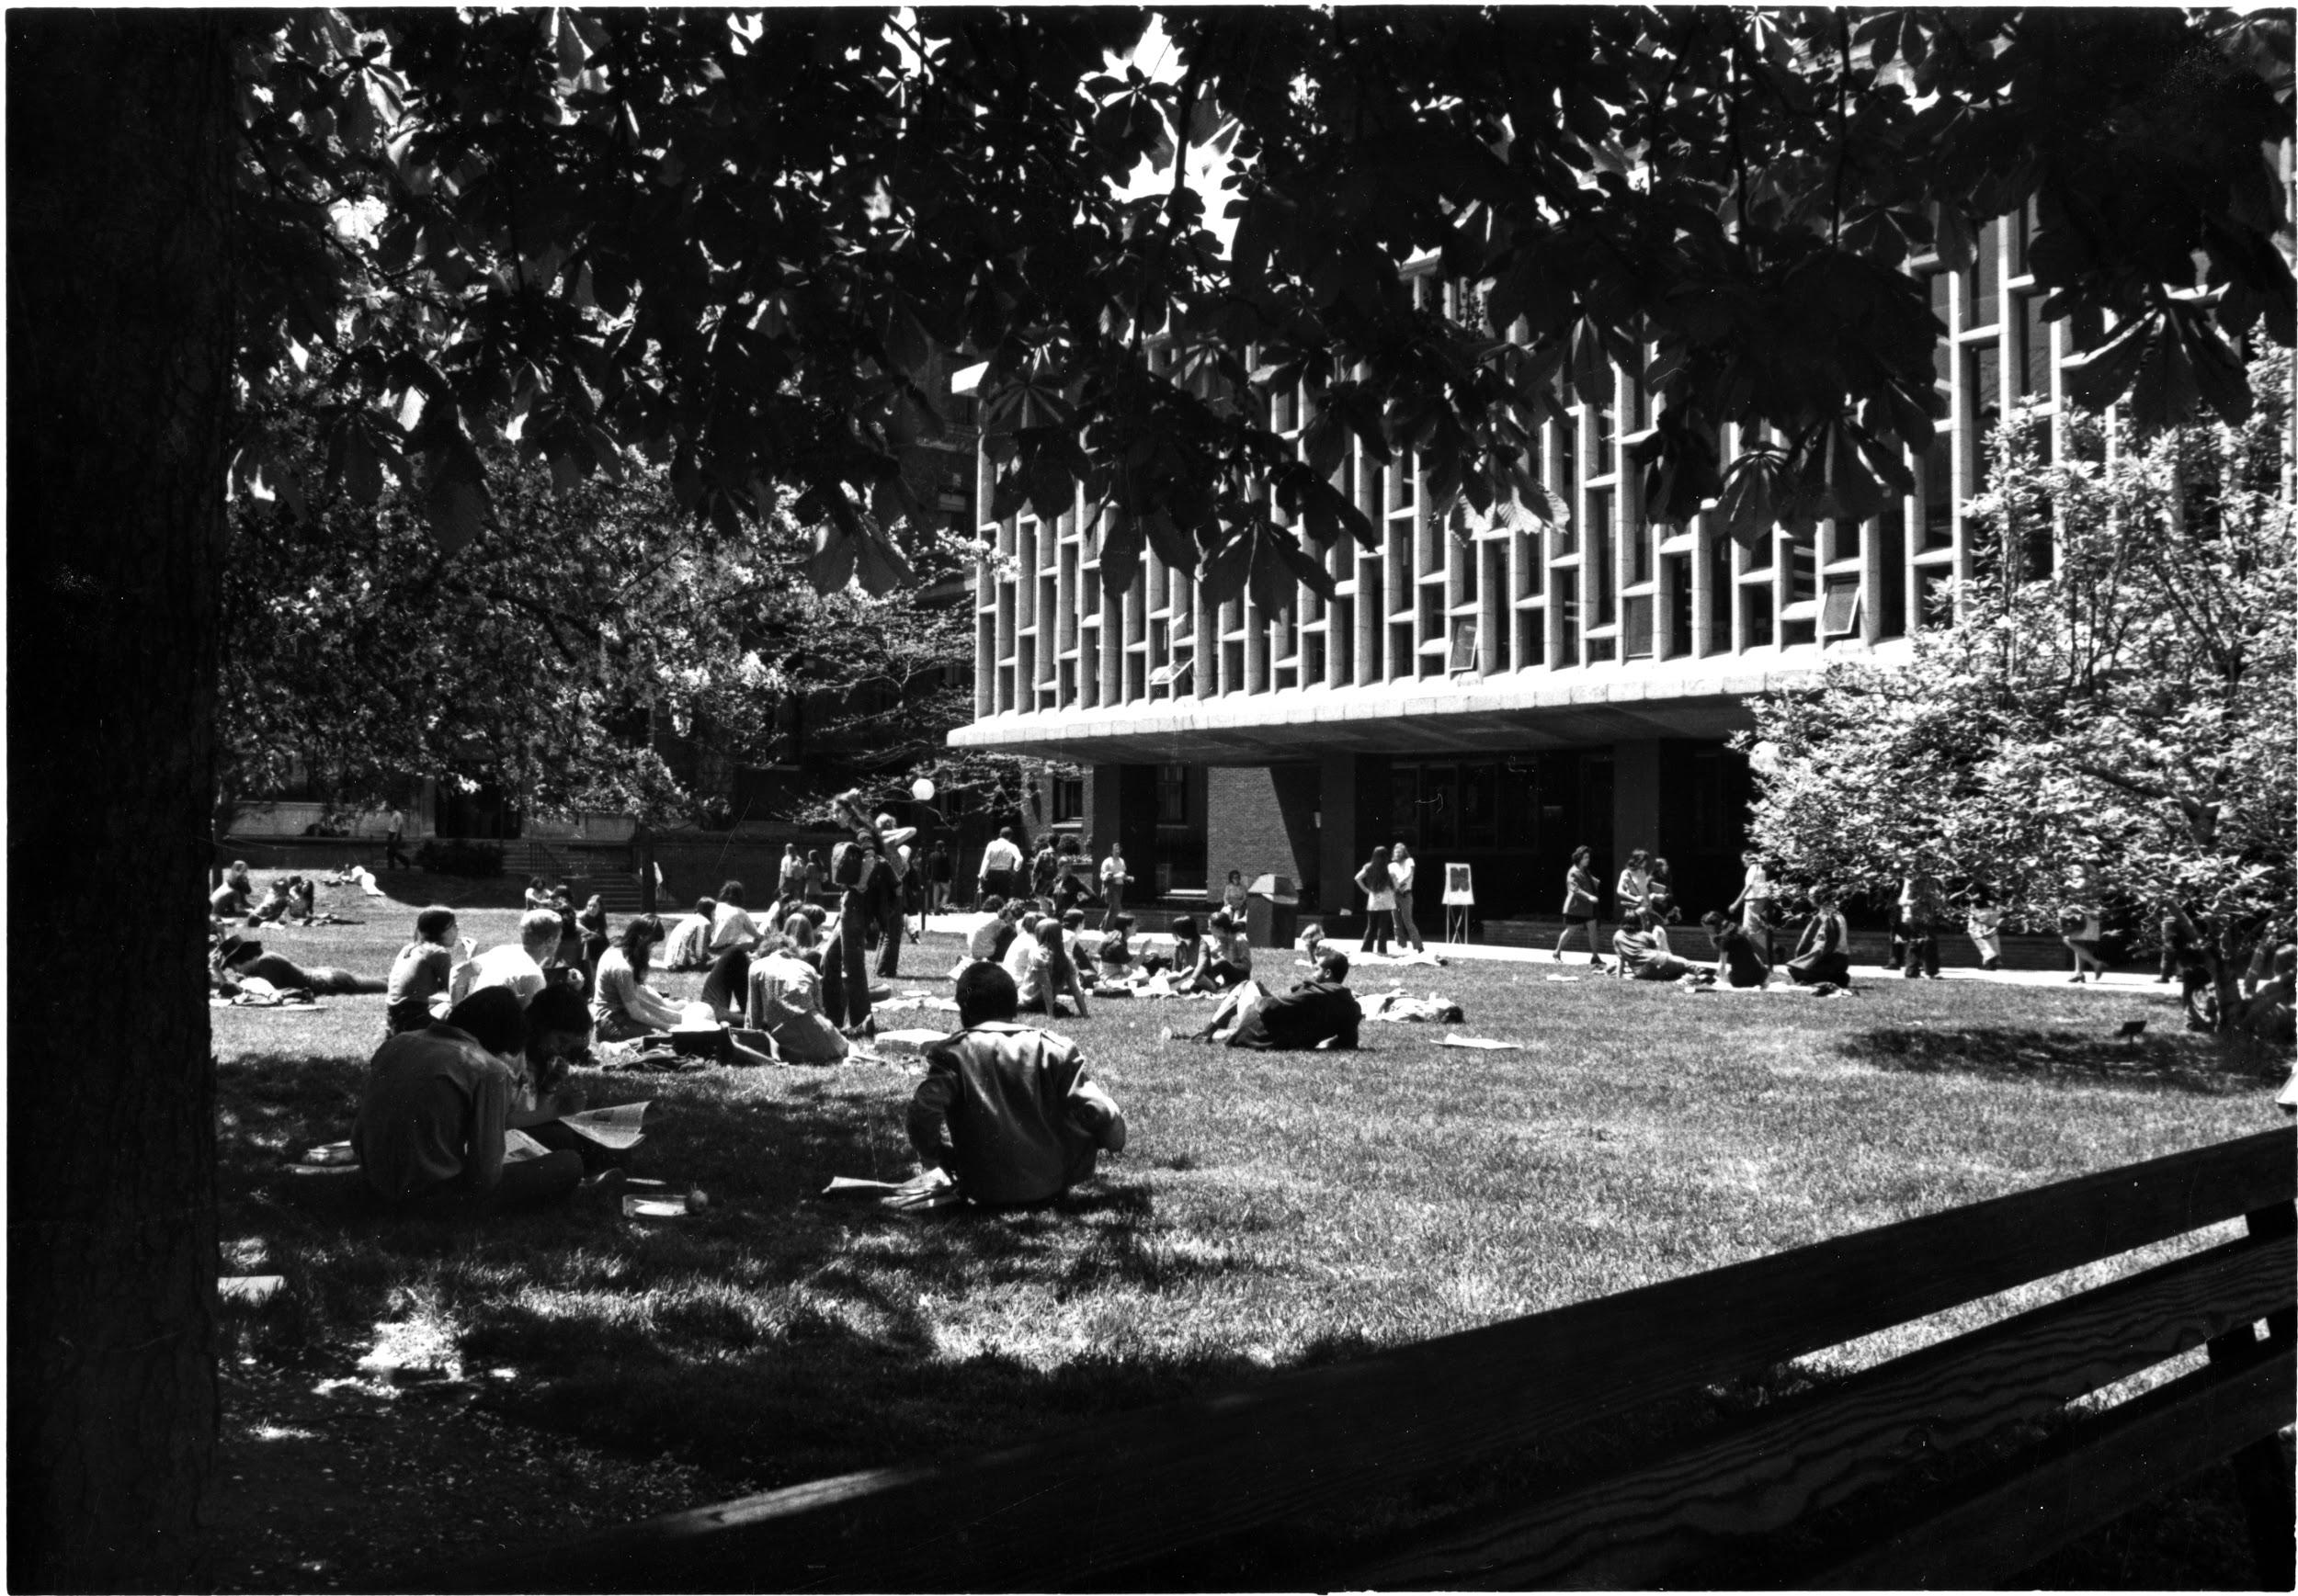
1970s
Notes:
It’s a gathering place.

Slide 23
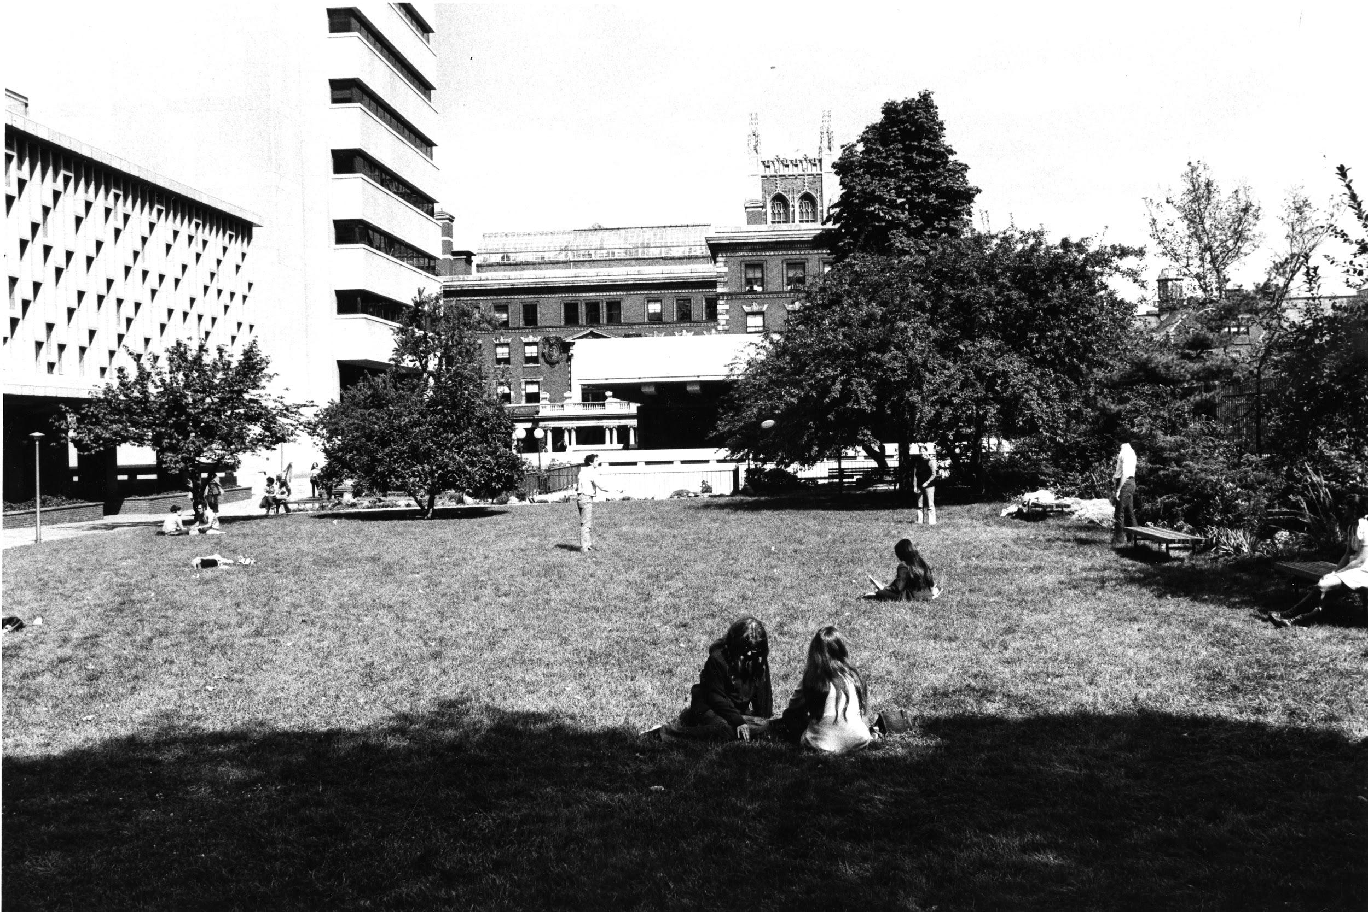
1970
“Groundskeeper Ray Torres recalls that the tree was already over 15 feet tall when he first arrived on campus in 1977.” — “Barnard’s Blooming Magnolia”
It is now over 25 feet tall.

Slide 24
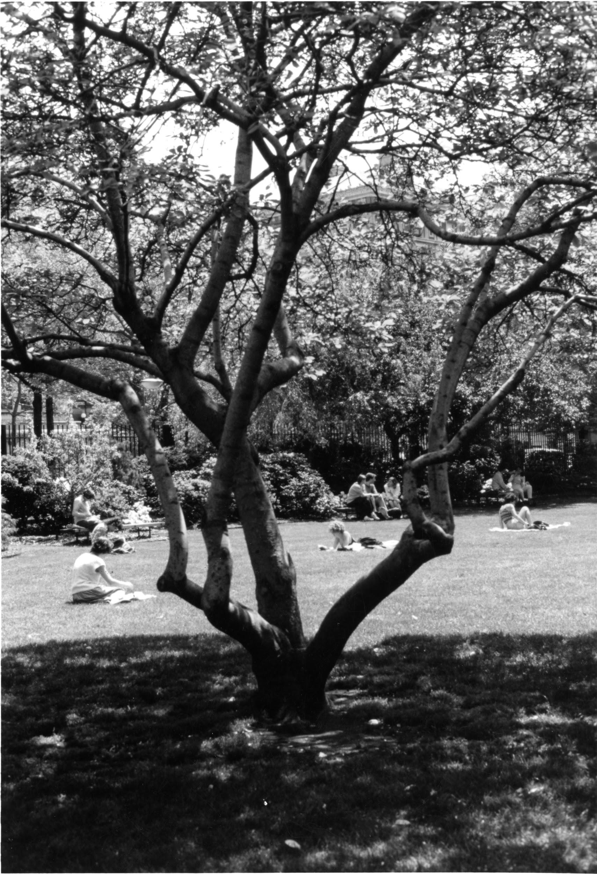
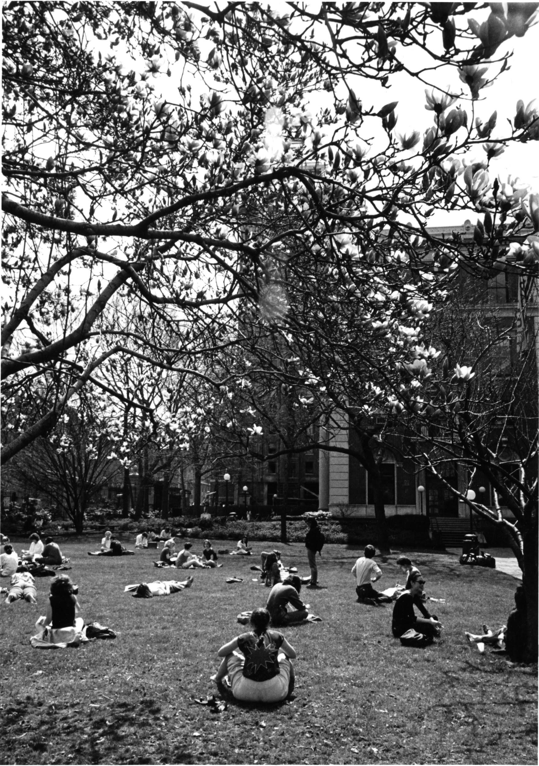
1988

Slide 25
What next?
Moving the magnolia for the new library

Slide 26
Sources Cited
Barnard Archives
“Barnard’s Blooming Magnolia”
Barnard’s Digital Collections
The Barnard Store
Cal Poly UFEI SelecTree Tree Detail Record: Saucer magnolia
Caroline Lange’s Instagram
Magnolia Instagram
Magnolia Twitter

