Slide 1
Who’s Afraid of Virginia Gildersleeve?
http://blogs.cuit.columbia.edu/ram31/
Making Barnard History Evening Seminar
February 16, 2015
Panelists:
Nancy Woloch
Bob McCaughey

Slide 2
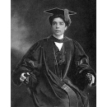
Virginia Crocheron Gildersleeve
Class of 1899

Slide 3
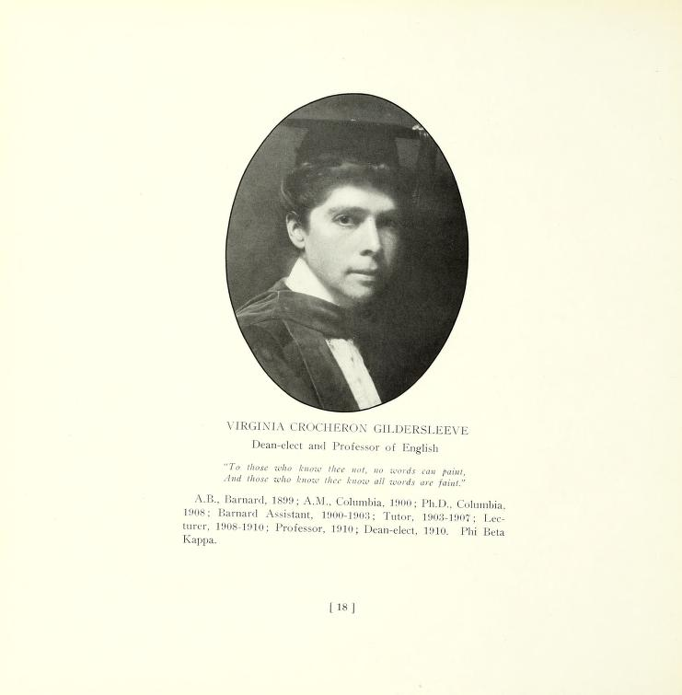
Virginia C. Gildersleeve
Dean-elect, 1911

Slide 4
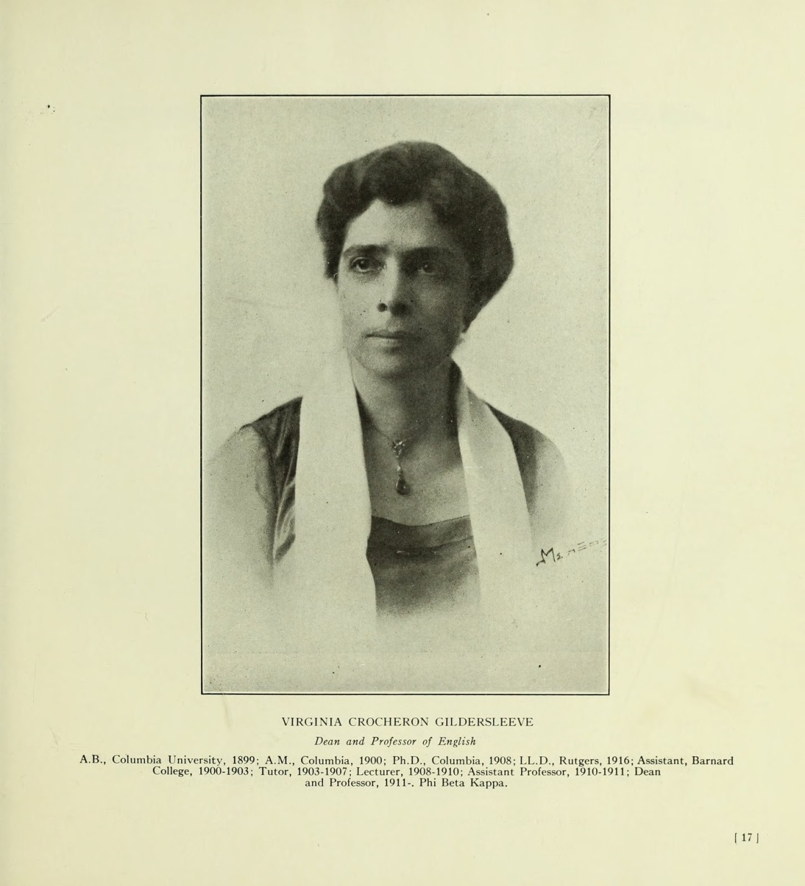
Virginia C. Gildersleeve circa 1921 (age 44); 10th year as dean

Slide 5
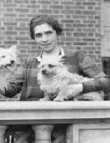
VCG, with dogs, by the Deanery

Slide 6
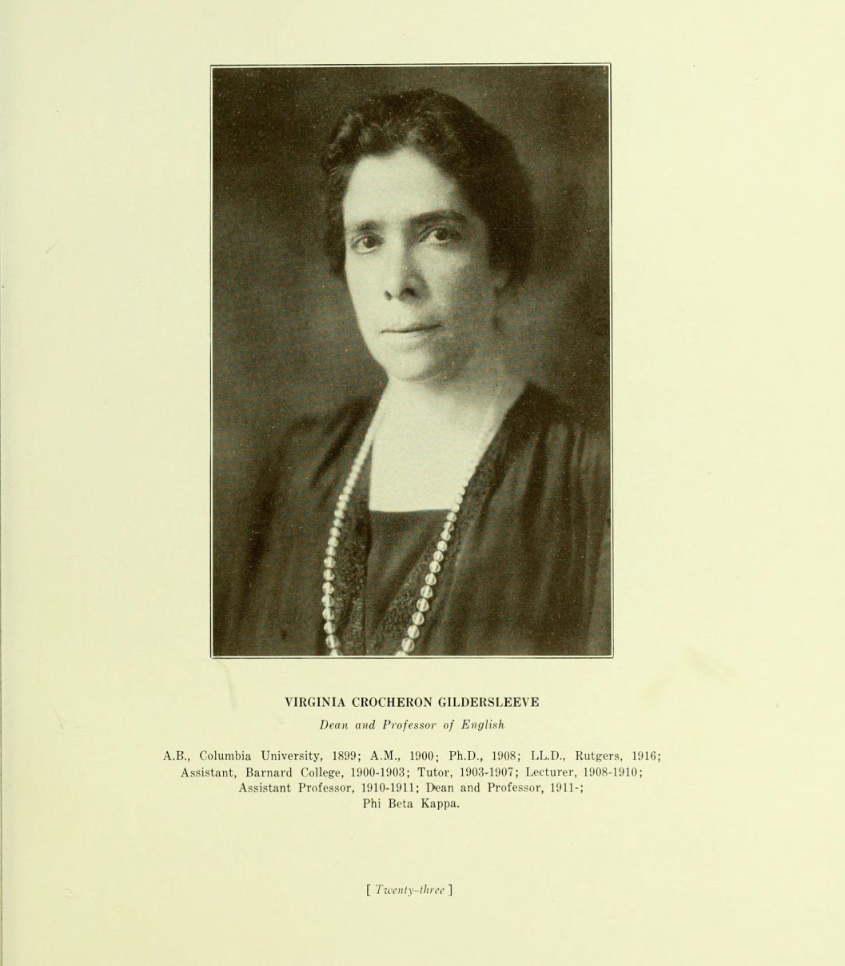
Virginia C. Gildersleeve
1927 (age 50); 16th year as dean

Slide 7
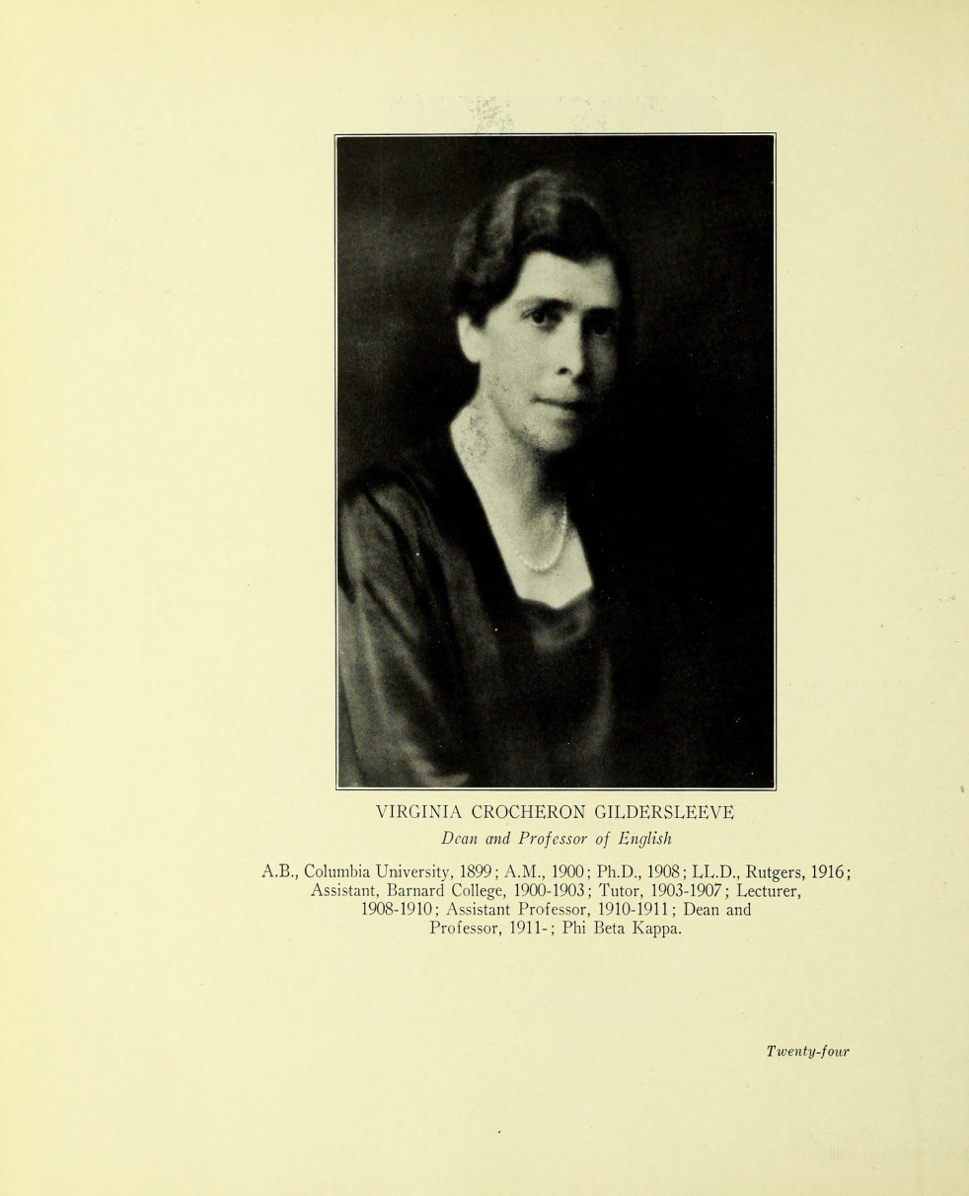
Virginia C. Gildersleeve
1930 (age 53); 19th year as dean

Slide 8
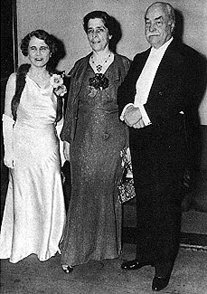
Helen Rogers Reid (BC 1903), Trustee 1914-1956;
VCG; Nicholas Murray Butler, at VCG’s 25th anniversary of her deanship (1936) [?]

Slide 9
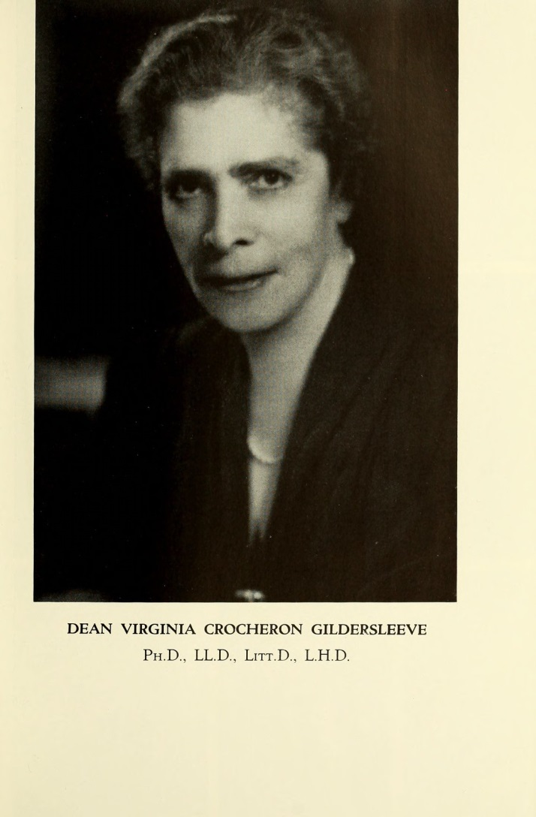
Virginia C. Gildersleeve
1940 (age 63); 29th year as dean

Slide 10
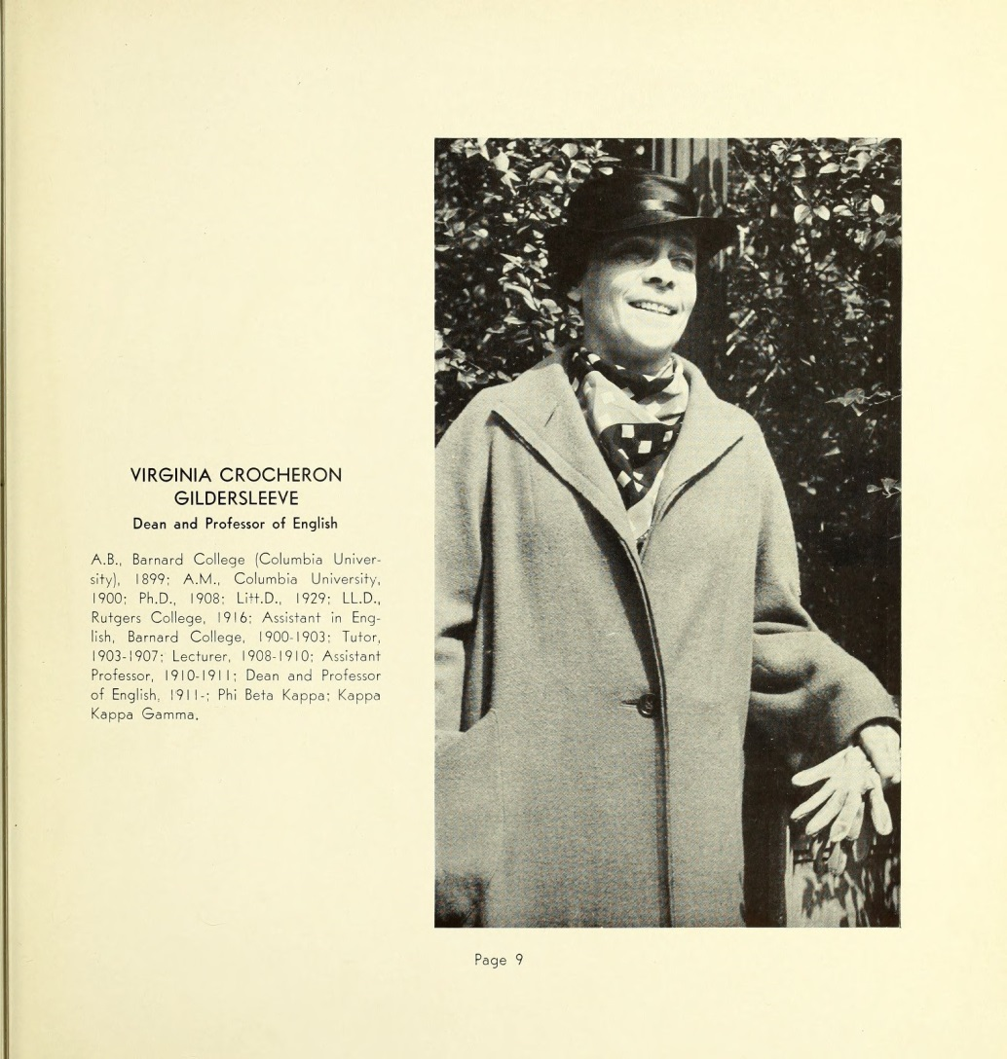
Virginia C. Gildersleeve
1937 (age 59)

Slide 11
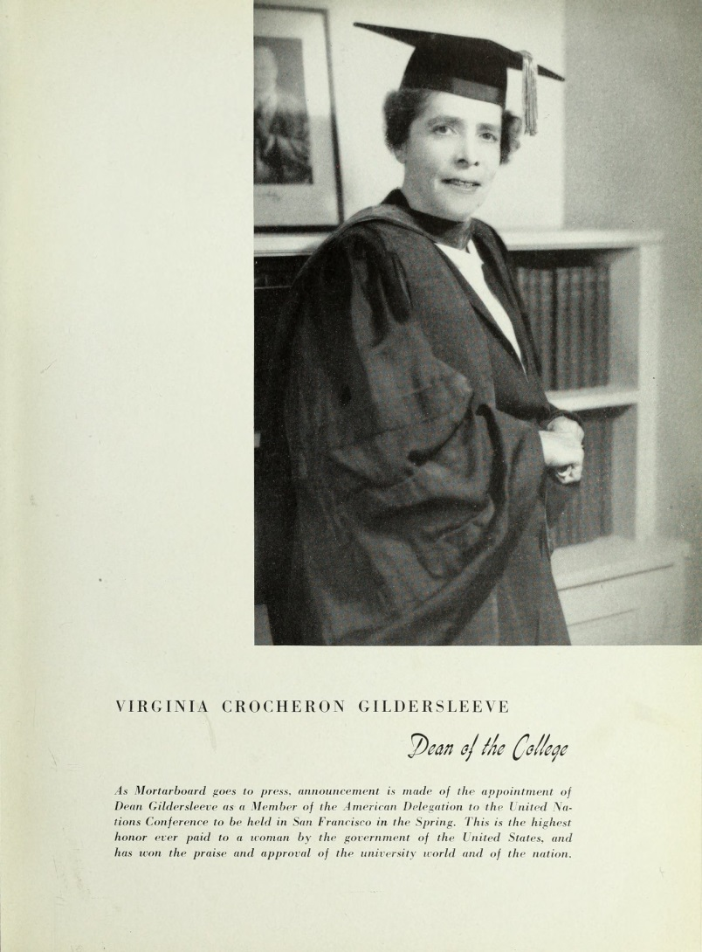
Virginia C. Gildersleeve,
1945 (age 67); 34 year as dean

Slide 12
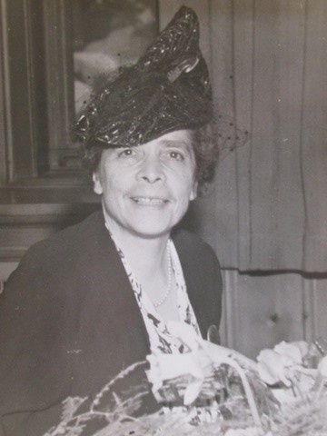
VCG, undated

Slide 13
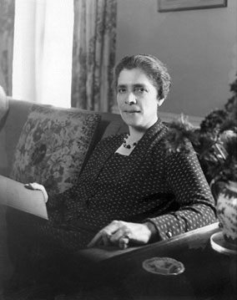
VCG seated

Slide 14
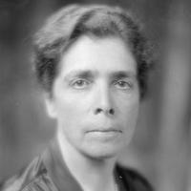
VCH, “The Stare”

Slide 15
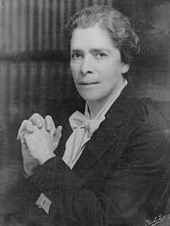
VCG, Hands clasped

Slide 16
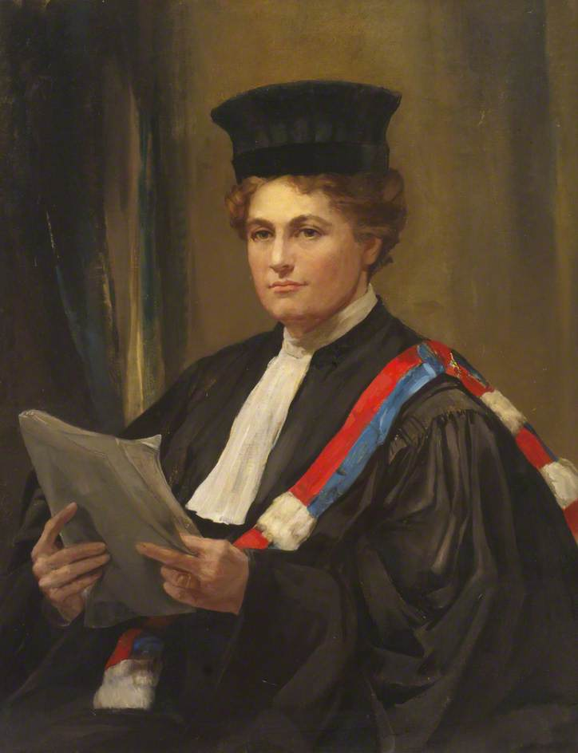
Caroline F. E. Spurgeon (1869-1942)
Chaucer and Shakespeare scholar
VCG companion 1920s - 1942

Slide 17
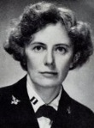
Elizabeth Reynard (1900-1962) (BC 1922);
Instructor Barnard English Department
Lt. WAVES (1944); VCG companion 1947-62

