Slide 1
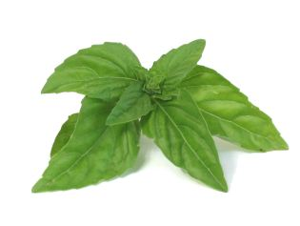
An Autonomous Hydroponic Herb Garden
Group 6: HYDROPONOMOUS
Jessica Cohen
Jamie Collier
Bikesh Dahal
Ben LeBlanc

Slide 2
Hydroponics Overview
Hydroponics
Method of growing plant using water based mineral solution, without soil.
Benefits:
Requires less water.
Allows for greater control of nutrient levels.
Easier to keep it pest and disease free.
Results in healthier plant growth.
Disadvantages:
Requires more maintenance.

Slide 3
Objective of the Design
General Objectives:
Create a fully automated, counter top, hydroponic herb garden.
Provide consumers with ability to grow herbs in urban living environments easily and cost-effectively.
Aesthetically pleasing exterior design.
Technical Objectives:
Automatically monitor and maintain pH, electrical conductivity and temperature of the nutrient solution.
Feedback control system for nutrients.

Slide 4
Initial Concept and Final Design
Initial Concept:
Ebb and Flow
Grow tray flooded with nutrients and then drained back.
Timer is set to perform the action multiple times a day.
Versatile but vulnerable to power outages, pump, and timer failures.
Final Design:
Nutrient Film Technique (NFT)
Nutrient solution constantly flows past the roots.
Reduced volume of nutrient solution required.
Leading method used for desired plant production.

Slide 5
Ebb-and-Flow vs. NFT
Ebb-and-Flow
NFT
Pros
Simple fluid dynamics
Great for small-scale
Simple construction
Cons
Water stagnation
Inefficient water use
Only provides moderate level of care
Pros
Commonly used for herbs
Self-stirring
Continuous flow (no timer)
Cons
Continuous power to pump
Maintaining nutrient film a challenge (1L/min)
Overgrown root system may halt flow

Slide 6
Overview of Literature Review
Internet Search:
Most of the existing products are manually operated and lack feedback systems for pH, electrical conductivity, temperature and nutrients.
Few devices have semi automated feedback control systems but are really expensive. ($1,500 or more).
Examples: Super Box, Aero Pro 7, Water Works, Modern Sprout.
Journal Search:
Important to monitor and regulate pH, temperature, and electrical conductivity for better growth of plants.

Slide 7
Control System
Arduino is used as the brain of the control system.
pH:
Monitor: pH sensor
Regulate: Administer solution via peristaltic pump
Temperature:
Monitor: Temperature sensor
Regulate: Heater operated by mechanical relay
Electrical Conductivity:
Monitor: EC sensor
Regulate: Administer solution via peristaltic pump

Slide 8
CAD Model

Slide 9
Basic Assumptions for Analysis
Nutrient Solution has same properties as Water
Incompressible
Constant Pressure
Laminar Flow
Dimensions of Reservoir
Length (in) | 18.50
Width (in) | 12.00
Height (in) | 3.50
Volume (in^3) | 777.00
Area (in^2) | 222.00
Volume (gal) | 3.36

Slide 10
Head Loss
Head Loss
Total less of head of the fluid throughout a pipe
$H_{l}=F∗\left(\frac{L}{D}\right)∗(\frac{V^{2}}{2g})$
Tubing Specifications
Diameter (in) | 0.38
Length (in) | 18.00
Friction | 0.00
Area (in^2) | 0.29
Flow Rate (l/m) | 1.00
Velocity (m/s) | 3.17E-09
Head Loss
H_{l}(m) | 1.23E-22

Slide 11
Evaporation of Water
Pool Equation
Evaporation based on the exposed surface area
$g_{h}=Θ∗A∗(x_{s}−x)$
Evaporation of Water
theta (kg/m^2h) | 25.00
Xs (20c) (kg/kg) | 1.47E-02
X (20c) (kg/kg) | 7.00E-03
gh (gal/week) | 1.22
Xs (25c) (kg/kg) | 1.98E-02
X (25c) (kg/kg) | 9.80E-03
gh (gal/week) | 1.59

Slide 12
Water Usage
Water Usage in a week
Usage (20C) (gal) | 1.77
Usage (25C) (gal) | 2.52
Water left (20C) (gal) | 1.59
Water left (25C) (gal) | 0.85
height (20C) (in) | 1.66
height (25C) (in) | 0.88
Based on evaporation and plant intake
Water Intake
intake (gal/week) (20C) | 0.55
intake (gal/week) (25C) | 0.92

Slide 13
Wall Pressure
Water pressure on wall
Resultant force at 1/3 height
$P_{avg}=\frac{ρgh}{2}$
$F= P_{avg}∗A$
Force on Walls
Pave (N/m²) | 436.05
Fmax (N) | 18.22
Fmin (N) | 11.82
Weight (N) | 124.91

Slide 14
Heating Water
Basic heat transfer equation
$Q=Cp∗m∗dt$
$Time=\frac{Q}{P}$
Heat Transfer - Heating Water
Q (watts) | 100.00
Cp (kJ/kg K) | 4.19
Mass of water (kg) | 12.73
dt (1) | 1.00
Q(kJ) (1) | 53.35
Time (1) min | 8.89

Slide 15
Nutrient Solution
Dilution of the nutrient Solution
Conversions
Dosing
Nutrient Solution
Conversion | 1 gal:750 gal
Volume (gal) | 3.36
Water (gal) | 3.36
Nutrients (gal) | 4.48E-03
Volume (liters) | 12.72
Water (liters) | 12.70
Nutrients (liters) | 1.70E-02
pH up/pH down
Conversion | 1ml:1gal
pH (ml) | 3.36

Slide 16
Growing Specifications
Plant Name | Lighting conditions | Lamp Type | Temperature | pH | PPM/TDS
Basil | High Light | T5 | warm | 5.5-6.5 | 700-1120
Mint | High light | T5 | warm | 5.5-6.5 | 1400-1680
Oregano | high light | T5 | warm | 6.0-7.0 | 1120-1400
Parsley | high light | T5 | warm | 5.5-7.0 | 560-1260
Sage | high light | T5 | warm | 5.5-6.5 | 700-1120
Scallion | high light | T5 | warm | 6.0-7.0 | 980-1260
Thyme | high light | T5 | warm | 5.5-7.0 | 560-1120

Slide 17
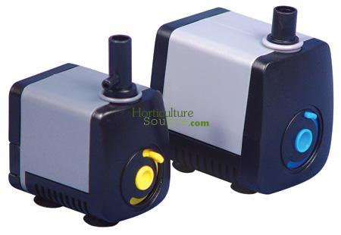
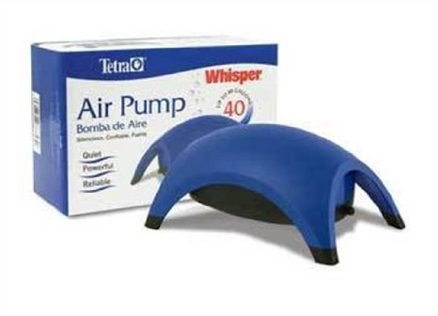
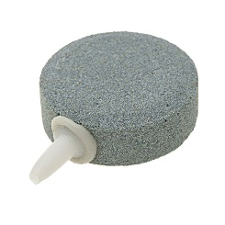
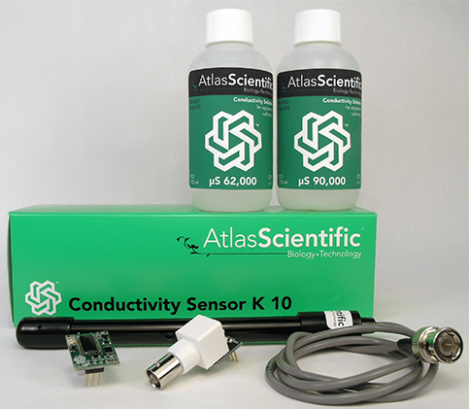
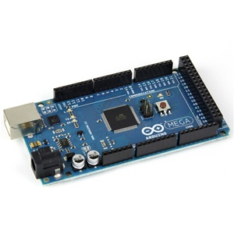
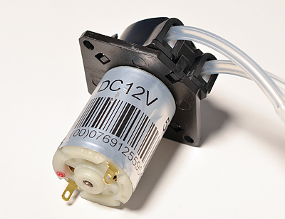
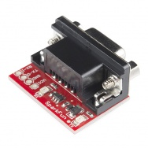
Major Purchase Items
Item | Item # | Manufacturer | Price Per Item | # | Total Cost
EC kit (k=0.1) | N/A | Atlas Scientific | $159.95 | 1 | $159.95
Arduino Mega 2560 | MKSP5 | MakerShed | $64.99 | 1 | $64.99
Peristaltic pump | ID: 1150 | adafruit | $24.95 | 3 | $74.85
Serial Conversion Unit | PRT-00449 | SparkFun | $13.95 | 1 | $13.95
SSR 16-channel | SKU:20-018-103 | Sainsmart | $20.99 | 1 | $20.99
Pump | 728490 | Horticulture Source | $6.12 | 1 | $6.12
Air Pump | ASIN: B004PB8SMM | Amazon | $11.04 | 1 | $11.04
Air Bubbler | ASIN: B0050HJ7Q6 | Amazon | $7.84 | 1 | $7.84
Water Heater | ASIN: B00513MZ1I | Amazon | $11.29 | 1 | $11.29
Total Cost: $321.12

Slide 18
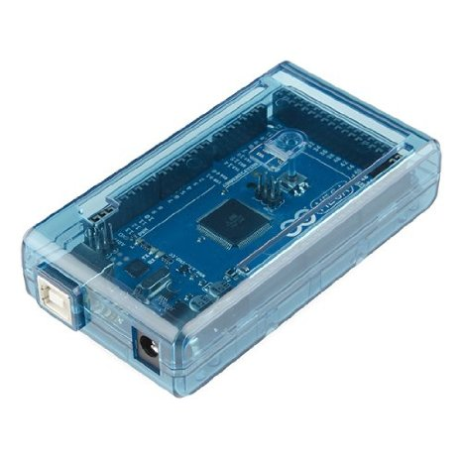
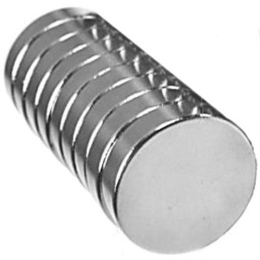
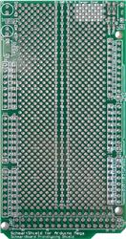
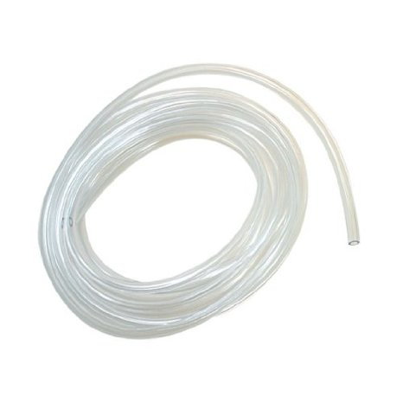
Secondary Purchase Items
Item | Item # | Manufacturer | Price Per Item | # | Total Cost
Arduino Mega Case | ASIN: B00D8J2UK8 | Amazon | $9.99 | 1 | $9.99
Magnets | ASIN: B001KV38ES | Amazon | $7.87 | 1 | $7.87
Grow Light | # 203124380 | Home Depot | $24.97 | 2 | $49.94
Breadboard for Mega | 872-206-0001-01 | Mouser | $13.00 | 1 | $13.00
Tubing | ASIN: B0002563MM | Amazon | $1.37 | 1 | $1.37
Total Cost: $82.17

Slide 19
Plan

Slide 20
Risks
System not properly waterproofed
Control system not adequately fine tuned
Power outages
Inconsistent nutrient film
Rapid water loss from evaporation
Grow lights will exceed budget

