Slide 1
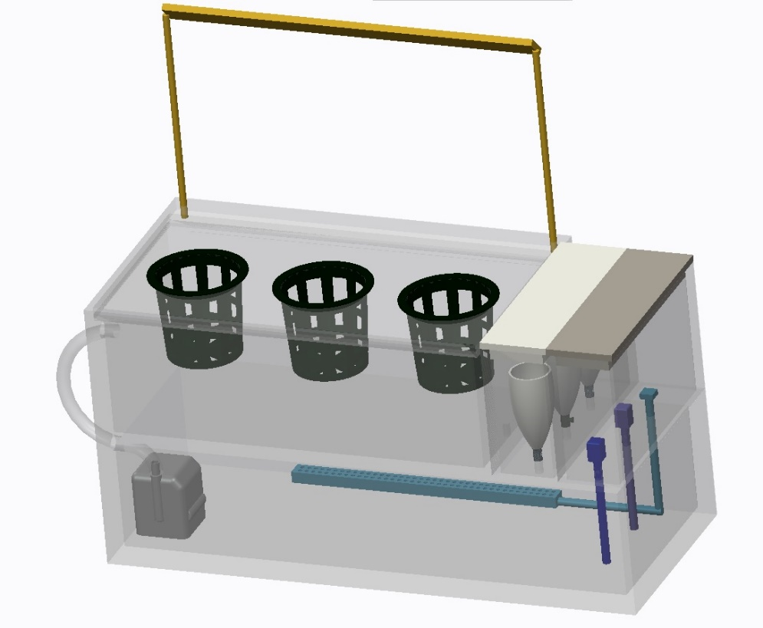
Autonomous Hydroponic Garden
Group JibJab:
Jamie Collier, Bikesh Dahal, Jessica Cohen, Ben Leblanc
11.19.2013

Slide 2
Project Description
Household autonomous garden
Hydroponic system to maintain specific plants
Tomatoes
Basil
Cilantro
Minimal user interaction (only maintain reservoir level)
Maximize health of plant and rate of growth
Key components:
Temperature
pH
Oxygen content
Light
Electrical Conductivity
Constraints
Size
User Interface
Cost

Slide 3
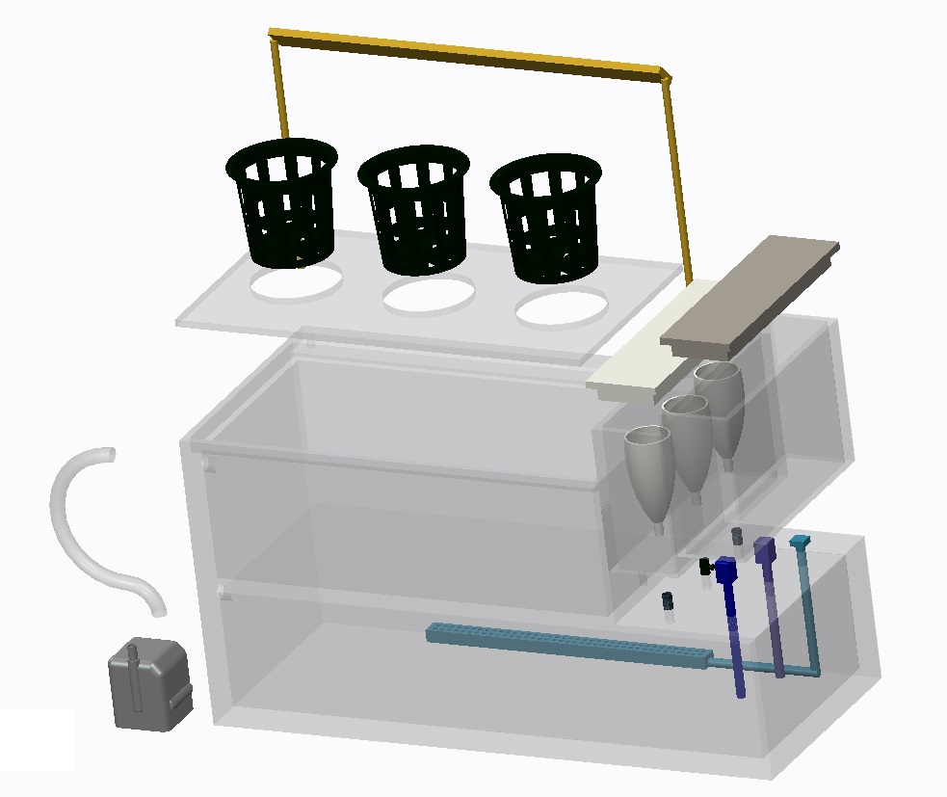
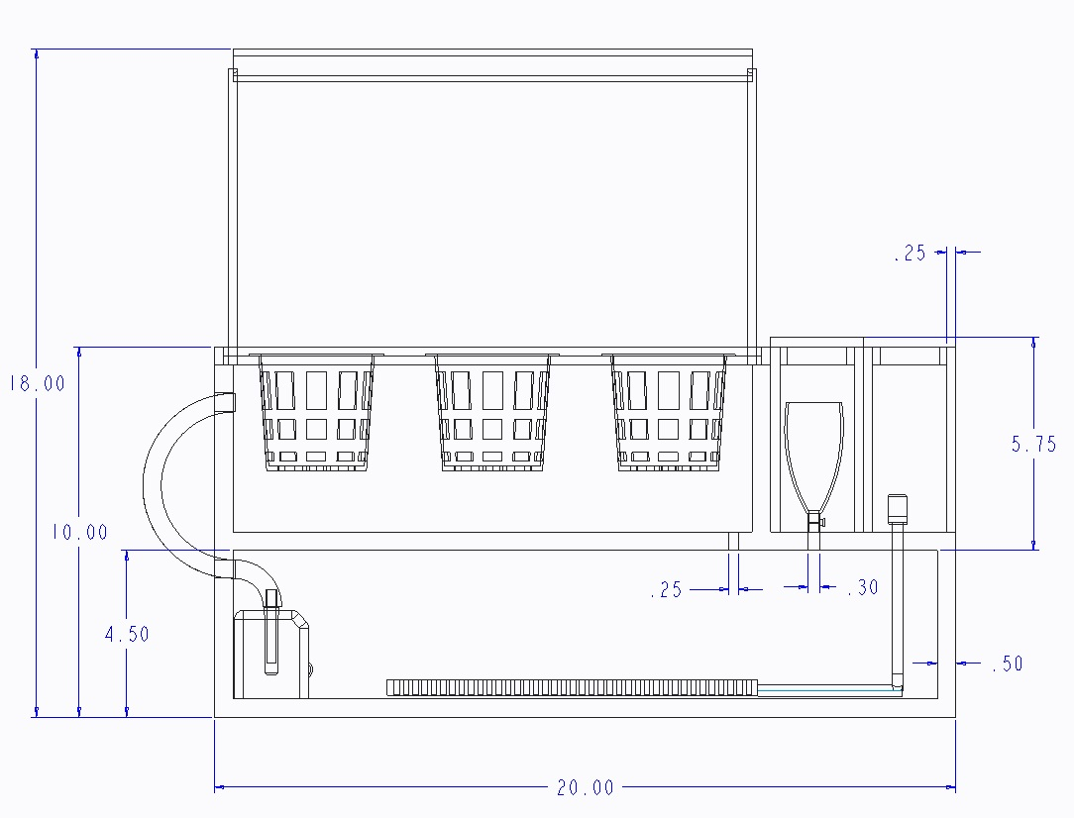
CAD Design – Overview
Lighting
Plant Cage
Nutrient Funnel
Top Reservoir
Electronics Box
Probes: pH, EC, Temperature
Water Pump
Bottom Reservoir
Air Stone
Valve
Units: inches
8” wide

Slide 4
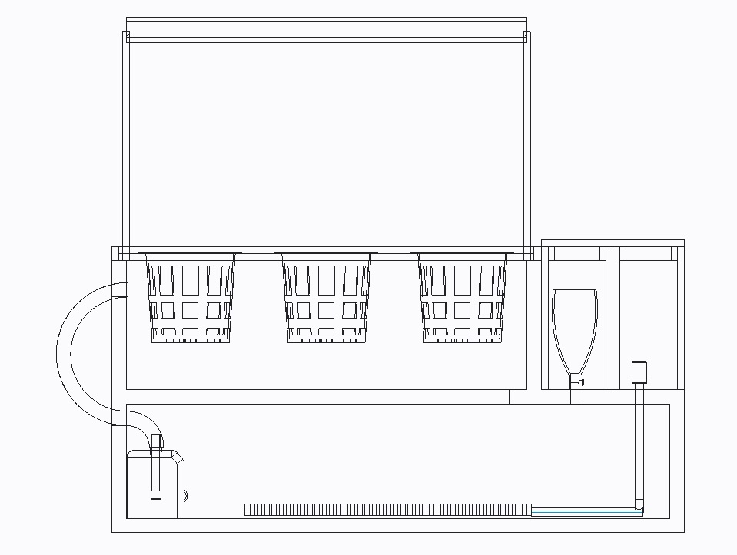
Direction of Flow

Slide 5
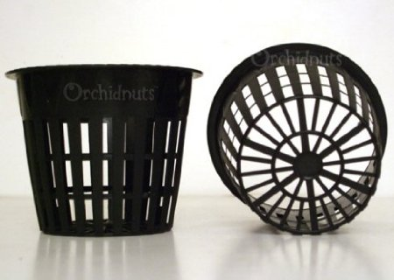
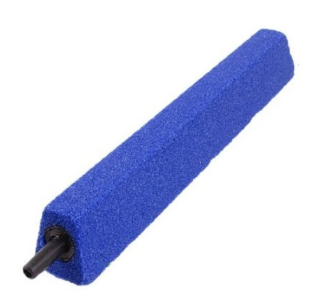
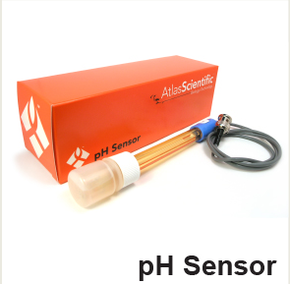
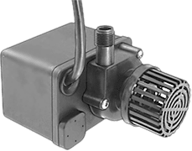
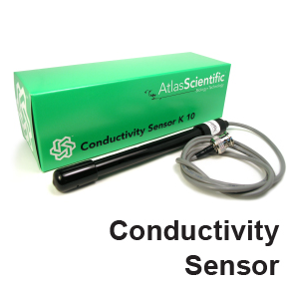
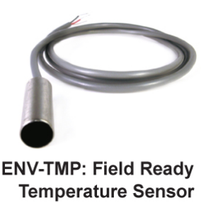
Purchased Parts
Parts | Price | Number needed | Total Price
3 inch round slotted mesh net (9 Pack) | 10.33 | 1 | 10.33
Hydroponic Grow Rocks | 22 | 1 packet | 22
Submersible pump | 100 | 1 | 100
Flexible tubing | 5 | 1 | 5
Air Stone / Air pump | 25 | 1 | 25
Solenoid valves | 30 | 4 | 120
pH, Temp, and EC sensors | 200 | 1 | 200
Arduino | 30 | 1 | 30
Solid-state relay | 18 | 1 | 18
LED grow light | 80 | 1 | 80
Total Price | - | - | 611
Air Stone
Mesh Net
Submersible Pump
Sensors

Slide 6
Levels of Success
Level 1: Monitor temperature and control light with display
Level 2: Monitor pH and electrical conductivity
Level 3: Control temperature
Level 4: Control pH and electrical conductivity
Level 5: IOS application with user interface

Slide 7
Associated Risks
Waterproofing system
Sealants and Glues
Rabbet Joints
Control systems
Slow enough settling time
Low overshoot
Feasible ranges for each component
Electrical Failure
Plant dies
Lower Cost Materials
Sensor Corrosion (predicted life)

Slide 8
Gantt Chart 1

Slide 9
Gantt Chart 2

Slide 10
Any Suggestions?

