Slide 1
Columbia University’s Advanced Concepts Data Center Pilot
June 6, 2011

Slide 2
Agenda
12:00pm Welcome and Opening Remarks
Bryan P. Berry, NYSERDA
1:00pm Advanced Concepts Data Center Pilot Project Highlights
Alan Crosswell, Chief Technologist, CUIT
2:00pm Project Review
Richard Hall, Project Director, CUIT
2:30pm Installation Summary
Ian Katz, Manager, CUIT Data Center
3:30pm Measurements and Results
Peter Crosta, Research Computing Services, CUIT
4:30pm Closing Comments
Victoria Hamilton, Research Initiatives Coordinator
5:00pm Meeting Adjourned
2

Slide 3
Welcome and Opening Remarks Bryan P. Berry, NYSERDA
Notes:
Nilda to introduce LK (15 min)
Rich to introduce JB

Slide 4
Advanced Concepts Data Center Pilot Project Highlights Alan Crosswell, Associate VP and Chief Technologist, CUIT
Notes:
DON’T FORGET TO REMIND EVERYONE WHY THY ARE HERE
Measurement drives behavior
Know what you are measuring – CUIT put in A LOT of measurement
“PUE not gold standard”

Slide 5
Conclusions
The ability to measure provides evidence to support
Improvements in daily operations
Sustainable long-term strategy
Hardware Refresh Policy shows measurable improvement
Advances in server technology render power tuning as obsolete
Long-term savings realized thru energy-efficiency must compete with project economies
Collaboration between Facility and IT departments is essential

Slide 6
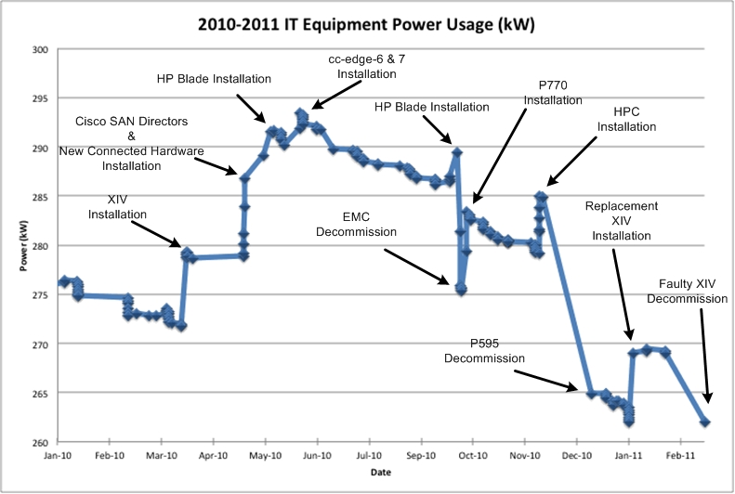
Accomplishments
Verified server energy efficiency improvements from January 2010 to March 2011: Increased load shows overlap between old and replacement equipment, followed by decreases when old equipment has been removed
Successful experiment with replacement of 30 old servers with newer, presumably more efficient models led to funding of an ongoing annual $500K project to aggressively consolidate and virtualize most servers over the next three years, and to maintain a steady state three-year refresh cycle
Notes:
Major changes happened when replacing two EMC storage systems with a higher capacity IBM XIV system and when two IBM p595 servers were replaced by two IBM p770 servers. Smaller dips indicate individual old servers being

Slide 7
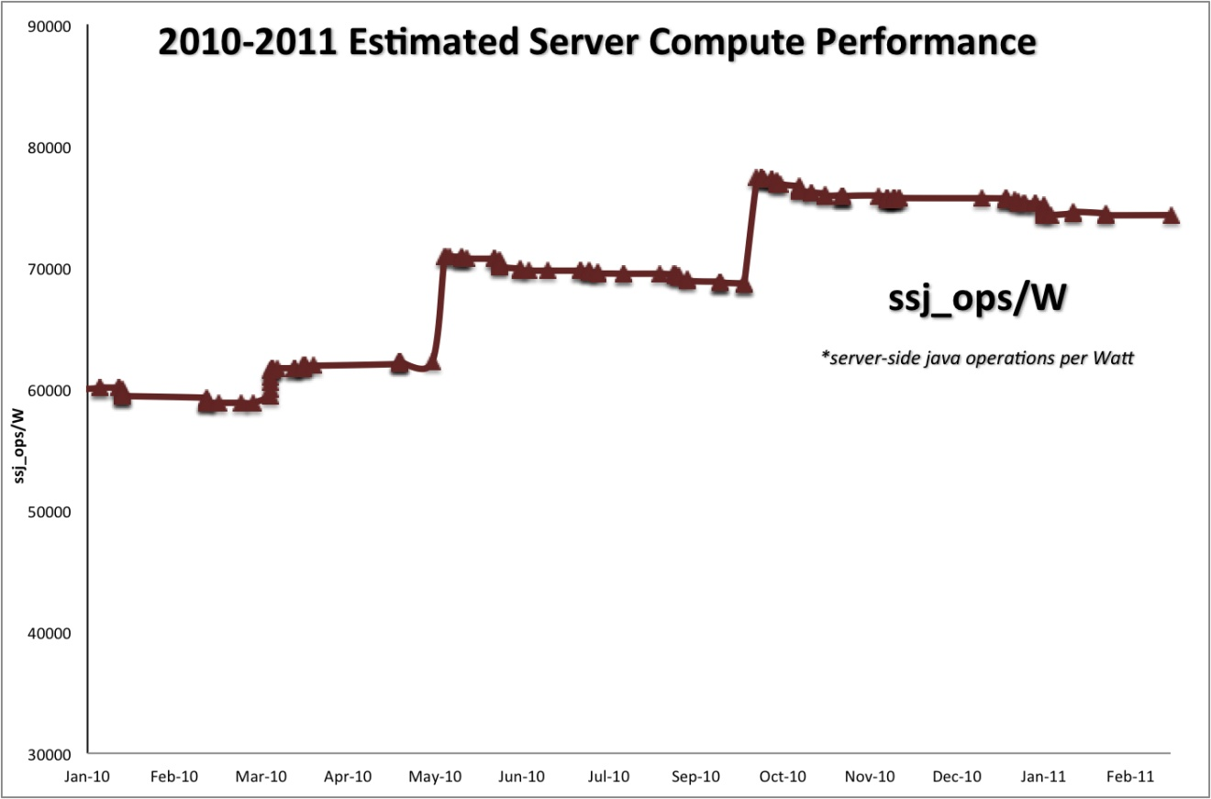
Accomplishments
Estimated server compute performance has increased approximately 20% while energy demand has been reduced

Slide 8
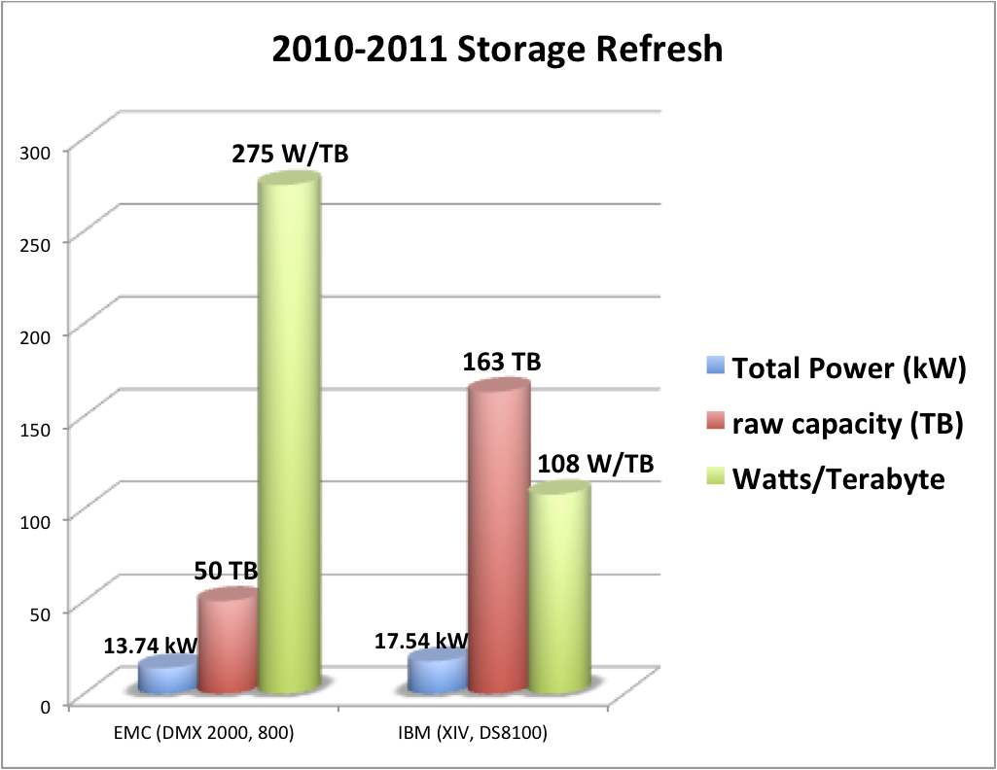
Accomplishments
OLD Storage NEW Storage
An enterprise storage refresh project also leveraged our newly green data center approach to (a) require the bidding vendors to document their energy efficiency as one of the selection criteria, and, (b) implement a new overhead cable distribution system to begin the (lengthy) process of removing under floor airflow blockages.
Notes:
Storage capacity increased 226% while increasing electrical load only 27%.

Slide 9
Accomplishments
Average IT Power Demand Load Reduction | 14.34 | kW
Annual kWh reduction due to IT equip (24h, 365d) | 125,601 | kWh
Total Facility Power Demand Reduction (PUE of 2.01) | 28.82 | kW
Total Annual kWh reduction | 252,458 | kWh
Estimated Annual Cost Savings ($.185 per kWh) | $46,705
Total Facility Carbon Footprint Reduction | 96.4 | Metric Tons of CO₂ Equivalent*
*Calculated using 0.00038180 MTCE/kWh
Server Consolidation and Storage Refresh Projects
88 machines installed
120 machines retired
Net decrease of 32 hardware devices
Notes:
Estimated Demand and Total Load Reduction

Slide 10
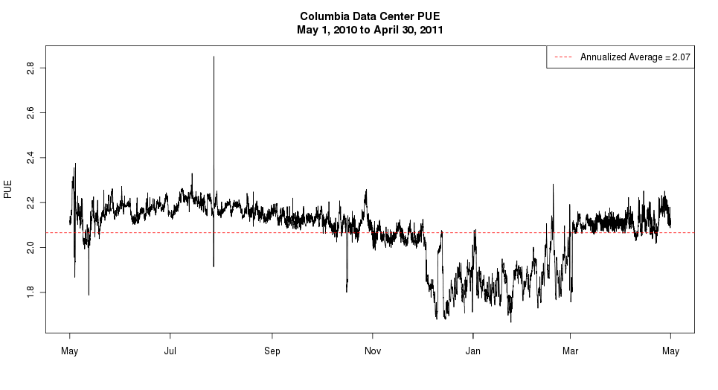
CUIT’s Power Usage Effectiveness (PUE)
7/27/10 - Chilled Water Outage
Extensive instrumentation for real-time measurements of electrical and cooling loads has enabled us to measure and calculate our Power Usage Effectiveness in real time, and to confirm seasonal variations in PUE thanks to use of air- and water-side economizing
Notes:
Need to know PUE to know if worth investment to improve – improving can save a lot money
There are cost effective improvements that don’t move PUE but save energy

Slide 11
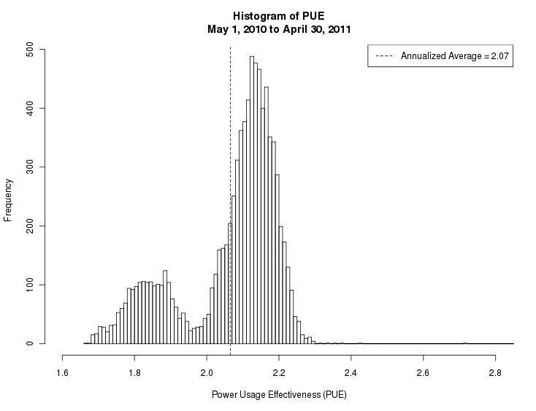
CUIT’s Power Usage Effectiveness (PUE)
Seasonal variation identifies
summer and winter PUE
PUE driven by
fluctuations in cooling load
IT load steadily decreasing;
though small impact on PUE

Slide 12
Dissemination of Findings
External Meetings & Publications:
07/19/11 – Global Strategic Management Institute’s Green Data Center Conference in Boston, MA
03/24/11 – Extreme Data Center Efficiency Summit in NY, NY
10/14/10 – Educause Annual Meeting, Anaheim, CA
06/14/10 – ACM SIGMETRICS GreenMetrics2010 Workshop
05/03/10 – NSF Workshop on Sustainable Cyberinfrastructure, Cornell University, Ithaca, NY
04/15/10 – cited in Educause ECAR Green IT study (See Sheehan and Smith, 2010)
03/03/10 – Datacenter Dynamics panel sponsored by NYSERDA, New York, NY
10/20/09 – Association of IT Professionals, Long Island Chapter meeting
10/06/09 – Internet 2 Member Meeting, San Antonio, TX
05/07/09 – cited in newly published book The Greening of IT: How Companies Can Make a Difference for the Environment by John Lamb (IBM Press)
03/04/09 – CANARIE Green IT workshop, Ottawa, Canada

Slide 13
Dissemination of Findings
CUIT Sponsored Meetings & Communication:
Open House/Workshop
A public “Winter Workshop” on Green Data Centers was held at the Columbia Faculty House on January 7, 2011, with an audience of roughly 50 information technology and facilities professionals and other higher education staffers from the New York metro area and elsewhere. Workshop attendees featured representatives from schools including CUNY, the Albert Einstein College of Medicine, the Rockefeller University, Pennsylvania State University, Princeton University, Yale University and the University of Chicago. The agenda and presentations for the workshop are available on the project blog .
Project Blog
http://blogs.cuit.columbia.edu/greendc/
Status Review Meetings
External Committee
Internal Advisory Committee
Working Group

Slide 14
Main Issue
Original goal: Pilot nine racks of high power density in-row cooling to test industry claims of cooling efficiency
Lessons learned
Equipment Manufacturers estimates may not incorporate infrastructure requirements
Close collaboration with Facilities key requirement
Conclusion
The goals of delivering both energy-efficient and reliable in-row cooling far exceed the budgeted funds.
Next Steps
Explore alternative HVAC efficiency improvements

Slide 15
Advanced Concepts Data Center Pilot Project - Review Richard Hall, Project Director, CUIT
Notes:
Insert page after here showing one-liners for each task.

Slide 16
CUIT’s NYSERDA project
New York State Energy Research & Development Authority is a public benefit corporation funded by NYS electric utility customers. http://www.nyserda.org
Columbia competed for and was awarded an “Advanced Concepts Datacenter demonstration project”. 18 months starting April 2009 (24 Months – per Change Order approved 6/1/11)
~ $1.2M ($447K Direct costs from NYSERDA)
Goals:
Research and test some industry best practices in a “real world” datacenter
Measure and verify claimed energy efficiency improvements.
Share lessons learned with our peers.

Slide 17
Scope of Work – Detail
To achieve the overall project objectives, CUIT has broken down the project into major tasks.
Inventory (task 2) – COMPLETE
Create detailed physical inventory of existing in-scope server
Instrument server power consumption (task 3) – COMPLETE
Install network monitored power monitors for each server
Perform data collection at 5-min intervals
Instrument server input air temperature and overall DC chilled water (task 4) - COMPLETE
Install server input ambient air temperature for each server
Install BTU metering on data center supply and return lines
Perform data collection at 5-min intervals
Establish overall Data Center profile (task 5) - COMPLETE
Utilize equipment load results to establish baselines
Develop PUE ratio for entire data center & inventoried servers
Implement 9 racks of high power density in-row cooling (task 6) – Change Request
17
17
Notes:
17
Task 1 is Project Management
First non-PM task is inventory – pilot is a sub-set of all servers in datacenter
Next, need to set-up monitoring infrastructure
Monitoring allows us to develop a baseline profile – will continue to change (seasonal, infrastructure improvements and consolidation (pilot and beyond project))
Besides TASK 2 – every task on slide emphasizes IT and Facilities collaboration
Monitoring electrical and HVAC
Implementing self-cooled racks requires electrical and HVAC infrastructure
Task 6 – in the middle of with vendor selection – all main players IBM, APC, Rittal and Liebert selection expected soon

Slide 18
Scope of Work Detail Cont’d
Replace 30 “old” servers and measure efficiency improvement (task 7) – COMPLETE
Consolidate the replacement servers into high density racks and re-implement the same IT services
Take measurements of before-and-after power consumption
Document expected and actual efficiency improvement
Compare old and new research clusters (task 8) – COMPLETE
Benchmark applications on new Astronomy/Statistics HPC cluster
Implement server power management (task 9) - COMPLETE
Install server BIOS/high level power management feature upgrades to servers (identified in task 2)
Increase chilled water set point and measure (task 10) - COMPLETE
Document measured before-and-after energy consumption
Communicate results (task 11) – On-going
Share results with key stakeholders
18
18
Notes:
18
Task 7 works from task 1
Task 10 – currently working with Facilities on exploring our options
Peter concentrating on 7,8 and 9 measuring energy & power consumption (comparing old and new).
Our team wants to, not only communicate accomplishments - but open up dialogue with you (our stakeholders)
We do this by highlighting what needs to be done to accomplish tasks – including collaboration between IT and facilities, the importance of creating the monitoring infrastructure and the importance of understanding how and what we are measuring to compare.
Ian will discuss the setup of the monitoring infrastructure and the work involved with facilities
Peter will discuss the tools and initial results of our comparison analysis

Slide 19
Infrastructure Update Ian Katz, Data Center Facilities Manager, CUIT

Slide 20
Change Request
CUIT proposed a revised project scope for Task 6 and no-cost extension of 12 months
Modify Task 6 related to HVAC efficiency
Investigate the feasibility and, if feasible, implement other HVAC efficiency possibilities
Specific tasks
Base Computational Fluid Dynamics (CFD) analysis
Projected CFD analysis incorporating several options:
Removal of under floor blockages
Addition of CRAC return air ducting
Addition of hot aisle curtain containment
Energy savings projections
Conceptual drawings
Overhead electrical bus distribution.
HVAC CRAC return ducting.
HVAC curtain containment.
Coordinated HVAC CRAC control system.
Budget estimates for above options
If feasible, implementation one or more of the above

Slide 21
Computational Fluid Dynamics (CFD) Analysis
CFD Modeling Objectives
Improve data center efficiency and effectiveness
Develop optimized airflow and control strategies
CFD Modeling Assumptions
All CRAC units operate independently to maintain underfloor air pressure
IT loads based upon existing readings
Modeling Scenarios
Existing layout as baseline
Future layout with reconfigured hot and cold aisles

Slide 22
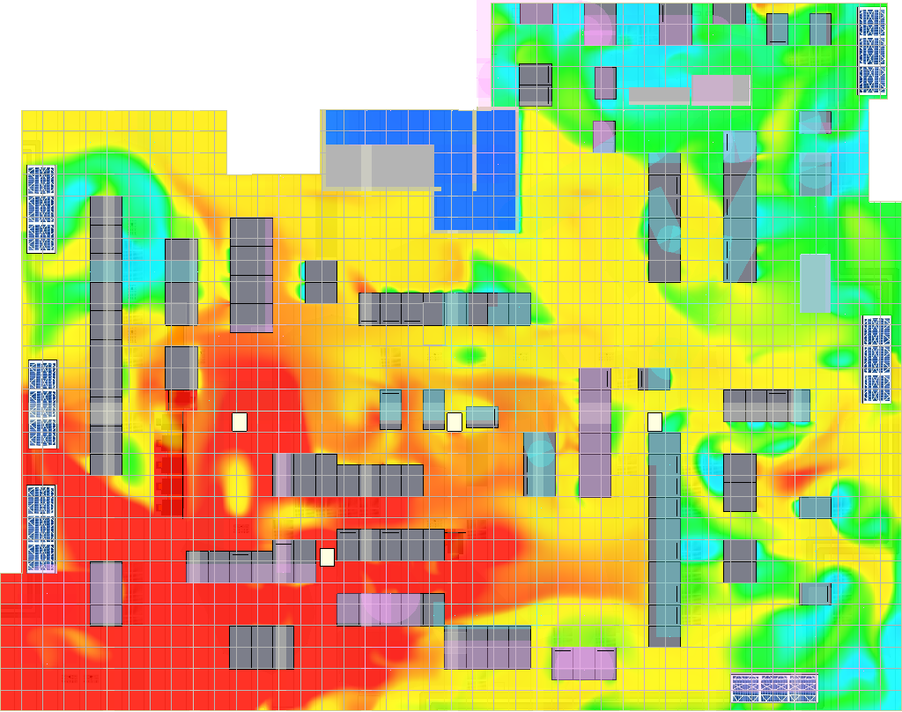
Temperature Profile
Results – Baseline Model
Temperature profile at 6’-0” shows heat load returning to CRAC units through other equipment.
Cold spots and hot spots define problem areas.
Temperature Profile @ 6’-0”

Slide 23
Velocity and Pressure Profiles
Underfloor cabling chokes off airflow to the middle of the room
Pressure highest at CRAC units indicated that units are overworked and underperforming
Velocity Profile @ -4”
Pressure Profile @ -4”

Slide 24
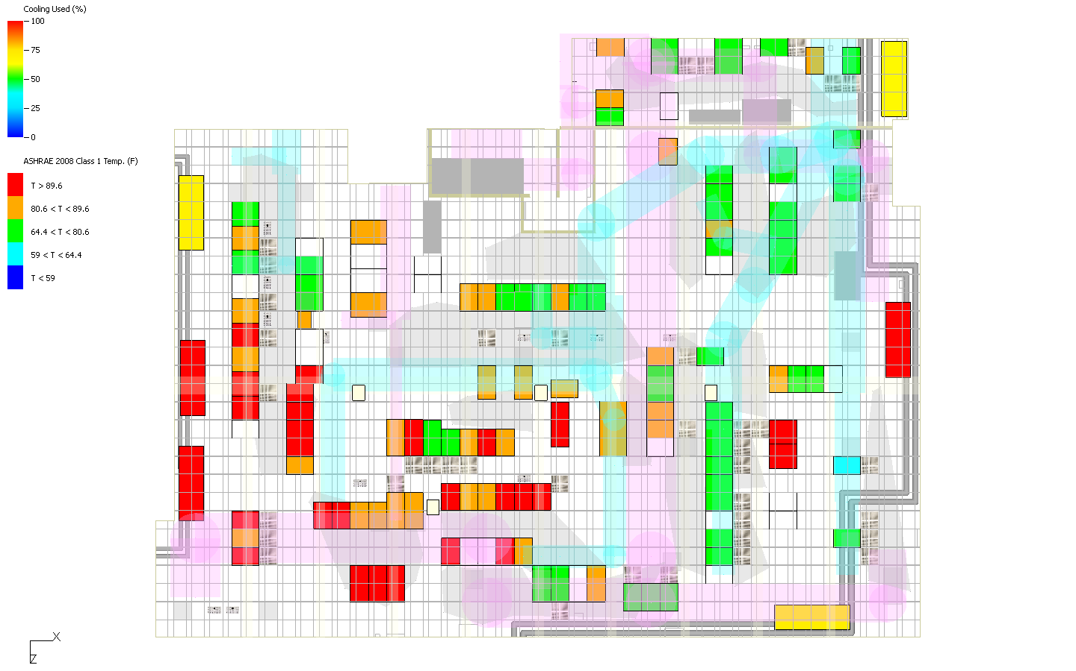
Results – Baseline Model
ASHRAE Cabinet Compliance determines the highest inlet temperatures and considers anything over 80F as failing.
Cabinets in areas of hot air recirculation tend to fail ASHRAE compliance.
Cooling percentage is highest with warmest return air temperatures.
CRAC Cooling % / ASHRAE Cabinet Compliance

Slide 25
CFD Conclusions
This report serves as a progress set to make any changes required before future data center layout is solved.
Existing data and power cabling below the raised flow proves its debilitating effects on the airflow.
Cabinet placement is crucial to avoid recirculation of hot air and improve ASHRAE compliance.
More information to come on projected energy savings.

Slide 26
Summary of Measurements and Results Peter Crosta, Research Computing Services, CUIT

Slide 27
Overview - Server Power Analysis
Comparing power consumption of old and new(er) hardware
High performance computing (HPC) cluster power consumption comparison
Power management and tuning
Notes:
Try not to repeat too much of what you saw last year, but review of some previous results and some newer results
NEXT: out with the old…

Slide 28
Server-level changes in power consumption
If we replace old servers with new servers, how will power consumption change?
Measurement Plan
Inventory servers
Determine comparison groups
Two-tiered power measurement strategy
1) Pre/post migration comparison
2) SPECpower benchmark
Notes:
Though we did a lot of macro and data center-wide analysis, we also went to the micro level and looked at individual pieces of hardware.
The main idea here is to replace older, less energy efficient servers with newer, more energy efficient hardware
Theory: 2 big ideas:
- 1. newer hardware can consume less energy at baseline (while idle or just turned on)
- When a processor is run at a lower frequency (speed), it generates less heat and consumes less power
- Achieved by SpeedStep in Intel Cores or PowerNow speed throttling in AMD laptop processors or Cool’n’Quiet for Desktops/servers
- 2. Newer hardware consumes less energy than older hardware when performing work
- Might be able to get more done, do more calculations, for a given amount of power
- We might think of a measure of efficiency such as performance per watt of power consumed: Can we get the same amount of work done by providing less energy input?
1) We first took an inventory of all the servers that were slated to be retired or replaced, and we noted the associated IT services. Some services are scheduled to be moved to brand new hardware such as blades, while other services will be migrated to just new-er hardware. Some servers are to be retired and not replaced, while others have already been replaced as this is a operating data center. Advice: Living document with versioning. This changes frequently
2) We used the inventory to come up with a suite of service comparison groups consisting of several examples of these old-to-new server transitions. For this task, we focus on services - such as web hosting, database, and e-mail - that are to be migrated from older hardware to new or newer hardware. We selected a sample of 10 groups, many of which would be replicated several times. We sought to include a variety of service and hardware types.
3) We then approached power consumption measurement from 2 directions
4) pre/post migration comparison – to measure power consumed while performing specific IT services
5) SPECpower benchmark (ssj_ops) – to look at idle power consumption and to have a standard measure of performance that can help compare hardware types
I will go into MORE DETAIL on both of these
NEXT: pre/post migration

Slide 29
Pre/post migration comparisons
Power consumption of same IT services on different hardware
Migration
Old server
New server
Time
Linux-Apache-MySQLP-PHP (LAMP) Example:
Old Server | Standalone DL360 G5p
New Server | Blade BL460 CG6
Old Watts (Week Avg) | 241 W
New Watts (Week Avg) | 170 W
Notes:
For each of the 10 service groups, we will do the following
Collect a typical weeks worth of power consumption data before the service moves to new hardware
Then perform the migration
Collect another typical weeks worth of power consumption data after the service has been migrated
Since loads may vary throughout the year, we plan to look at a typical week during the semester that may provide a decent representation of power consumption
This comparison will enable us to calculate the total amount of energy used to perform the IT service in that time period, and we can extrapolate from there.
FOR EXAMPLE: LAMP
Old server from 4/2007.
New server from 7/2009.
30% less power used after change to blade infrastructure
Next: Graph of DL360 G5p power consumption over typical week

Slide 30
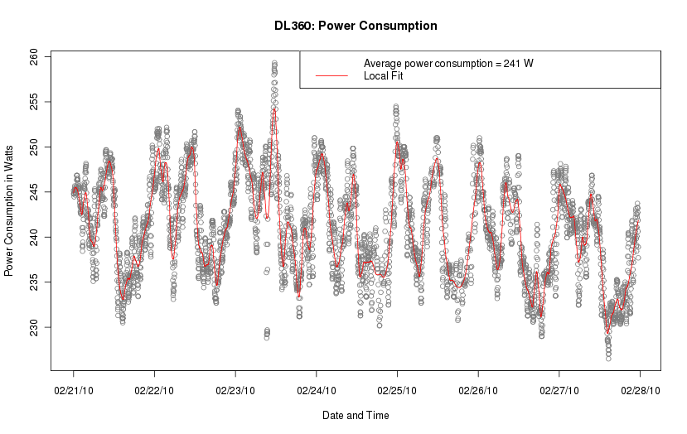
Notes:
Example power usage profile of server
AXES!!!
What we learn: daily cycles – 2 highs per day, weak bowing pattern (inverted U) throughout week, average power consumption 241W
Feb 21 is a Sunday
NEXT: Graph of BL460 typical week

Slide 31
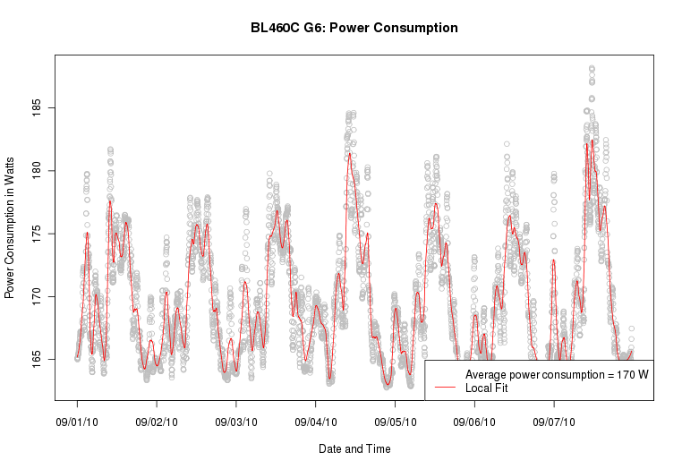
Notes:
Sep 5 is a Sunday
This is blade only, chassis ignored here.
What we learn: slightly different pattern when moved to a blade. One peak per day
NEXT: And the 2nd way to look at these changes: SPECpower…

Slide 32
SPECpower benchmark
Industry standard benchmark to evaluate performance and power
Addresses the performance of server side Java
Finds maximum ssj_ops (server side Java operations per second)
With simultaneous power measurement, allows calculation of ssj_ops / watt (performance per watt)
Notes:
We chose the SPECpower benchmark as a way of comparing equipment: traditional servers vs. blades, for example
1 SPEC is the Standard Performance Evaluation Corporation – a nonprofit, nonaligned, industry standard, widely used by (IBM, Sun, Dell, HP, etc). First came out in December 2007.
2 Performance of server side java:
- Runs Java program that Exercises CPUs, caches, memory hierarchy, garbage collection, etc …
3 The benchmark’s goal is to find the maximum ssj_ops – server side Java operations per second
4 Allows calculation of performance / watt when simultaneously measuring power
- SPECpower provides an idle period for active idle power measurement as well as several load levels for power consumption measurements at different machine states.
- There will be 11 SPECpower results in total because we will be running the benchmark on 11 different types of equipment . We will combine these with the pre/post migration results to get a more complete picture of how power consumption changed due to the service migration
======
Now I am going to show two examples of benchmark results that were run on two different machines.
NEXT: Sample SPECpower comparison might look like

Slide 33
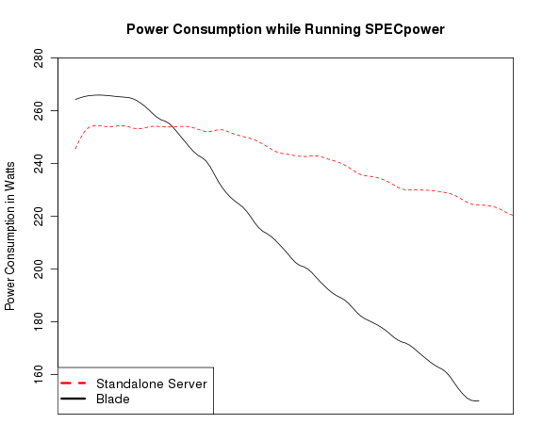
Example SPECpower comparison
DL360 G5p standalone server
Max: 255 W
Idle: 221 W
Overall ssj_ops/W: 139
BL460 G6 Blade
Max: 266 W
Idle: 150 W
Overall ssj_ops/W: 600
Standalone server
Blade
100%
50%
Idle
Load (Time)
SPECpower benchmarks only valid for internal CUIT comparisons.
Results were smoothed for visual clarity.
Notes:
This slide shows type of data we were able to gather from measurement database and SPECpower benchmark.
AXES!
Explain different slopes related to the way servers respond to energy needs
This is why we like blades/newer hardware: nice response to decreased load
Additional Specific examples of Efficiency gains from retiring and upgrading hardware:
Libraries application server moved from host drawing a weekly average of 1674 W to a host drawing 539 W.
Reconfiguration of mail storage required half as many servers, yielding savings of 3680 W
Next: SPEC on Casaba

Slide 34
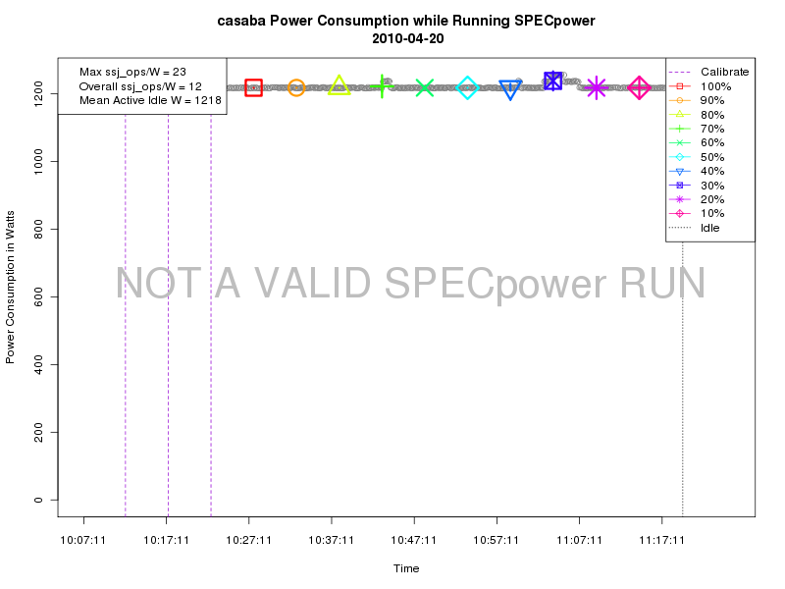
Not all SPECpower results look like that: Sun Sunfire V880
Notes:
This is casaba – a Sun Sunfire V880 from 2002
Vertical axis here goes from 0 to 1200 W
Horizontal Axis is time again
- Different pattern than last graphs
-With this server, like many older ones, we learned that there are only two settings: ON and OFF
At idle: 1218 W
Overall ssj/W: 12
Performance per watt: 23 ssj_ops / W
{Manuf max power 1500 W, 825 @55%}
NEXT: Summary

Slide 35
Power measurement summary
Designed plan to measure old and new server power consumption in multiple ways.
Energy consumed while running the same IT services
Performance per watt of power used (SPECpower)
Power usage improvements noted in most cases of moving a service from older to newer hardware – especially when moved to blades.
Used analysis sample to construct aggregate measures for data center (as Alan showed earlier)
Notes:
I only showed one example, others in final report
Next: CLUSTER COMPARISON

Slide 36
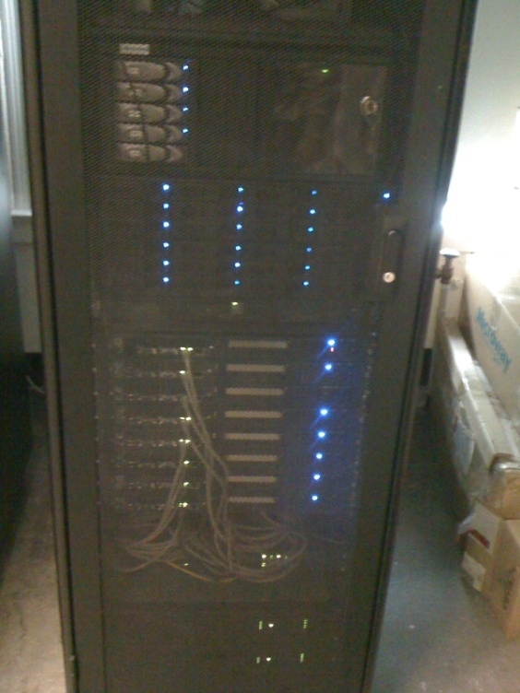
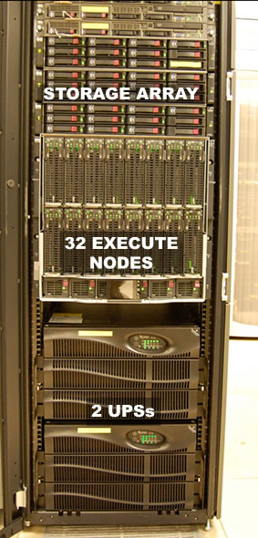
Cluster comparison
Can a new, larger research cluster be more energy efficient than an older, smaller research cluster?
Beehive
Hotfoot
Notes:
Beehive: named for Praesepe or Beehive Cluster or stars in the constellation Cancer about 577 light years away
Hotfoot: named for the first sled dog to win the Iditarod

Slide 37
The clusters
Beehive
Built in 2005
16 cores
8 standalone servers
Dual-core 2.2 GHz AMD Operton
2 to 8 GB RAM
10 TB SATA storage
OpenPBS scheduler
Theoretical Peak GFlops: 61
IDLE POWER IN WATTS: 2.7 kW
Hotfoot
Built in 2009
256 cores
16 high-density blades (2 servers each)
Dual quad-core 2.66 GHz Intel Xenon
16 GB RAM
30 TB SATA storage
Condor scheduler
Theoretical Peak GFLops: 2724
IDLE POWER IN WATTS: 4.1 kW
Notes:
Here are some basic stats on the two clusters
Beehive in Physics building; Hotfoot in DC
{44.37 Watts per TPeak GFlops for Beehive}
{1.52 Watts per TPeak Gflops for Hotfoot }
NEXT: Cluster Comparison Plan

Slide 38
Cluster comparison plan
Power use in active idle state
Beehive = 2.7 kW
Hotfoot = 4.1 kW
Energy consumption while running research tasks or proxies
Counting to one billion
Summing primes from 2 to 2 million (MPI)
Summing primes from 2 to 15 million (MPI)
Notes:
Now we already showed idle power usage, but measuring power in active idle state only tells half the story.
We really want see how the systems differ while performing the same tasks
- How do we put systems at load? Well, we chose three jobs to run while measuring power…
{ Why not SPEC or HPL suite (sicortex)? (we did not have access to SPEC when doing the cluster comparisons, HPL is focused on seeing how fast a computer can go, not necessarily concerned with power, sicortex out of business, green500 uses linpack (runs pretty short) ) }
NEXT: T8 Results

Slide 39
New cluster uses less energy to run jobs
Notes:
Note: since jobs ran over a period of time, we now report energy used in Wh or kWh rather than power consumption in Watts
1: count to one billion
2: mpi sum primes to 2 million (14 slots)
3: mpi sum primes to 15 million (14 slots)
4: mpi sum primes to 15 million (256 slots on hotfoot)
NEXT: T8: Summary

Slide 40
Power tuning
Implement server-, BIOS-, OS-level power tuning and power management
Re-run benchmarks and service group comparisons to collect additional power usage data
Notes:
Not many opportunities to power tune,
Most servers did not have capabilities: only newer blades and DL380 G5.
TALK THROUGH SPECpower results
Blade: Default power with SPEcpower between 100 and 200 W
Performance: between 150 and 220 W
Conservative: between 100 and 150 W
Best benchmark score on default setting
Next: EE cluster

Slide 41
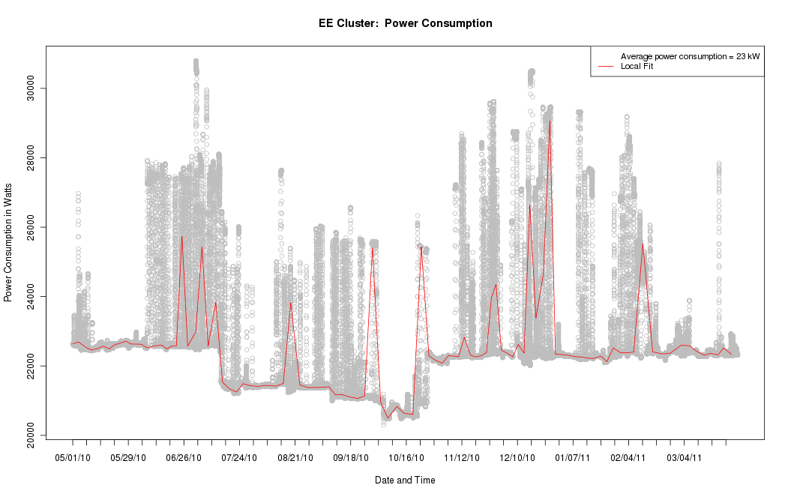
Electrical Engineering Cluster – Unable to be tuned
Notes:
Next blade tuning

Slide 42
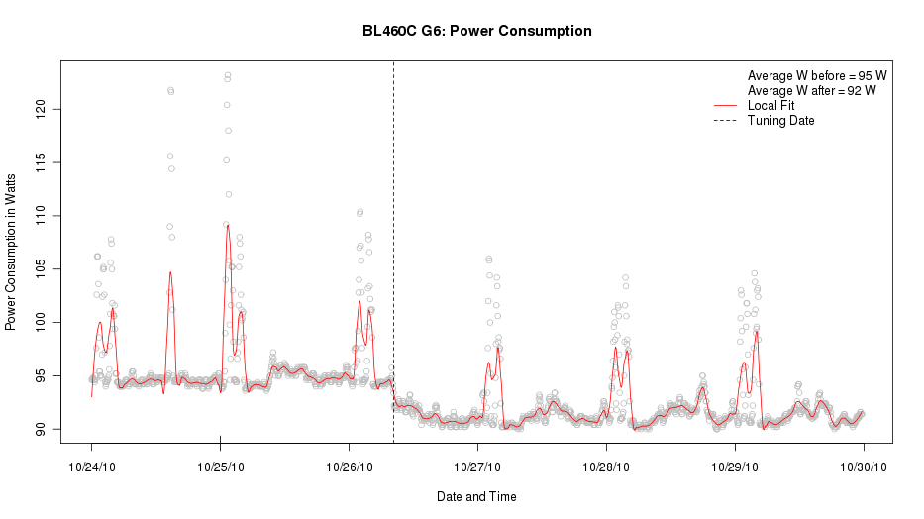
Blade power tuning example
Notes:
Blade put into conservative power mode on 10/26.
Note drop inaverage power level from about 95 to 92 W
Not a lot, but something
DONE. To Victoria.

Slide 43
Closing Comments Victoria Hamilton, Director of Research Initiatives, Office of the Executive Vice President for Research (OEVPR)

Slide 44
Thank You, NYSERDA
Thanks to many groups around Columbia and within CUIT
Departments of Statistics and Astronomy & Astrophysics
Columbia University Facilities
CUIT Data Center Facilities and Operations, Network Operations and Engineering, Systems Operations and Engineering, Research Computing Services, Classroom & Desktop Engineering, and the Project Management Office
This work is supported in part by the New York State Energy Research and Development Authority (NYSERDA agreement number 11145). NYSERDA has not reviewed the information contained herein, and the opinions expressed do not necessarily reflect those of NYSERDA or the State of New York.
Notes:
Get nyserda disclaimer

