Slide 1

Greening Computing
Data Centers and Beyond
Christopher M. Sedore
VP for Information Technology/CIO
Syracuse University

Slide 2
Computing “Greenness”
What is Green?
  Energy efficient power and cooling?
  Carbon footprint?
  Sustainable building practice?
  Efficient management (facility and IT)?
  Energy efficient servers, desktops, laptops, storage, networks?
  Sustainable manufacturing?
  All of the above…

Slide 3
Measuring Green in Data Centers
PUE is the most widely recognized metric
  PUE = Total Facility Power / IT Power
PUE is an imperfect measure
  Virtualizing servers can make a data center’s PUE worse
  PUE does not consider energy generation or distribution
No “miles per gallon” metric is available for data centers: “transactions per KW”, “gigabytes processed per KW”, “customers served per KW” would be better if we could calculate them
The Green Grid (www.thegreengrid.org) is a good information source on this topic

Slide 4
A New Data Center
Design requirements
  500KW IT power (estimated life 5 years, must be expandable)
  6000 square feet (estimated life 10 years)
  Ability to host departmental and research servers to allow consolidation of server rooms
  Must meet the requirements for LEED certification (University policy)
  SU is to be carbon neutral by or before 2040 – new construction should contribute positively to this goal
So we need to plan to use 500KW and be green…

Slide 5
Design Outcomes
New construction of a 6000 square foot data center
Onsite power generation – Combined Cooling Heat and Power (CCHP)
DC power
Extensive use of water cooling
Research lab in the data center
We will build a research program to continue to evolve the technology and methods for ‘greening’ data centers

Slide 6
SU’s GDC Features
ICF concrete construction
12000 square feet total
6000 square feet of mechanical space
6000 square feet of raised floor
36” raised floor
~800 square feet caged and dedicated to hosting for non-central-IT customers
Onsite power generation
High Voltage AC power distribution
DC Power Distribution (400v)
Water cooling to the racks and beyond

Slide 7
Onsite Power Generation

Slide 8
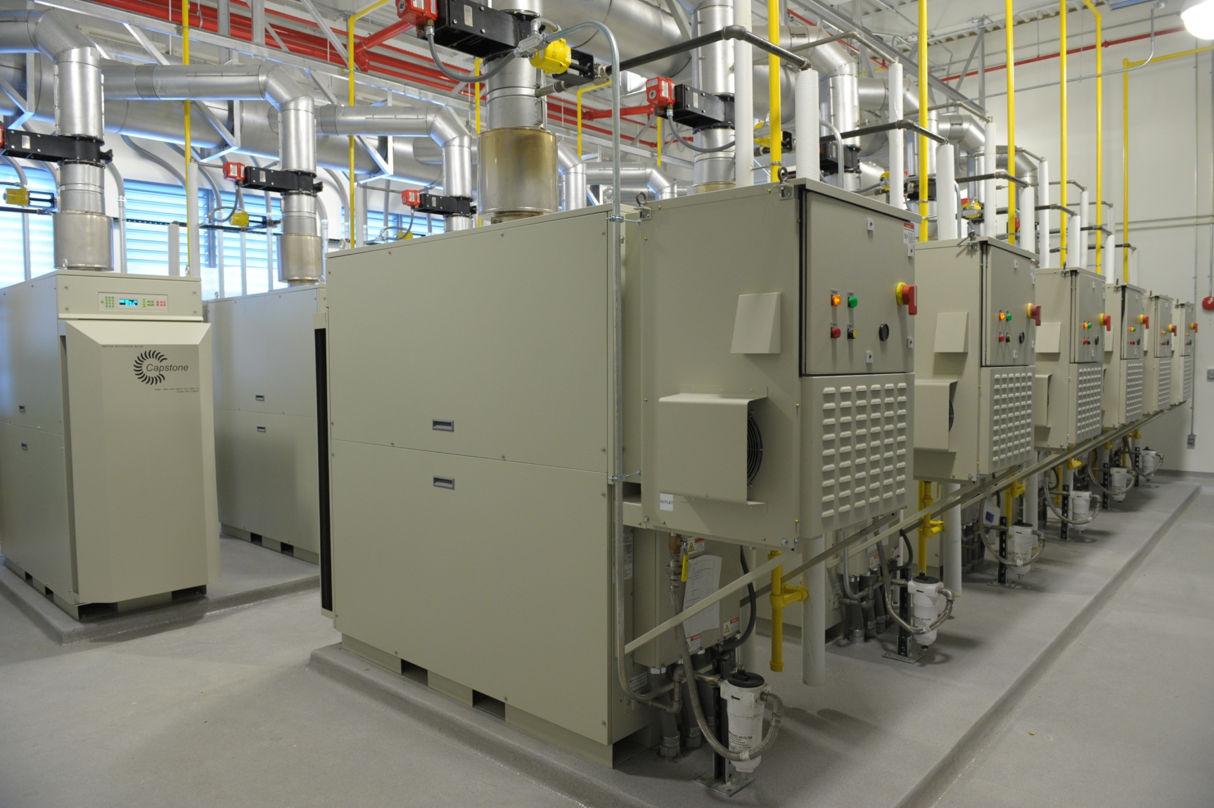
Microturbines

Slide 9
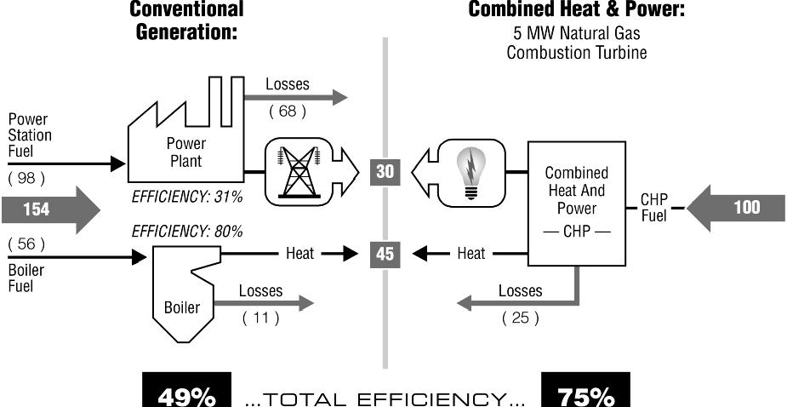
Why Onsite Power Generation?
This chart from the EPA (EPA2007) compares conventional and onsite generation.

Slide 10
Evaluating Onsite Generation
Several items to consider
  “Spark spread” – the cost difference between generating and buying electricity
  Presence of a “thermal host” for heat and/or cooling output beyond data center need
  Local climate
  Fuel availability
CCHP winning combination is high electricity costs (typically > $0.12/kwh), application for heat or cooling beyond data center needs, and natural gas at good rates
PUE does not easily apply to CCHP

Slide 11
AC Power Systems
Primary AC system is 480 3ph
Secondary system is 240v/415v
All IT equipment runs on 240v
Each rack has 21KW of power available on redundant feeds
240v vs. 120v yields approximately 2-3% efficiency gain in the power supply (derived from Rasmussen2007)
Monitoring at every point in the system, from grid and turbines to each individual plug
The turbines serve as the UPS

Slide 12
Is High(er) Voltage AC for You?
If you have higher voltage available (240v is best, but 208v is better than 120v)
  During expansion of rack count
  During significant equipment replacement
What do you need to do?
  New power strips in the rack
  Electrical wiring changes
  Staff orientation
  Verify equipment compatibility

Slide 13
DC Power System
400v nominal
Backup power automatically kicks in at 380v if the primary DC source fails
Presently running an IBM Z10 mainframe on DC
Should you do DC? Probably not yet…

Slide 14
Water Cooling
Back to the future!
Water is dramatically more efficient at moving heat (by volume, water holds >3000 times more heat than air)
Water cooling at the rack can decrease total data center energy consumption by 8 - 11% (PG&E2006)
Water cooling at the chip has more potential yet, but options are limited
  We are operating an IBM p575 with water cooling to the chip

Slide 15
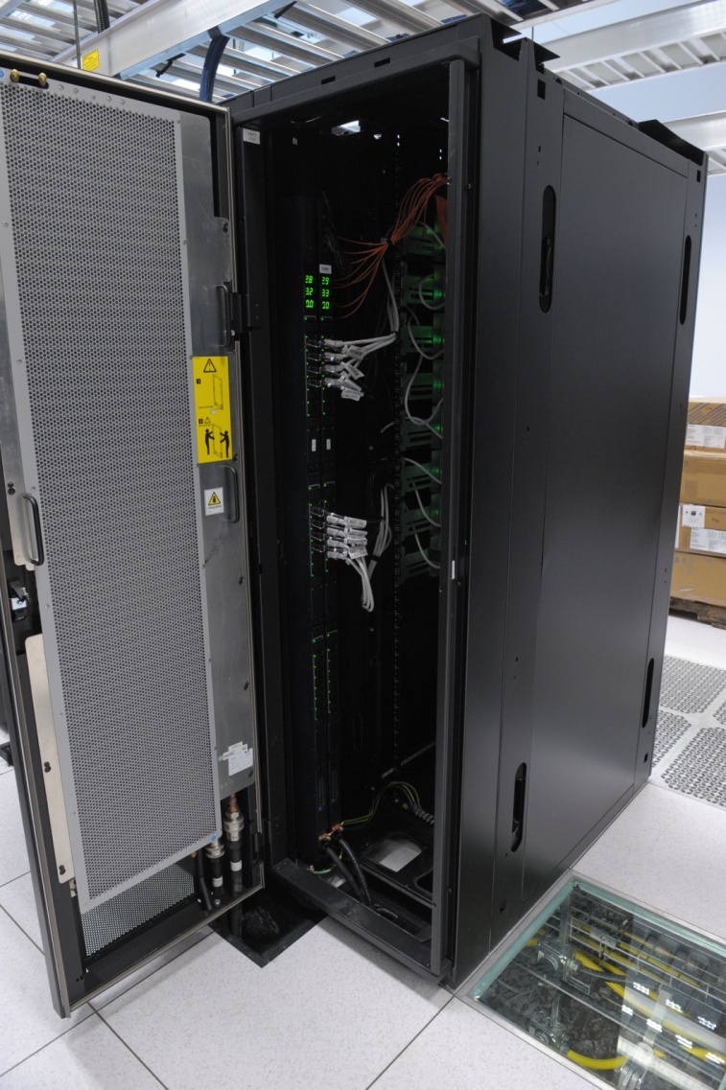
Water Cooling at the Rack
Rear door heat exchangers allow an absorption up to 10KW of heat
Server/equipment fans blow the air through the exchanger
Other designs are available, allowing up to 30KW heat absorption
No more hot spots!

Slide 16
When Does Water Cooling
Make Sense?
A new data center?
  Always, in my opinion
Retrofitting? Can make sense, if…
  Cooling systems need replacement
  Power is a limiting factor (redirecting power from your air handlers to IT load)
  Current cooling systems cannot handle high spot loads

Slide 17
Hot Aisle/Cold Aisle and Raised Floor
We did include hot aisle/cold aisle and raised floor in our design (power and chilled water underfloor, network cabling overhead)
Both could be eliminated with water cooling, saving CapEX and materials
Elimination enables retrofitting existing spaces for data center applications
  Reduced ceiling height requirements (10’ is adequate, less is probably doable)
  Reduced space requirements (no CRACs/CRAHs)
  Any room with chilled water and good electrical supply can be a pretty efficient data center (but be mindful of redundancy concerns)
Research goals and relative newness of rack cooling approaches kept us conservative…but SU’s next data center build will not include them

Slide 18
Other Cooling
Economizers – use (cold) outside air to directly cool the data center or make chilled water to indirectly cool the data center. Virtually all data centers in New York should have one!
VFDs – Variable Frequency Drives – these allow pumps and blowers to have speed matched to needed load
A really good architectural and engineering team is required to get the best outcomes

Slide 19
Facility Consolidation
Once you build/update/retrofit a space to be green, do you use it?
The EPA estimates 37% of Intel-class servers are installed in server closets (17%) or server rooms (20%) (EPA2007)
Are your server rooms as efficient as your data centers?

Slide 20
Green Servers and Storage
Ask your vendors about power consumption of their systems … comparisons are not easy
Waiting for storage technologies to mature– various technologies for using tiered configurations of SSD, 15k FC, and high density SATA should allow for many fewer spindles
Frankly, this is still a secondary purchase concern—most of the time green advantages or disadvantages do not offset other decision factors

Slide 21
Virtualization
Virtualize and consolidate
  We had 70 racks of equipment with an estimated 300 servers in 2005
  We expect to reduce to 20 racks, 60-80 physical servers, and we are heading steadily toward 1000 virtual machines (no VDI included!)
Experimenting with consolidating virtual loads overnight and shutting down unneeded physical servers
Watch floor loading and heat output
Hard to estimate the green efficiency gain with precision because of growth, but energy and staffing have been flat while OS instances have tripled+

Slide 22
Network Equipment
Similar story as with servers—ask and do comparisons, but does not usually drive against other factors (performance, flexibility)
Choose density options wisely (fewer larger switches is generally better than more smaller ones)
Consolidation – we considered FCoE and iSCSI to eliminate the Fiber Channel network infrastructure…it was not ready when we deployed, but we are planning for it on the next cycle

Slide 23
Datacenter results to date…
We are still migrating systems to get to minimal base load of 150kw, to be achieved soon
Working on PUE measurements (cogen complexity, thermal energy exports must be addressed in the calculation)
We are having success in consolidating server rooms (physically and through virtualization)

Slide 24
Green Client Computing
EPEAT, Energy Star…
Desktop virtualization
New operating system capabilities
Device consolidation (fewer laptops, more services on mobile phones)
Travel reduction / Telecommuting (Webex/Adobe Connect/etc)

Slide 25
Green Desktop Computing
Windows XP on older hardware vs Windows 7 on today’s hardware

Slide 26
Green Desktop Computing
Measuring pitfalls…
In New York, energy used by desktops turns into heat—it is a heating offset in the winter and an additional cooling load (cost) in the summer
ROI calculation can be complicated

Slide 27
Green big picture
Green ROI can be multifactor
Greenness of wireless networking: VDI + VoIP + wireless = significant avoidance of abatement, landfill, construction, cabling, transportation of waste and new materials, new copper station cabling
Green platforms are great, but they need to run software we care about—beware of simple comparisons

Slide 28
Green big picture
Green software may come about
It is hard enough to pick ERP systems, adding green as a factor can make a difficult decision more difficult and adds to risks of making it wrong
Cloud – theoretically could be very green, but economics may rule (think coal power plants—cheaper isn’t always greener)
Know your priorities and think big picture

Slide 29
Questions?

Slide 30
References
EPA2007 Report to Congress on Server and Data Center Energy Efficiency http://www.energystar.gov/ia/partners/prod_development/downloads/EPA_Datacenter_Report_Congress_Final1.pdf accessed June 2010
Rasmussen2007 N. Rasmussen et al “A Quantitative Comparison of High Efficiency AC vs DC Power Distribution for Data Centers” http://www.apcmedia.com/salestools/NRAN-76TTJY_R1_EN.pdf accessed June 2010
PG&E2006 Pacific Gas and Electric 2006 “High Performance Data Centers: A Design Guidelines Sourcebook” http://hightech.lbl.gov/documents/DATA_CENTERS/06_DataCenters-PGE.pdf accessed June 2010

