Slide 1
Columbia University’s Green Data Center Winter Workshop Agenda – January 7, 2011
9:00am Registration & Breakfast
9:30 – 10:15 Welcome and Opening Remarks
10:30 – 11:15 Data Center Best Practices - Electrical and Cooling Overview
11:30 – 12:30 Columbia University’s Advanced Concepts Data Center Pilot
12:30– 1:30pm Lunch
1:30 – 2:15 Syracuse University’s Data Center
2:30 – 3:15 New York University’s Data Center
3:30 – 5:00 Closing Comments/Open Discussion
5:00pm Meeting Adjourned

Slide 2
Columbia University’s Green Data Center Winter Workshop
Measuring and Validating Attempts to Green Columbia’s Data Center
Columbia University Information Technology
January 7, 2011

Slide 3
Agenda
Opportunities to “Go Green”
Columbia University’s Advanced Concepts Datacenter Demonstration project
Challenges and Successes
Lessons Learned
Questions & Answers
3
IBM 7090 in University Computer Center, 1966
Notes:
Pic -Reminder that we have super-old datacenter

Slide 4
Opportunities to “Go Green”
Data centers consume 3% of all electricity in New York State (1.5% nationally - estimated in 2006 which translates to $4.5 billion annually)
Centralizing research computing saves energy, space and money
Columbia’s commitment to Mayor Bloomberg’s PlaNYC 30% carbon footprint reduction by 2017.
NYS Gov. Paterson’s 15 x15 goal - 15% electrical demand reduction by 2015
National Save Energy Now 25% energy intensity reduction in 10 yrs.
Notes:
First bullet – ENERGY STAR PROGRAM AUG 2007 (Report to Congress)

Slide 5
CU Data Center Improvement Program
Begun with an assessment and recommendation performed by Bruns-Pak, Inc. in 2009.
Columbia Facilities Operations HVAC (Heating, Ventilation, Air Conditioning) study by Horizon Engineering.
Generator overload mitigation study by Rowland Engineering.
JB&B, Gensler & Structuretone developed a master plan which was used to develop:
  DOE ARRA grant application for HVAC improvements (not awarded).
  NIH ARRA grant application for electrical improvements (awarded 04/15/10 Core Research Computing Facility).
  NYSERDA grant application awarded 04/01/2009.
  Future funding opportunities
Syska Hennesy developing detailed plans for NIH Grant
Notes:
Over-all assessment - Bruns Pak – Data Center consultants (NYC)
Then became more focused on infrastructure – HVAC and Generator
Led to development of master plan (8 steps) – allowed us to identify and focus effort on key areas in need of improvement

Slide 6

Columbia’s NYSERDA project
New York State Energy Research & Development Authority is a public benefit corporation funded by NYS electric utility customers. http://www.nyserda.org
Columbia competed for and was awarded an “Advanced Concepts Data Center Demonstration Project”
  24 months starting April 2009
  ~ $1.2M ($447K Direct costs from NYSERDA)
Goals:
  Learn about and test some industry best practices in an operational datacenter
  Measure and verify claimed energy efficiency improvements
  Share lessons learned with our peers
Notes:
Allowed us to put our previous efforts to work, but we realized we could also perform a service to our peers w/ NYSERDA’s grant -> GOALS
RETOFITTING an OPERATIONAL 1960’s Data center into a modern/green data center

Slide 7
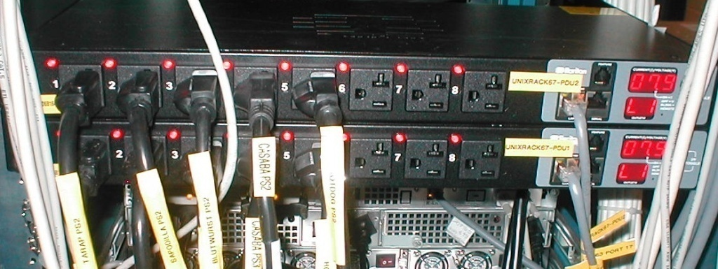
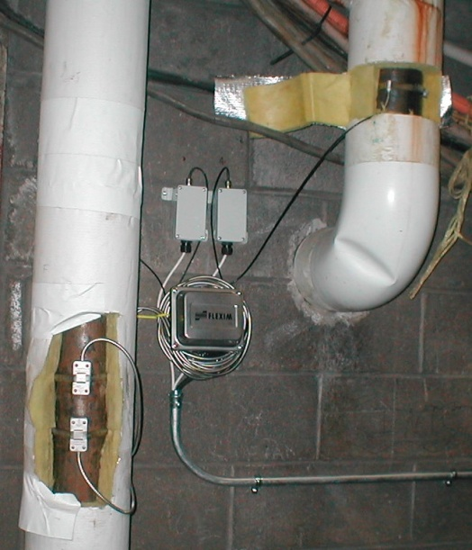
Scope of Work
Inventory
  Create detailed physical inventory of existing servers
Measure server power consumption
  Install network-monitored power distribution units (PDUs) for each server
Measure server input air temperature and data center chilled water
  Install input ambient air temperature monitors for each server
  Install BTU metering on data center supply and return lines
7
7
Notes:
7
Inventory – we have over 600 servers – needed a sample size to track
Measuring – not only power draw but heat load/cooling (also requires energy usage)

Slide 8
Scope of Work Cont’d
Establish overall data center power consumption profile
  Utilize equipment load results to establish baselines
  Develop Power Usage Effectiveness ratio for entire data center
Implement 9 high density racks with in-row cooling
Replace 30 “old” servers and measure efficiency improvement
  Consolidate the replacement servers into high density racks and re-implement the same IT services
  Take measurements of before-and-after power consumption
  Document expected and actual efficiency improvement
Notes:
theory of why self-cooled high density racks are more efficient – concentrate cooling on heat source, so not working harder

Slide 9
Scope of Work Cont’d
Compare old and new high performance research clusters
  Document changes in energy consumption
Implement server power management features
  BIOS- and operating system-level tweaks
Increase chilled water set point and measure
  Document measured before-and-after energy consumption
9
9
Notes:
9

Slide 10
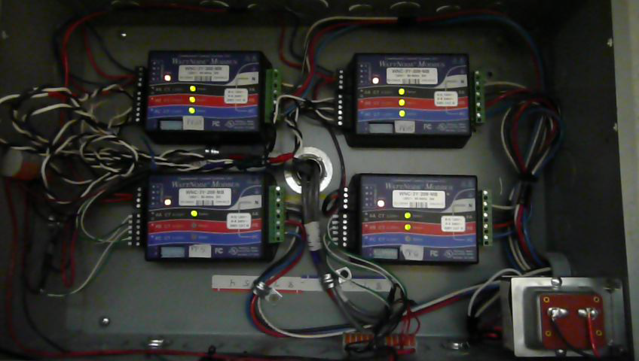
Installation Summary of Monitoring and Measurement Tools
Ian Katz, Data Center Facilities Manager, CUIT

Slide 11
Accomplishments
Installed power meters throughout Data Center
  Established overall data center power usage ~ 290kW
Installed metered PDU’s and plugged in inventoried hosts
Installed chilled water flow meters
  Established overall data center heat load ~ 120tons
Established CU Data Center PUE (Power Usage Effectiveness)
Other Data Center Improvements

Slide 12
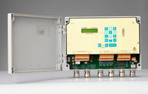

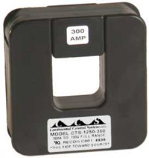
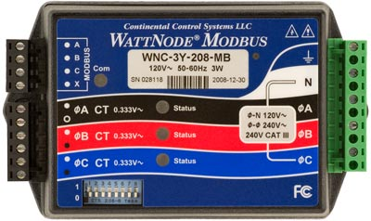

Selected Metering Products
Power Panel Metering
  WattNode Meter
  Babel Buster SPX (ModBus to SNMP translator)
Server Level Metering
  Raritan PDU
Chilled Water Metering
  Flexim – Fluxus ADM 7407
Notes:
Modbus – facilities industry standard for monitoring, communicates on RS-485 serial network… SNMP is IT industry standard for monitoring devices, communicates over ethernet.

Slide 13
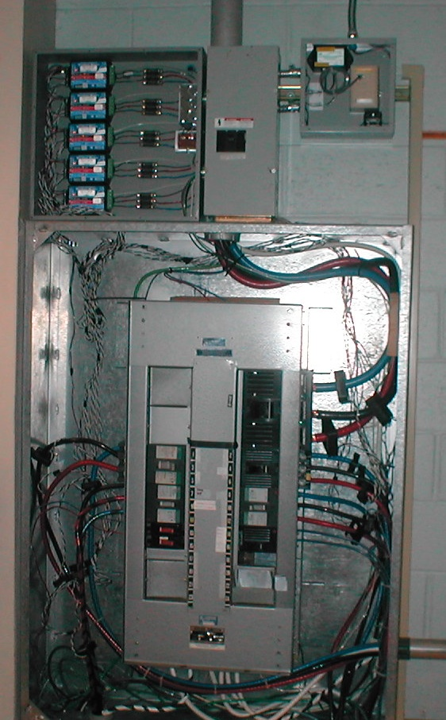
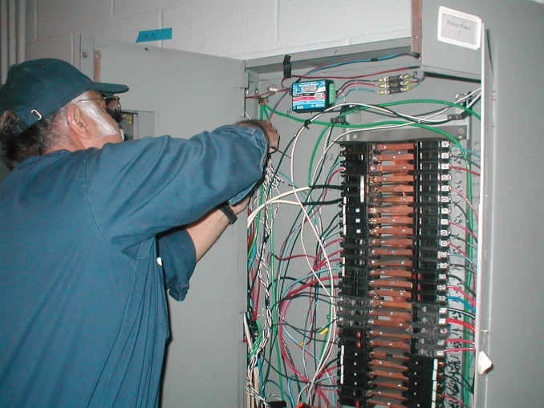
Power Meter Installation
Installed WattNodes in 20 Power Panels
17 Panels in Data Center
3 Main Feeder Panels in Mechanical room
  ATS 2 & 3 - HVAC Load
  ATS 4 - IT Load
290kW IT load read from PP1,2,3,4,5,6,16,26,27
120kW HVAC load read from ATS 2 & 3
Notes:
Challenges to getting it done…Knowledge base improvement – we know usage vs capacity now (cuf used to have to install temporary meter for 1 week to measure our load). Costs…$10k for 20 wattnodes + ct’s + cuf install costs

Slide 14
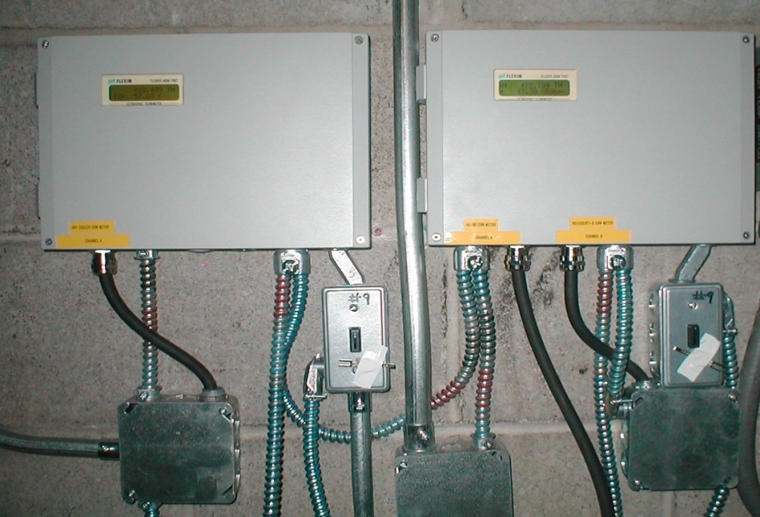
Chilled Water Meter Installation
Flexim meters installed in Mechanical Room
Sensors installed to measure flow rate and temperature
Result is Heat Flow Rate in tons
HF (tons) = Vol Flow (gpm) * ∆T / 24
Sensors installed in 3 locations
  Liebert CRACs 1 – 6
  AC 1 & 2
  Dry Coolers
Meters tied into same Modbus network as Wattnodes

Slide 15
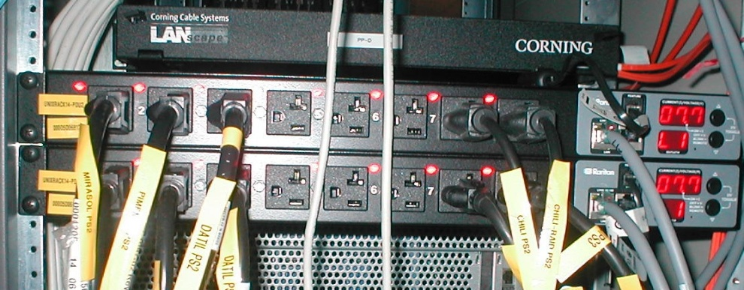

Server Level Metering
Meter many different hardware types with Raritan PDU’s
  Sun: NetraT1, V100, V210, V240, 280R, V880, T2000
  HP: DL360G4p, DL360G5p, DL380G5
30 Servers Identified to:
  Establish Active/Idle Benchmark
  Investigate service usage comparisons
Blade chassis (HP c7000) and blade servers (HP BL460c) metered with built-in tools.
Notes:
Chose Raritan for per outlet power metering.

Slide 16


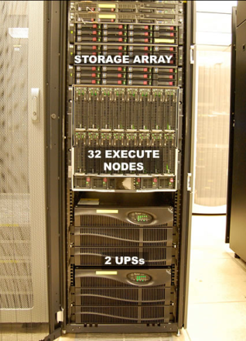
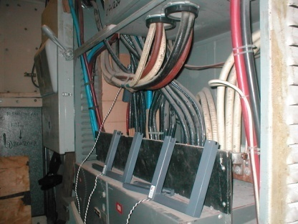
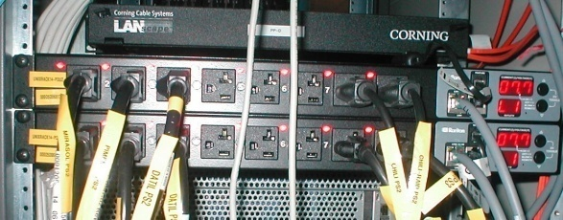
Wattnode meters
Campus Level
power panel
CRAC unit
Data Center: 200 Level
Flexim meters
chilled water pipes
Mechanical Room: 100 Level
Main IT power feed (ATS4)
server rack
Raritan Power Distribution Units (PDUs)
and Uninterruptible Power Supplies (UPSs)

Slide 17
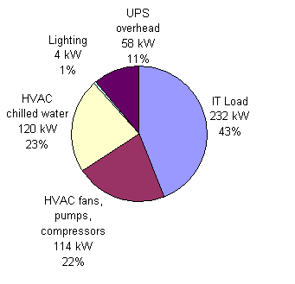
Data Center PUE (Summer) – PUE = 2.26
Notes:
We will move toward the annualized average pue which is becoming the industry standard. Right now, we are looking at PUE differences per season.
DON’T FORGET TO HIT THE LINK TO THE ANIMATED PUE

Slide 18
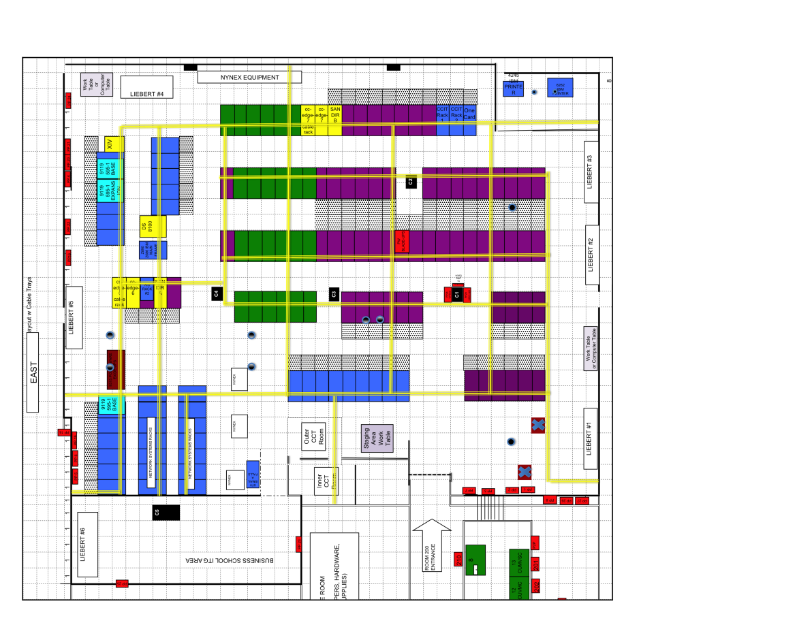
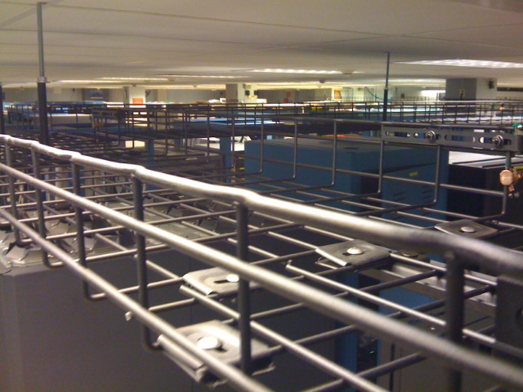
More Data Center Improvements
Installed Overhead Cable Trays
  Will allow us to remove network cabling under raised floor
Began Implementation of New Data Center Layout
  Hot Aisle / Cold Aisle Format
*Future*
  Duct CRAC units & use ceiling as plenum to return hot air from hot aisles to CRACs
  Install overhead power bus to further reduce airflow obstructions under raised floor

Slide 19
Measurement Plan and Initial Results
Peter Crosta, Research Computing Services, CUIT

Slide 20
Server Power Analysis
Comparing power consumption of old and new(er) hardware
High performance computing (HPC) cluster power consumption comparison
Power management and tuning
Notes:
NEXT: out with the old…

Slide 21
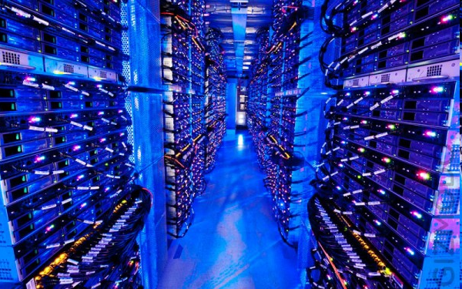
Out with the old, in with the new
If we replace old servers with new servers, how will power consumption change?
IBM 7090 in University Computer Center, 1966
Microsoft’s Chicago data center, 2009
Notes:
The main idea here is to replace older, less energy efficient servers with newer, more energy efficient hardware
Theory: 2 big ideas:
- 1. newer hardware can consume less energy at baseline (while idle or just turned on)
- When a processor is run at a lower frequency (speed), it generates less heat and consumes less power
- Achieved by SpeedStep in Intel Cores or PowerNow speed throttling in AMD laptop processors or Cool’n’Quiet for Desktops/servers
- 2. Newer hardware consumes less energy than older hardware when performing work
- Might be able to get more done, do more calculations, for a given amount of power
- We might think of a measure of efficiency such as performance per watt of power consumed: Can we get the same amount of work done by providing less energy input?
NEXT: Power measurement plan

Slide 22
Power measurement plan
Inventory servers
Determine comparison groups
Two-tiered power measurement approach
  1) pre/post migration comparison
  2) SPECpower benchmark
Notes:
I now will take you through our power measurement plan
1) We first took an inventory of all the servers that were slated to be retired or replaced, and we noted the associated IT services. Some services are scheduled to be moved to brand new hardware such as blades, while other services will be migrated to just new-er hardware. Some servers are to be retired and not replaced, while others have already been replaced as this is a operating data center.
2) We used the inventory to come up with a suite of service comparison groups consisting of several examples of these old-to-new server transitions. For this task, we focus on services - such as web hosting, database, and e-mail - that are to be migrated from older hardware to new or newer hardware. We selected a sample of 10 groups, many of which would be replicated several times. We sought to include a variety of service and hardware types.
3) We then approached power consumption measurement from 2 directions
4) pre/post migration comparison – to measure power consumed while performing specific IT services
5) SPECpower benchmark (ssj_ops) – to look at idle power consumption and to have a standard measure of performance that can help compare hardware types
I will go into MORE DETAIL on both of these
NEXT: pre/post migration

Slide 23
Pre/post migration comparisons
Power consumption of same IT services on different hardware
Migration
Old server
New server
Time
Linux-Apache-MySQLP-PHP (LAMP) Example:
Old Server | Standalone DL360 G5p
New Server | Blade BL460 CG6
Old Watts (Week Avg) | 478 W
New Watts (Week Avg) | 330 W
Notes:
For each of the 10 service groups, we will do the following
Collect a typical weeks worth of power consumption data before the service moves to new hardware
Then perform the migration
Collect another typical weeks worth of power consumption data after the service has been migrated
Since loads may vary throughout the year, we plan to look at a typical week during the semester that may provide a decent representation of power consumption
This comparison will enable us to calculate the total amount of energy used to perform the IT service in that time period, and we can extrapolate from there.
FOR EXAMPLE: LAMP
70% less power used after change to blade infrastructure
Next: Graph of DL360 G5p power consumption over typical week

Slide 24
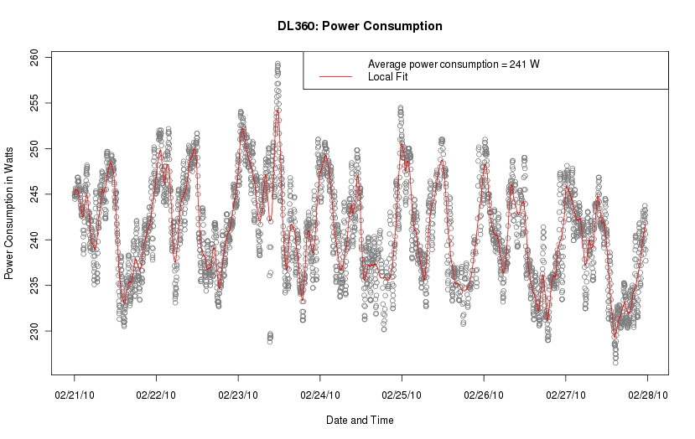
Notes:
Example power usage profile of server
AXES!!!
NEXT: Also looked at SPECpower…

Slide 25
SPECpower benchmark
Industry standard benchmark to evaluate performance and power
Addresses the performance of server side Java
Finds maximum ssj_ops (server side Java operations per second)
With simultaneous power measurement, allows calculation of ssj_ops / watt (performance per watt)
Notes:
We chose the SPECpower benchmark as a way of comparing equipment: traditional servers vs. blades, for example
1 SPEC is the Standard Performance Evaluation Corporation – a nonprofit, nonaligned, industry standard, widely used by (IBM, Sun, Dell, HP, etc). First came out in December 2007.
2 Performance of server side java:
- Runs Java program that Exercises CPUs, caches, memory hierarchy, garbage collection, etc …
3 The benchmark’s goal is to find the maximum ssj_ops – server side Java operations per second
4 Allows calculation of performance / watt when simultaneously measuring power
- SPECpower provides an idle period for active idle power measurement as well as several load levels for power consumption measurements at different machine states.
- There will be 11 SPECpower results in total because we will be running the benchmark on 11 different types of equipment . We will combine these with the pre/post migration results to get a more complete picture of how power consumption changed due to the service migration
======
Now I am going to show two examples of benchmark results that were run on two different machines.
NEXT: Sample SPECpower comparison might look like

Slide 26
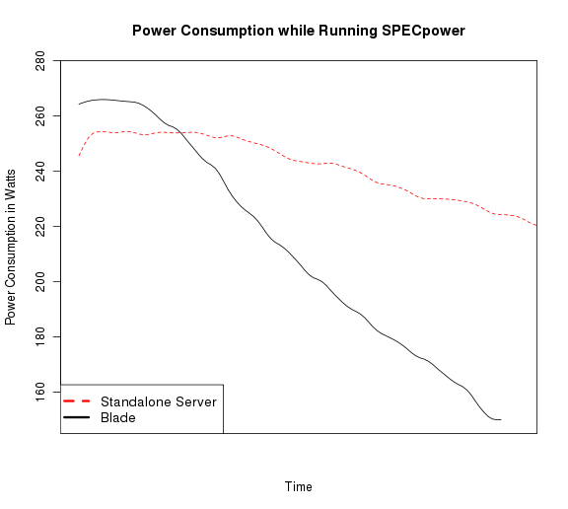
Example SPECpower comparison
DL360 G5p standalone server
  Max: 255 W
  Idle: 221 W
  Overall ssj_ops/W: 139
BL460 G6 Blade
  Max: 266 W
  Idle: 150 W
  Overall ssj_ops/W: 600
Standalone server
Blade
SPECpower benchmarks only valid for internal CUIT comparisons.
Results were smoothed for visual clarity.
Notes:
This slide shows type of data we were able to gather from measurement database and SPECpower benchmark.
AXES!!!!!!!!!!!
Explain different slopes related to the way servers respond to energy needs
Additional Specific examples of Efficiency gains from retiring and upgrading hardware:
Libraries application server moved from host drawing a weekly average of 1674 W to a host drawing 539 W.
Reconfiguration of mail storage required half as many servers, yielding savings of 3680 W

Slide 27
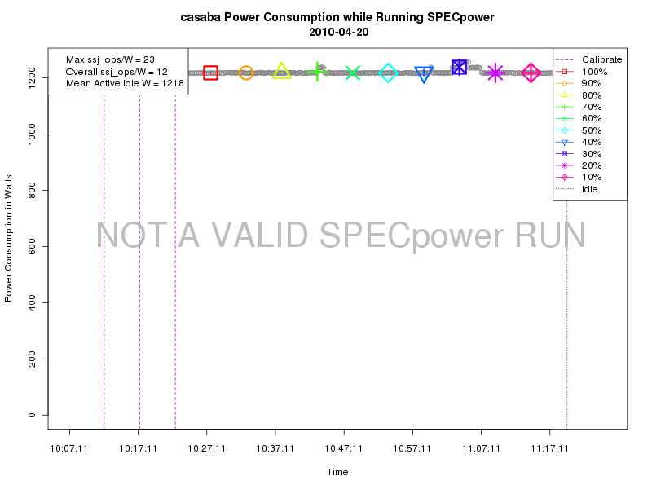
Not all SPECpower results look like that: Sun Sunfire V880
Notes:
This is casaba – a Sun Sunfire V880 from 2002
Vertical axis here goes from 0 to 1200 W
Horizontal Axis is time again
- Different pattern than last graphs
-With this server, like many older ones, we learned that there are only two settings: ON and OFF
At idle: 1218 W
Overall ssj/W: 12
Performance per watt: 23 ssj_ops / W
{Manuf max power 1500 W, 825 @55%}
NEXT: Summary

Slide 28
Power measurement summary
Designed plan to measure old and new server power consumption in multiple ways.
  Energy consumed while running the same IT services
  Performance per watt of power used (SPECpower)
Power usage improvements noted in most cases of moving a service from older to newer hardware – especially when moved to blades.
We can use these measurements to determine future hardware changes and purchases.

Slide 29
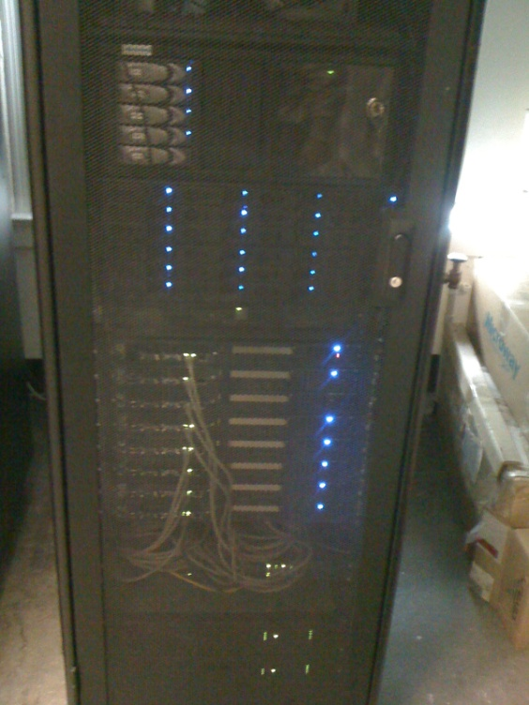

Cluster comparison
Can a new, larger research cluster be more energy efficient than an older, smaller research cluster?
Beehive
Hotfoot
Notes:
Beehive: named for Praesepe or Beehive Cluster or stars in the constellation Cancer about 577 light years away
Hotfoot: named for the first sled dog to win the Iditarod

Slide 30
The clusters
Beehive
Built in 2005
16 cores
8 standalone servers
Dual-core 2.2 GHz AMD Operton
2 to 8 GB RAM
10 TB SATA storage
OpenPBS scheduler
Theoretical Peak GFlops: 61
IDLE POWER IN WATTS: 2.7 kW
Hotfoot
Built in 2009
256 cores
16 high-density blades (2 servers each)
Dual quad-core 2.66 GHz Intel Xenon
16 GB RAM
30 TB SATA storage
Condor scheduler
Theoretical Peak GFLops: 2724
IDLE POWER IN WATTS: 4.1 kW
Notes:
Here are some basic stats on the two clusters
Beehive in Physics building; Hotfoot in DC
{44.37 Watts per TPeak GFlops for Beehive}
{1.52 Watts per TPeak Gflops for Hotfoot }
NEXT: T8 Challenges

Slide 31
Cluster comparison plan
Power use in active idle state
  Beehive = 2.7 kW
  Hotfoot = 4.1 kW
Energy consumption while running research tasks or proxies
  Counting to one billion
  Summing primes from 2 to 2 million (MPI)
  Summing primes from 2 to 15 million (MPI)
Notes:
Now we already showed idle power usage, but measuring power in active idle state only tells half the story.
We really want see how the systems differ while performing the same tasks
- How do we put systems at load? Well, we chose three jobs to run while measuring power…
{ Why not SPEC or HPL suite (sicortex)? (we did not have access to SPEC when doing the cluster comparisons, HPL is focused on seeing how fast a computer can go, not necessarily concerned with power, sicortex out of business, green500 uses linpack (runs pretty short) ) }
NEXT: T8 Results

Slide 32
Cluster energy use while running jobs
New cluster uses less energy to run research jobs than old cluster.
Notes:
Note: since jobs ran over a period of time, we now report energy used in Wh or kWh rather than power consumption in Watts
1: count to one billion
2: mpi sum primes to 2 million (14 slots)
3: mpi sum primes to 15 million (14 slots)
4: mpi sum primes to 15 million (256 slots on hotfoot)
NEXT: T8: Summary

Slide 33
Cluster comparison summary
Older cluster consumes less power and uses less energy at baseline
Advantages of newer cluster are evident as utilization increases
Notes:
Measured at baseline, mostly due to the difference in the number of machines, Beehive draws less power and therefore uses less energy
Hotfoot proves to be more power efficient as long as it is being utilized. So when we measure the amount of power consumed to perform a specific task, Hotfoot uses less energy than Beehive if the task requires sufficient resources.
NEXT: Power tuning

Slide 34
Power tuning
Implement server-, BIOS-, OS-level power tuning and power management
Re-run benchmarks and service group comparisons to collect additional power usage data
Notes:
Not many opportunities to power tune,
Most servers did not have capabilities: only newer blades and DL380 G5.
TALK THROUGH SPECpower results
Blade: Default power with SPEcpower between 100 and 200 W
Performance: between 150 and 220 W
Conservative: between 100 and 150 W
Best benchmark score on default setting
Next: blade tuning example

Slide 35
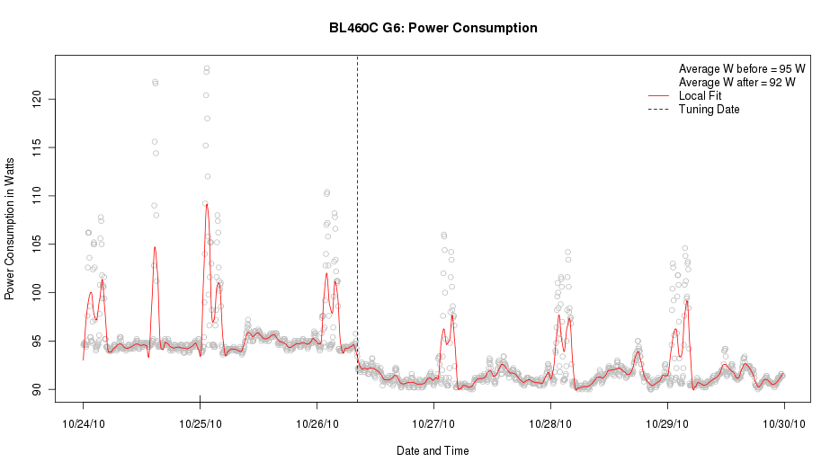
Blade power tuning example
Notes:
Blade put into conservative power mode on 10/26.
Note drop inaverage power level from about 95 to 92 W
Not a lot, but something

Slide 36
Overall Challenges to the Data Center Pilot Project
Operational data center
Communication between IT and Facilities
Identification of what to measure
Implementing and storing measurements
High-density, chilled rack infrastructure complexity and cost
Notes:
Alan
Operational data center
- speaks for itself. Can’t just start unplugging and testing things
- taking production hosts out of service to run benchmarks
IT’s limited infrastructure knowledge requires Communication between IT and Facilities
- who owns instrumentation
- different protocols
- different management bureaucracies
- much work out of IT control; heavy reliance on facilities workers
Costs
- mention both anticipated and unanticipated costs?
- costs of servers is easy; costs of facilities improvements more complicated
- wasn’t just cost of self cooled racks, but a bunch of infrastructure costs we didn’t anticipate
Identification of what to measure and Compare
- raw power consumption – active and idle
- efficiency measure: MIPS/W, FLOPS/W
- Some benchmark program; which one?
Implementing measurements
- beating the clock for hosts slated for retirement
- building a useful measurement data base of appropriate size (instinct is to collect everything forever; costs)

Slide 37
High-density Chilled Racks
Preliminary design with assistance of engineering firm
RFP issued
  stressed energy efficiency as well as facilities operational standards
Finalists selected
Complications due to dual mode cooling plant
  Nominal 45 degree chilled water operation vs. 100 degree dry-cooler operation
  No “off-the-shelf” products work in both modes
Possible solution identified
Currently finalizing peer review of engineering design
Risk - High cost impact

Slide 38
Project Successes
Measurement Infrastructure
  Installed power meters throughout data center
    20 Power Panels (17 in DC, 3 feeders panels in machine room)
    Established overall data center IT load ~ 247kW
  Installed metered PDUs and plugged in servers
  Installed chilled water flow meters
    Sensors installed to measure flow rate and temperature
    Established overall data center heat load ~ 120tons
General Infrastructure
  Hardware Consolidation
  Cable Tray
  Revised Layout (Hot & Cold aisle) format
Estimated Columbia data center PUE (Power Usage Effectiveness)
Notes:
Measurement infrastructure can be used past scope of project
General Infra:
- though out of scope of project (not a direct), but a side benefit of knowledge gained from the project, we implemented some other energy efficient practices
- hardware consolidation outside of the project
- cable trays are green: cables were under the floor blocking air flow, so raised cables overhead
- hot/cold aisle allows direction of cold air to hot aisles; allows ACs to work where they should be working; avoids air mixing at higher temperatures and ACs working overtime
PUE
- Can calculate a PUE at any time

Slide 39
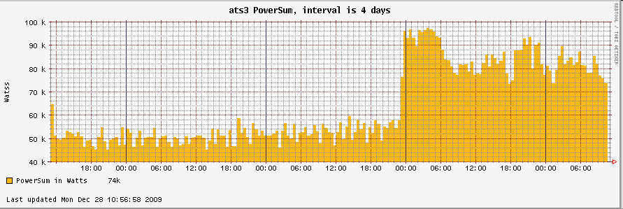
Project Successes cont’d
High Performance Computing (HPC) Cluster Comparison
  - Validated new research cluster by comparing power usage between old and new clusters
Measurement Database
  Continuous collection of server power usage (5 minute intervals)
  Integration with Cricket and Nagios tools
  Validation of hardware upgrades and consolidation
    Total power usage over time
    Also used SPECpower benchmark – performance per watt
Notes:
DB - Reference for Historic data
CLUSTERS
Older cluster consumes less power and uses less energy at baseline
Advantages of newer cluster are evident as utilization increases
- Cricket and Nagios, don’t need to spend a lot of money on commercial tools. Open is good.
SPEC: standard measurement tool (SPECpower benchmark)
- Industry standard benchmark to evaluate performance and power
- Addresses the performance of server side Java
- Finds maximum ssj_ops (server side Java operations per second)
- With simultaneous power measurement, allows calculation of ssj_ops / watt (performance per watt)

Slide 40
Related Work: Consolidation and Virtualization
4-Year Plan
  Standardized server hardware architecture with Intel blades and VMware virtualization
  Standardize on Linux Operating System
  Standardize on Oracle Data Base System
Notes:
Objectives:
Standardized server hardware architecture with Intel blades and VMware virtualization
Standardize on Linux Operating System
Standardize on Oracle Data Base System

Slide 41
Lessons Learned
Work with facilities early to anticipate dependencies
  Chilled water set point change
  Installation of high-density self-cooled racks
Low-hanging fruit of power tuning servers not as promising as we thought
Latest server hardware not always necessary for green improvement
Measuring every piece of hardware is expensive - extrapolate
Notes:
Two projects that were unable to be completed because we did not work with facilities early enough to properly establish costs.
Increasing the chilled water set point – Post award, we worked with facilities crew, and they did a feasibility study. They said that because data center is part of campus chilled water system that heats multiple buildings, every time water goes through each building, the water gets hotter. A 5-degree change would make it such that the water would be too hot to cool buildings at the end of the line.
Install 9 high-density racks - we initially didn’t anticipate the high costs of additional work (such as plumbing and electrical) which take it out of budget. As of now, what we have been quoted puts it out of budget.
Power tuning: we had higher hopes
BIOS- and OS-level power tuning rarely possible
Most hosts un-tunable or already tuned
Retrofitting older data center vs new construction
Didn’t go from oldest servers to blades; but migrated oldest to less old and less old to new. Intermediate steps still result in efficiency improvements without throwing away good equipment. Also can makes sense in operational data center.
By selecting a reasonable sample of systems, can extrapolate from there without the expense and work of instrumenting and measuring each piece

Slide 42
Future Considerations
Post-project monitoring, measurement, and data collection
Integrating data with hardware retirement and purchase decisions
Effective dissemination of information
Notes:
Three last takeaways:
It is important to continue monitoring, measuring, and collecting data after Project closure. This means ensuring these operations are mandated with proper funding.
Information gathered from data collection should be injected into business processes, whether it is for hardware retirement, purchasing, upgrades, consolidation, etc.
Related to this is ensuring effective information dissemination. The decision makers must be aware of the information they have; so proper mechanisms must be in place.

Slide 43
Thank You!
Questions
More info: http://blogs.cuit.columbia.edu/greendc/
This work is supported in part by the New York State Energy Research and Development Authority (NYSERDA agreement number 11145). NYSERDA has not reviewed the information contained herein, and the opinions expressed do not necessarily reflect those of NYSERDA or the State of New York.

