Slide 1
Tailoring MI Spirit for COVID-19 Issues
COVID-19 Action Team

Slide 2
Tailoring MI Spirit for COVID-19 Issues
Recent data show that the mental health status of adults has been negatively affected by the coronavirus pandemic

Slide 3
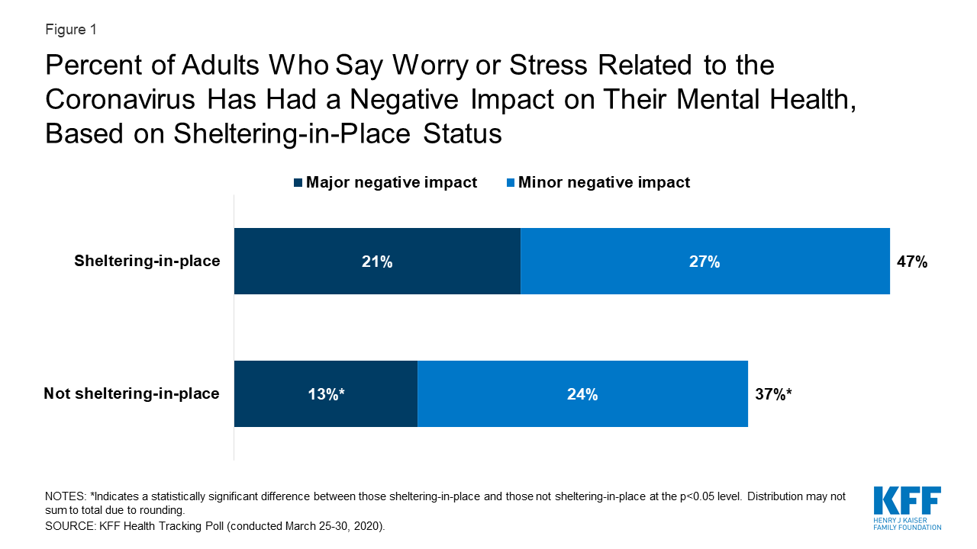
Tailoring MI Spirit for COVID-19 Issues

Slide 4
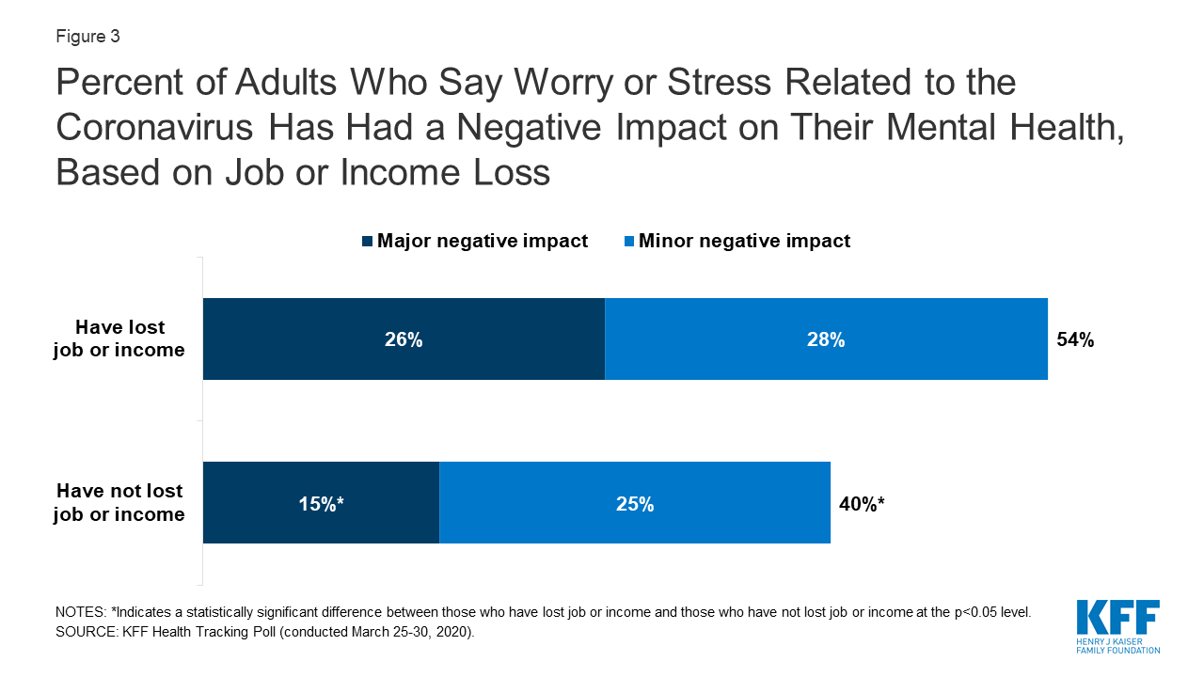
Tailoring MI Spirit for COVID-19 Issues

Slide 5
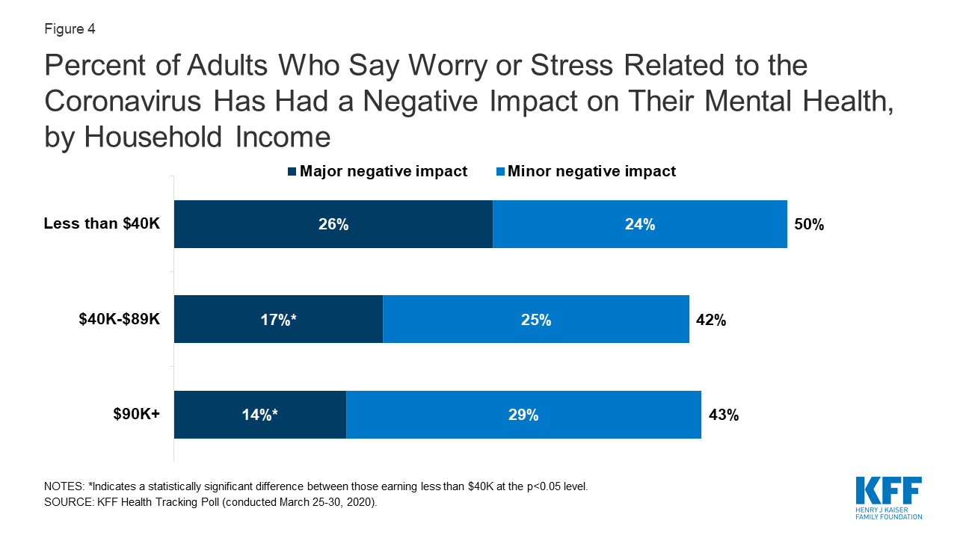
Tailoring MI Spirit for COVID-19 Issues

Slide 6
Tailoring MI Spirit for COVID-19 Issues
There are a range of issues associated with the pandemic.
On the following slides are some examples:

Slide 7
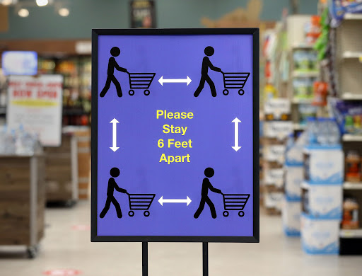
Tailoring MI Spirit for COVID-19 Issues
Non-adherence to preventative measures - e.g., not following social distancing rules or wearing a mask in public

Slide 8
Tailoring MI Spirit for COVID-19 Issues
Increased risks for (1) individuals having substance use disorders, (2) people with chronic respiratory conditions, (3) older individuals, (4) people not residing in permanent settings, (5) incarcerated persons, (6) individuals in unstable marital relationships, and (7) health care workers
Many of the above individuals lack access to health care resources and social support which further increases the health care risks.

Slide 9
Infusing MI Spirit into COVID-19 Issues

Slide 10
Collaboration
Compassion
Evocation
“MI Spirit”
Acceptance

Slide 11
Infusing MI Spirit into COVID-19 Issues
Collaboration: Creating a safe environment that enables the individual to reveal their struggles, activate their strengths, and make decisions for positive change
Acceptance: Demonstrating an understanding of the individual’s perspective of their own situation even when it conflicts with your own views
Compassion: Serving as a supportive and committed partner for change.
Evocation: Recognize and demonstrate that the person needs to make their own decisions on what/how/when to change or not to change

Slide 12
Infusing MI Spirit into COVID-19 Issues
These foundational attitudes of collaboration, acceptance, compassion and evocation were inspired by Carl Roger’s emphasis on the healing qualities of empathic understanding and unconditional positive regard.
Widespread dissemination of MI and its underlying compassionate MI spirit has provided a solid foundation for delivering many forms of treatment.
MI is committed to affirming strengths and capabilities of the person, focusing, clarifying, and discussing priorities for change and drawing out ideas/solutions from the person rather than persuading them to change.

Slide 13
Phase I MI Strategies: “Asking What Matters”
Case Examples 1: Carmen
Case Example 2: Francine

Slide 14
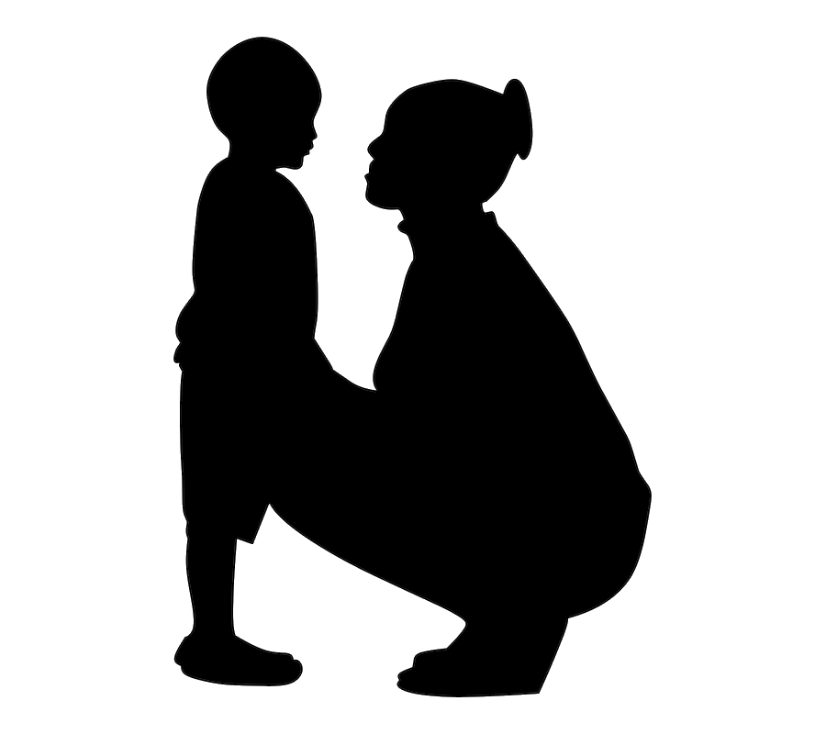
Case Example I
Meet Carmen, age 36.
Carmen is feeling despondent after recently losing her job.
Carmen has a 5-year-old son and is struggling with meeting his everyday needs; she feels unable to cope with the demands of being a single parent.
Carmen is 6 months sober from alcohol. She is concerned that, without a job combined with increased family stress, she will go back to drinking.

Slide 15
Case Example II
Meet Francine, age 28.
Francine is having difficulties with her roommate, Paula, who is regularly inviting friends over to their apartment.
Francine is worried about losing Paula as a friend if she raises her concerns about the risk of having people over.
Francine is also experiencing insomnia and issues related to binge eating at night when she cannot sleep.

Slide 16
Phase I MI Strategies: “Asking What Matters”
Where the person is at?
What is driving them?
What is important to them?
Asking clarifying questions
Really listening to what the person says

Slide 17
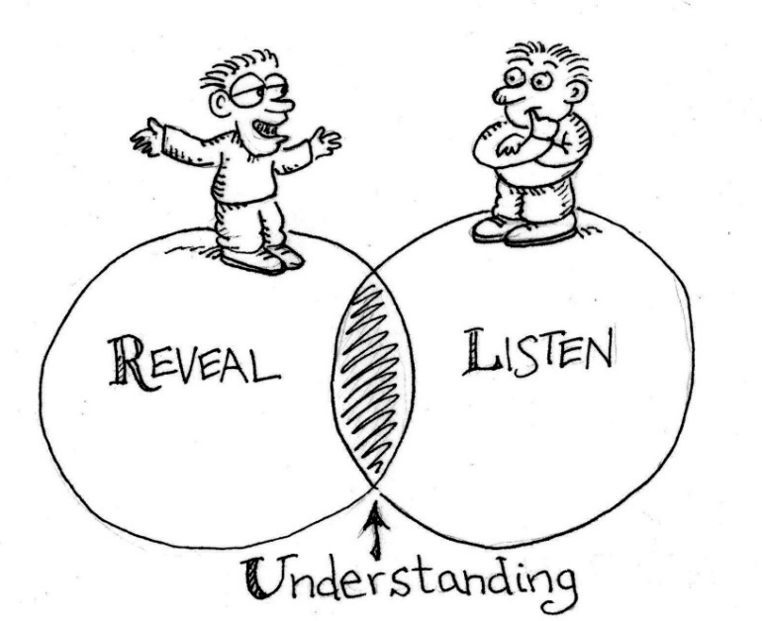
“Asking What Matters?”
How do we communicate to a person that we are listening, and show an understanding of the meaning of the person’s words?

Slide 18
Reflections, Reflections, Reflections
Reflections are statements that “capture” the essence or an understanding of the message being communicated behind a person’s words.
They are used in place of questions (which are used to attempt to gather more information from the person)
Questions can work against creating positive ties between the parties involved. Why?
You have to communicate your understanding = REFLECTIONS

Slide 19
Reflections
Reflections validate and acknowledge what the person is saying by capturing the overall meaning of the person’s words.
Affirmative reflections are very important.
Reflecting factual and specific qualities, strengths and abilities shared by the individual
Help “shine a light” on personal strengths that lie beneath the surface
Facilitates self-confidence, self-esteem and worthiness of the individual
Makes the individual feel “prized” or “celebrated”

Slide 20
Phase II MI Strategies: “Doing What Matters”
How can I guide the person, so change becomes more important to them?
How can I guide the person, so they become more confident about change?
The person must be the one verbalizing the reasons, needs, commitment, and steps toward changing.
You reflect, affirm, and summarize the change talk.

Slide 21
Basic Assumptions
You are the mirror for “change talk”
Reflect it back or evoke it so the person can “see” (hear), feel, and experience change
The person seeking help must be the one verbalizing the reasons, needs, commitment, and steps towards behavioral change.

Slide 22
Phase II MI Strategies: “Doing What Matters”
Case Example 1: Carmen
Case Example 2: Francine

Slide 23
“Doing What Matters”
Meeting them where they are at
Offering alternatives with permission (using FaceTime vs. in-person visits)
Collaborating with them on solutions that take what matters to them into account (not putting others in danger) to implement a creative approach in resolving the dilemma (conversing with a friend online)

Slide 24
“Doing What Matters”
How do you get “change talk”? ASK FOR IT!
What do you think might need to change?
What did you do in the past to be successful?
What needs to happen?
How important is it to you to _____?
What do you think is the first step?
Where do we go from here?

Slide 25
Change Talk Change Behavior
The more one talks about changing, the greater chance they will undergo behavior change.

Slide 26
“Doing What Matters”: E.A.R.S
Elaborate: ask for more details, intentions, elaboration, and about advantages and disadvantages looking back and looking forward; scaling question.
Affirm: reinforce it; encourage and support it; comment favorably on it.
Reflect: restate it back; accept it, acknowledge it, continue the paragraph.
Summarize: collecting bouquets of change talk; gather the change statements offered and ask him/her to affirm and reaffirm his/her commitment

Slide 27
Final Thoughts and Questions
What did you learn, relearn and/or unlearn about MI?
How will you apply the skills to your practice (professional) or personal situations?
Other thoughts?

