Slide 1
Migration and Immigration during the times of Pandemic
Policy training for CSSW COVID-19 Action Plan
Neeraj Kaushal
Mashura Akilova
Megan Curran

Slide 2
Objectives:
Participants will learn about the impact of COVID19 (and the resulting border closures and economic lockdowns) on various immigrant, migrant, and displaced populations in the US and globally.
Participants will learn about the effects of border closures and restrictions on mobility, nationally and internationally, on sending and receiving countries.
Participants will learn about policies to protect the immigrant, migrant, and displaced groups in future pandemic situations, followed by the recommendations for improving immigration policies post COVID19

Slide 3
Global Mobility

Slide 4
COVID19 and Global Migration
Migrants within and outside of the closed borders
Closed borders and economies of
Remittance-dependent countries
Migrant-dependent industries in host societies
Nativism vs. Globalism vs. Humanitarianism

Slide 5
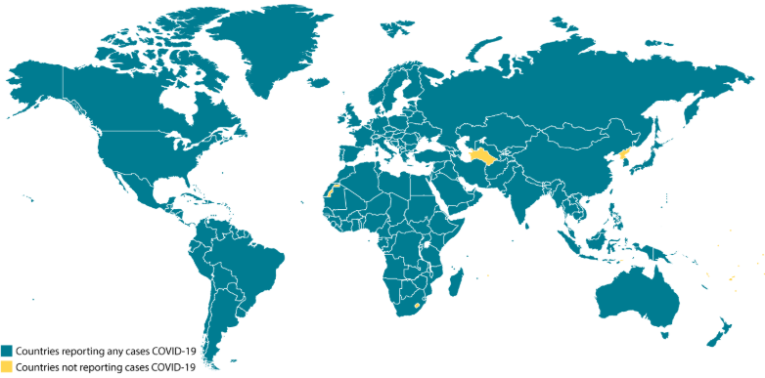
https://www.cdc.gov/coronavirus/2019-ncov/global-covid-19/world-map.html
Notes:
-Impact on Pandemics on Countries
-Mobility of COVID19 due to globalization, ease of travel, dependencies of countries from each other
-The first measure was to close borders (without much preparations)
-
No data for Turkmenistan, Lesotho, North Korea (West Africa has 6 cases according to John Hopkins) https://coronavirus.jhu.edu/map.html

Slide 6
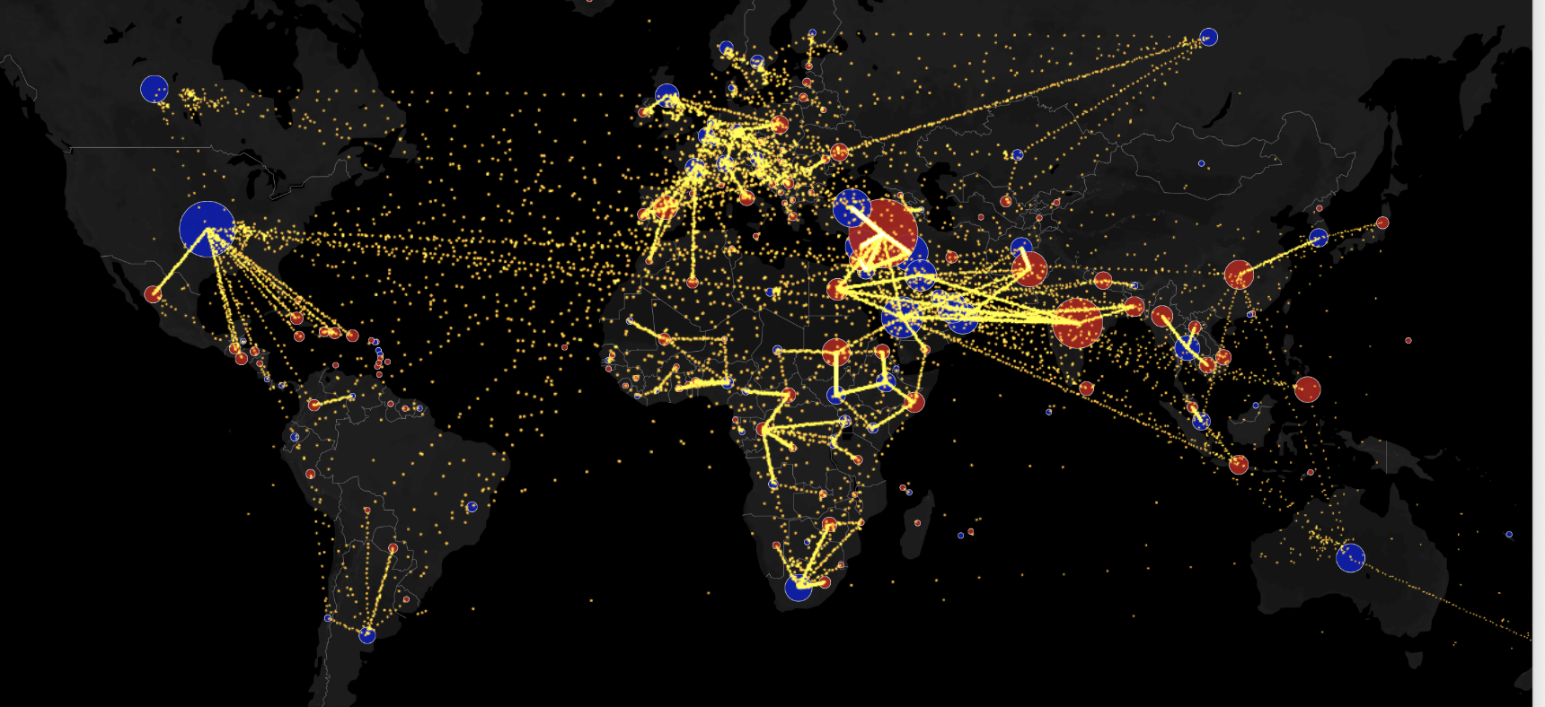
Global Migration Map
Source: http://metrocosm.com/global-migration-map.html

Slide 7
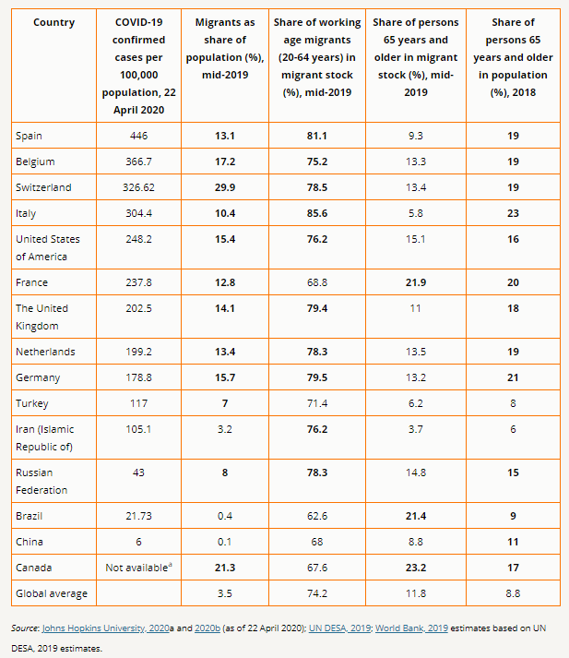
International Migrant Stock: 3.5% of global population
Total number of Migrants 271.6 Million
164 Millions of migrants are workers
20.6% and 17.8% of all workers in Northern America, and in Northern, Southern and Western Europe
https://migrationdataportal.org/?i=stock_abs_&t=2019
Notes:
https://migrationdataportal.org/themes/migration-data-relevant-covid-19-pandemic
https://migration.iom.int/
130 million or 47.9 of them female
Approximately one in five international migrants were estimated to live in just 20 cities -Beijing, Berlin, Brussels, Buenos Aires, Chicago, Hong Kong SAR, China, London, Los Angeles, Madrid, Moscow, New York, Paris, Seoul, Shanghai, Singapore, Sydney, Tokyo, Toronto, Vienna and Washington DC (IOM, 2015). For 18 of these cities, international migrants represented around 20 per cent of the total population (ibid.). The share of foreign-born persons in the total population in some cities exceeds the global average (around 3.4% in 2015) by a large margin (IOM, 2015). Dubai had a foreign born population of close to 83 per cent, while in Brussels it is 62 per cent, in Toronto 46 per cent, New York 37 per cent, and Melbourne 35 per cent, to name a few examples (ibid.).

Slide 8
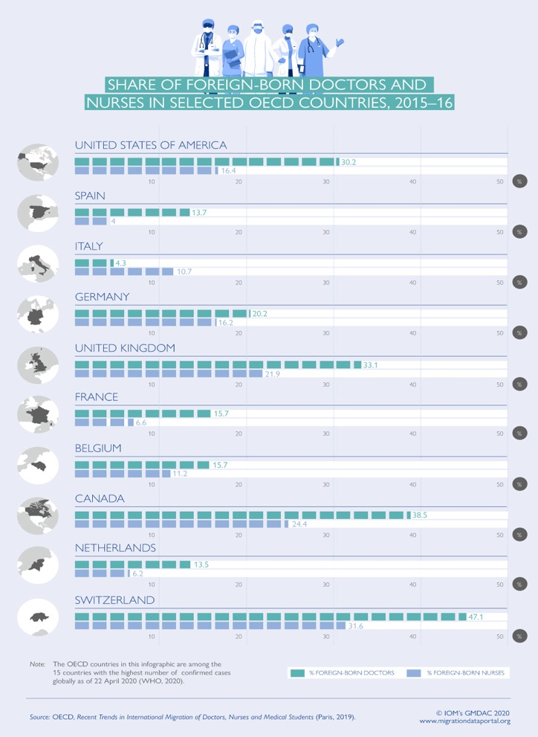
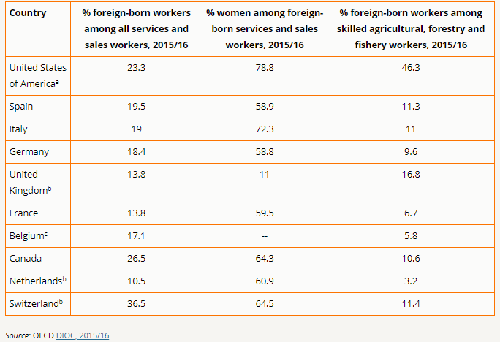
Economic Benefit of Migration
Share of foreign born workers
Share of foreign-born workers in fields that are considered essential
https://migrationdataportal.org/themes/migration-data-relevant-covid-19-pandemic
Notes:
https://migrationdataportal.org/themes/migration-data-relevant-covid-19-pandemic
As an illustration, among the 15 countries most affected by COVID-19, available international data show that at least 10 countries – the United States, Spain, Italy, Germany, France, the United Kingdom, Belgium, the Netherlands, Canada and Switzerland -- depend on foreign-born workers in the critical sector of healthcare services

Slide 9
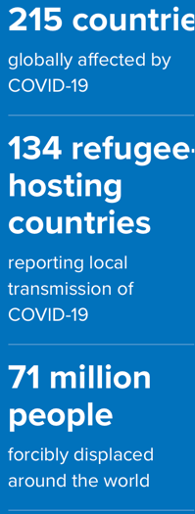
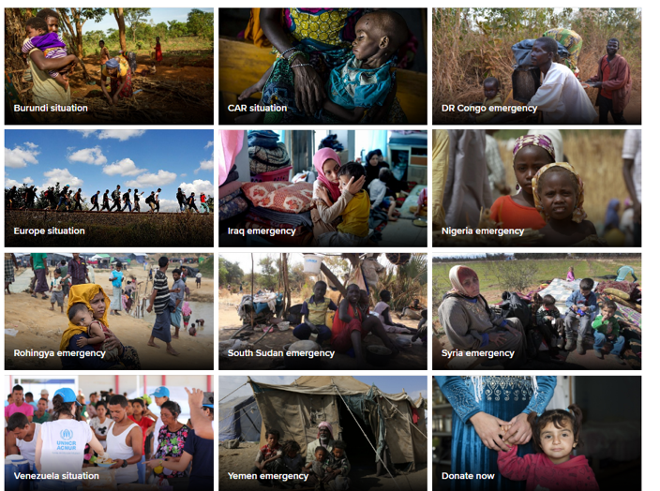
Various groups of affected migrants
Legally residing immigrants (employment, family members of citizens, labor migrants)
Displaced persons:
Refugees and Asylum Seekers (Many under temporary protection in Host Countries)
Internally Displaced Persons
Stateless persons
Undocumented migrants
Temporary migrants
International Students
Scholars
Various groups of visitors
Business people
Source: UNHCR

Slide 10
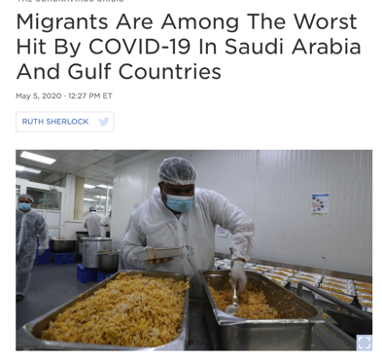
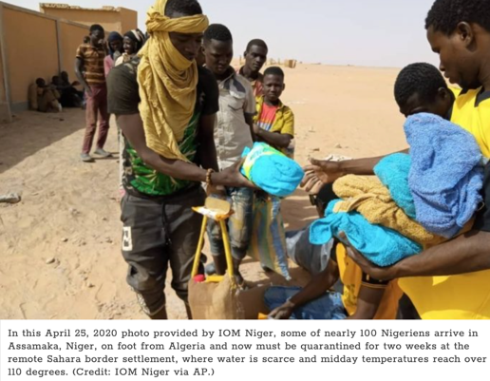
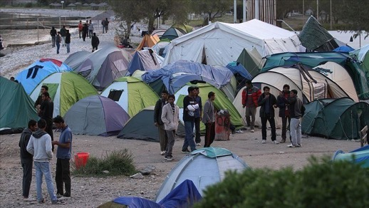
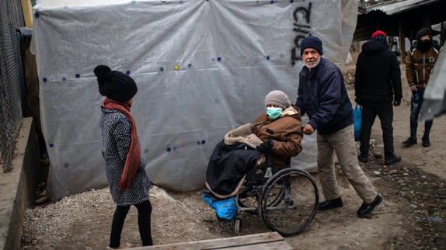
Impact of pandemic-related closures on migrants
Lack of income to survive in host countries
Lack of income to support families dependent on migrants at home
And national economies dependent in remittances
Higher exposure of those in the essential service sectors to COVID19
Living conditions:
Cramped and substandard housing
Multi-generational households
For those in the camps, no proper conditions to physically distance; water and hygiene, group gatherings for essential services
Homelessness
Sources: NY Times, NPR, CBS news
Notes:
https://www.nytimes.com/interactive/2020/04/28/world/asia/coronavirus-singapore-migrants.html
https://www.npr.org/sections/coronavirus-live-updates/2020/05/05/850542938/migrants-are-among-the-worst-hit-by-covid-19-in-saudi-arabia-and-gulf-countries
https://www.npr.org/sections/coronavirus-live-updates/2020/04/15/834999661/official-alleges-the-u-s-has-deported-many-covid-19-positive-migrants-to-guatema
https://www.cbsnews.com/news/deported-migrants-guatemala-coronavirus-cases/

Slide 11
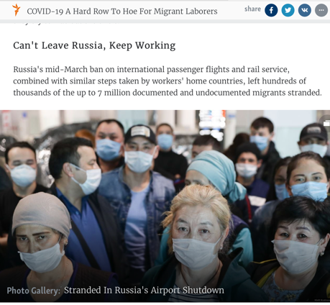
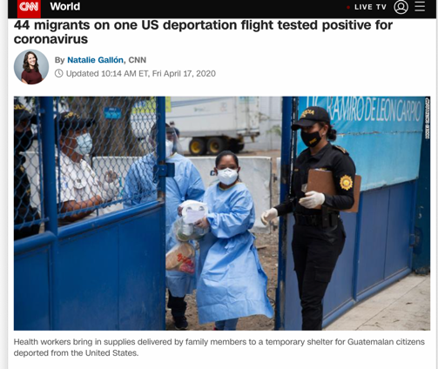
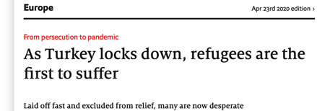
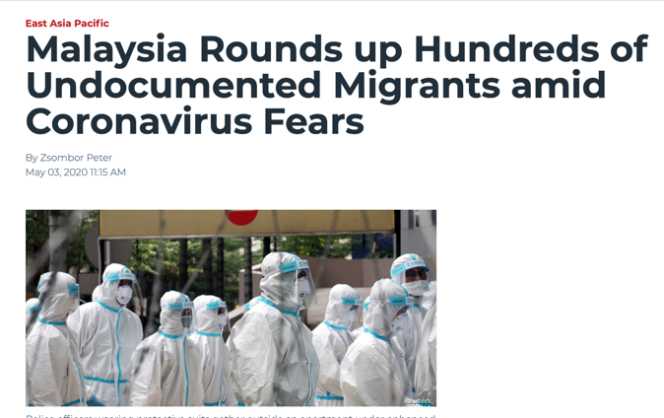
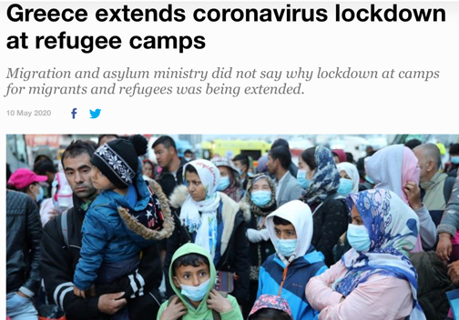
Impact of pandemic-related closures on migrants
Social and Health Insurance/Support
Lacking for many in informal economy
No official support channels offered even during the pandemic
Many groups are excluded from income support
Legal troubles (with shelter-in-closures and inability to renew status)
Xenophobia, nationalism, racism
Deportation
Exclusion
Blame-shifting
Persecution
Discrimination
Sources: Aljazeera, CNN, The Economist, RadioLiberty, VOX
Notes:
Although Saudi Arabia has the lowest percentage of migrant labourers in the workforce of all the Gulf states—officially just over 50% but probably somewhat higher in reality—the sheer numbers involved have far reaching implications, not only for Saudi Arabia itself, but for the region and for sending countries. The country has a population of 30 million, of whom 10 million are immigrants
Malaysuia
Immigrant key workers in Europe: How many and where?
How many immigrants are employed in the occupations that have been identified as essential in the response to the COVID-19 pandemic in the EU? We address this question in joint work with Jacopo Mazza (J.R.C. European Commission) (Fasani and Mazza 2020). We base our analysis on the most recent wave (2018) of the EU Labour Force Survey (EU-LFS). We restrict our sample to employed workers in the 15 to 64 age bracket and distinguish two main groups of migrants (EU mobile and extra-EU citizens) based on their country of birth. Finally, we identify the list of key occupations by combining information from the European Commission and the Dutch government.
According to our definitions and estimates, approximately 31% of employed working-age individuals are key workers in the EU, although this share varies widely across Europe, from over 40% in Denmark and France to just above 10% in Bulgaria and Slovenia. On average, 13% of key workers are immigrants in the EU. Figure 1 shows wide variation across member states: The share of immigrant key workers is close to zero in Eastern European countries such as Romania, Bulgaria, Poland and Slovakia, while it fluctuates around 20% in countries such as Italy, Belgium, Germany, Sweden and Austria. The largest figures are observed in Ireland (26%), Cyprus (29%) and Luxembourg (53%). In most countries, the share of Extra-EU key workers is larger than the EU-mobile share.
3.4 Million immigrants from 31.5M https://voxeu.org/article/covid-19-immigrant-workers-europe

Slide 12
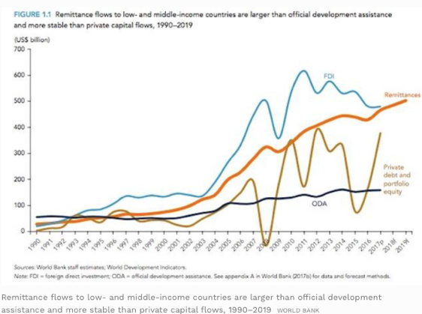
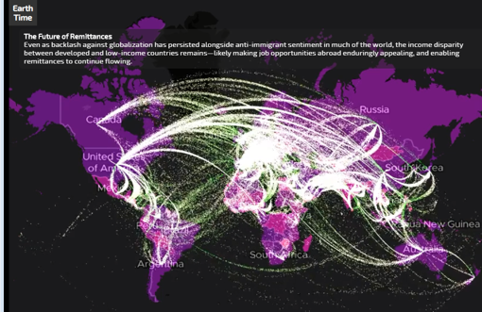
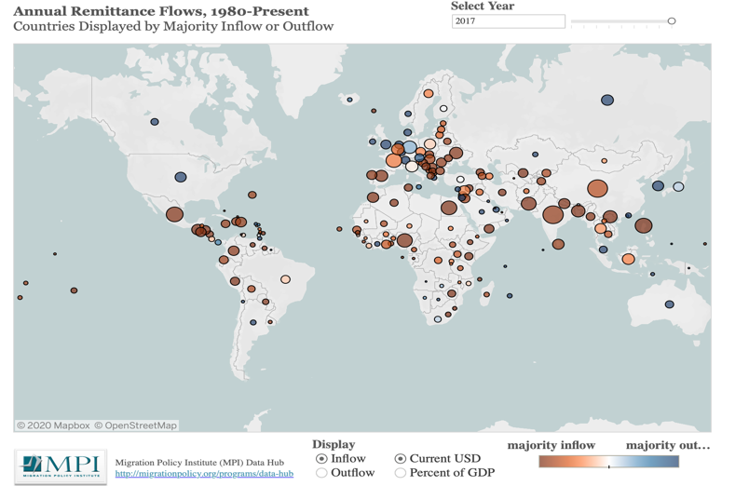
Impact of closed borders on economies
Migrant-dependent sectors of economy (hospitality, textiles, services, healthcare, domestic labor, agriculture, technology) globally are affected by lack of mobility
Developing economies dependent on remittances are impacted (projected to 20% (to $445B - WB)
Remittances are more effective for development and social welfare than ODA ($554B vs. $153B)
Lack of income to support families dependent on migrants at home
Observation of reverse remittances during COVID
https://www.migrationpolicy.org/programs/data-hub/global-remittances-guide
Notes:
Globally, 8 of the 15 countries most affected by COVID-19 - the United States of America, Switzerland, Germany, the Russian Federation, China, France, the Netherlands, and the United Kingdom - were among the 15 countries from which the highest amounts of remittances were sent in 2018. Remittances from these eight countries made up more than 25 per cent of all global remittances in 2018 (GMDAC analysis based on World Bank, 2020). The United States, countries in the Eurozone, the United Kingdom and Canada together accounted for an estimated 46 per cent of remittances sent to low- and middle-income countries in 2019 (World Bank, 2019). Oil-producing countries in the Gulf Cooperation Council (GCC) are an important destination for migrants from South Asia and East Africa.
International students
Globally, there were over 5.3 million international students in tertiary education in 2017, and 3.3 million of them were studying in Northern America and Europe (UNESCO, 2020). China, India, Germany, the Republic of Korea and Viet Nam were the top five countries of origin for international students. Nearly one in four international students came from just three countries: China, India and Germany. International students may also be affected by closure of university campuses, loss of student jobs and mobility restrictions by both origin and destination countries being hit by COVID-19.
Urbanization
Remittance flows are expected to fall across all World Bank Group regions, most notably in Europe and Central Asia (27.5 percent), followed by Sub-Saharan Africa (23.1 percent), South Asia (22.1 percent), the Middle East and North Africa (19.6 percent), Latin America and the Caribbean (19.3 percent), and East Asia and the Pacific (13 percent).
https://www.worldbank.org/en/news/press-release/2020/04/22/world-bank-predicts-sharpest-decline-of-remittances-in-recent-history
Official development assistance (ODA) is defined as government aid designed to promote the economic development and welfare of developing countries.

Slide 13
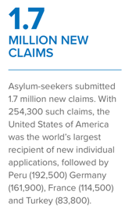
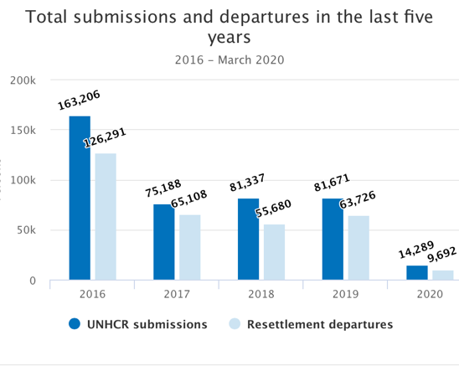
Impact of closed borders on Humanitarian Support
Halting of immigration services, including resettlement of refugees
Difficulty in access for humanitarian workers and other experts
Closed camps/services
Production and delivery of aid
Reduction of global financial support
More burden on low and middle-income host countries to deal with emergency support on their own
Reliance on overburdened and over-capacity healthcare and social welfare systems
Multiple layers of vulnerability of certain groups of refugees : women, children, people with disabilities, those with pre-existing conditions
UNHCR appeals for $6.7B in Humanitarian funds
Protection, Health and Infrastructure, Livelihoods, Cash Support, Education, and other programming to keep displaced persons safe
Source: UNHCR
Notes:
Forced migration or displacement by conflict and disasters
Refugees and internally-displaced persons are among the most vulnerable, in particular those living in camps and other overcrowded settings. The top-15 countries affected by COVID-19 host about 9 million refugees, or 3 out of 10 refugees worldwide. As other countries are increasingly affected by the pandemic, Jordan, Lebanon and Pakistan are together with Turkey and Germany among the top-5 refugee-hosting nations according to data by UN DESA for mid-2019 (2019, based on UNHCR and UNRWA estimates). In addition, 50.8 million people were estimated to be internally displaced by the end of 2019 - 45.7 million due to conflict and 5.1 million people were displaced in the context of disasters within their own country. 18.3 million of the 50.8 million were younger than 15 years, and 3.7 million over 60, with both groups being particularly vulnerable (IDMC, 2020).
Migrant deaths and disappearances
The Central Mediterranean remains the most dangerous maritime crossing for migrants. In April 2020, an estimated 1,132 people attempted to cross from North Africa to Italy and Malta, which is more than double of the figure in the same month in 2019 (498) according to IOM records. The number of deaths decreased to 18 and 13 in March and April 2020 compared to 56 and 52 during the same months in the previous year. Nonetheless, policy measures in response to COVID-19, such as port closures, and less search and rescue vessels in the Central Mediterranean route affect accurate data collection with many shipwrecks likely to go unnoticed.
In the Eastern Mediterranean migration route the number of people attempting to cross, including those arriving in Greece and those intercepted at sea and returned to Turkey, sharply decreased from 4,905 in March 2020 to 292 in April this year. The lock down and other mobility restrictions adopted in Turkey as well as augmented patrolling on the Greek side likely explain this reduction in attempted crossings in the Aegean Sea.
In the Western Mediterranean route, recorded arrivals in Spain decreased by about 45 per cent during the lockdown between mid-March and 30 April 2020 compared to the same period in the previous year (1,098 vs. 1,998 recorded arrivals).

Slide 14
United States

Slide 15
COVID-linked shutdowns in the US
Situation is unprecedented in human history
Primary goal is to contain the COVID
U.S. Consulate offices suspended routine consular services since March 18, globally
US northern and southern borders are blocked for non-essential travels
US has effectively ended asylum at the border
Due process rights of asylum seekers are suspended
CBP expelled 14,416 border crossers in April; unauthorized border-crossers are expelled
173 countries have imposed similar restrictions
Airlines have cancelled most international flights

Slide 16
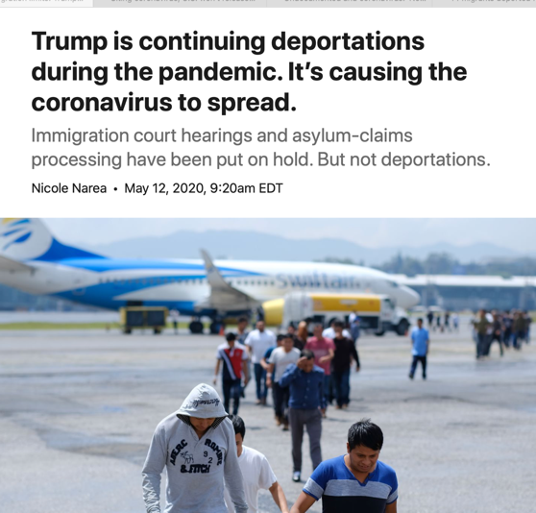
U.S. Immigration Policy
Trump was not a friend of immigrants even in the best of times…
ICE Raids
Asylum restrictions
Threats to renewal of DACA
Local immigration enforcement: 287(g); secure communities
Reforming American Immigration for Strong Employment Act
“Public charge” issue

Slide 17
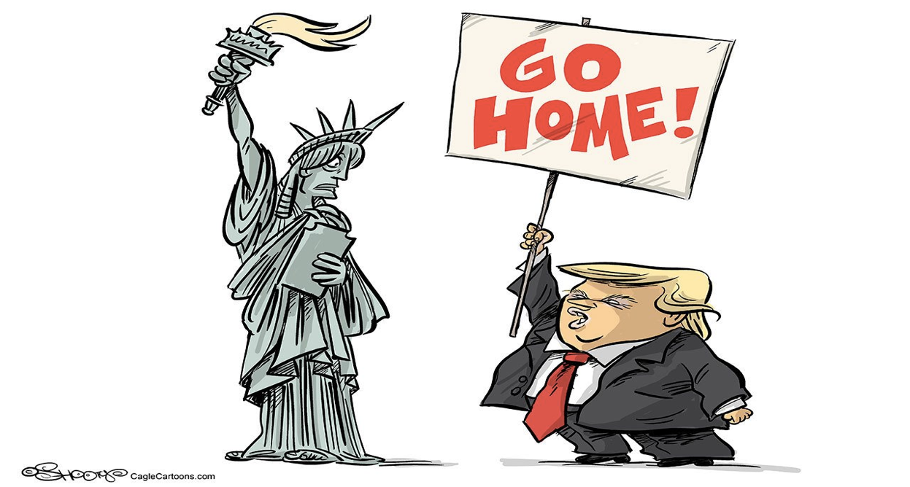
In the United States of America, a country of immigrants, by design......

Slide 18
“Public charge” during COVID
What is Public charge?
Chilling effect of public charge
Implications of public charge during COVID
Public charge rule Feb 24, 2020
New notice on USCIS website: “USCIS encourages all those, including aliens, with symptoms that resemble Coronavirus Disease 2019 (Covid-19) (fever, cough, shortness of breath) to seek necessary medical treatment or preventive services. Such treatment or preventive services will not negatively affect any alien as part of a future Public Charge analysis.”
Will the announcement reduce the chilling effect?

Slide 19
COVID & Immigrant health insurance
Immigrants are highly vulnerable
Yet, they do not have access to many safety net programs.
Many are left out of CARES Act
Low rate of health insurance
undocumented have low rates of insurance – 7.1 million have no insurance
undocumented generally lack primary health care providers
public charge” chilling effect would make them avoid COVID testing or treatment
less likely to use telemedicine
immigrants generally are young and have good health
Latino population has high incidence of diabetes that exposes them to greater risk of prolonged illness on account of COVID

Slide 20
Source: Kaushal and Muchomba, 2020

Slide 21
Immigrants are critical to the COVID economy
Essential critical Infrastructure jobs as defined by US department of Homeland security
69% of all immigrants in labor force
74% of all undocumented workers
65% of the native-born labor force
(workers in industries that meet the health, infrastructure, manufacturing, service, food, safety, and other needs of all Americans).

Slide 22
Immigrants: Frontline workers in the War against COVID (source : MPI)
Industries | Foreign-born workers share
Healthcare and social services | 17%
Essential retail and wholesale: groceries, pharmacies, gas stations | 18%
Manufacturing: food, medicine, soap/cleaning agents | 26%
Transportation: truck, rail, and water | 17%
Agriculture, forestry, fishing and hunting | 27%
Transportation: Bus, Metro, Taxi Drivers | 34%
Postal service | 13%
Scientific research and development | 22%
Total workers in Industries Vital to the COVD-19 response | 19%
Total Civilian Workforce | 17%
Notes:
Source MPI

Slide 23
Immigrants are critical to healthcare and social services industries(source : MPI)
 | Foreign-born share (%)
Registered Nurses | 16
Nursing Assistants | 22
Personal Care Aides | 25
Licensed Practical and licensed vocational nurses | 15
Physicians | 29
Medical and health service managers | 14
Medical assistants | 16
Home Health Aides | 38
Social Workers, not otherwise classified | 10
Receptionists and information clerks | 11
All workers in healthcare and social services | 17

Slide 24
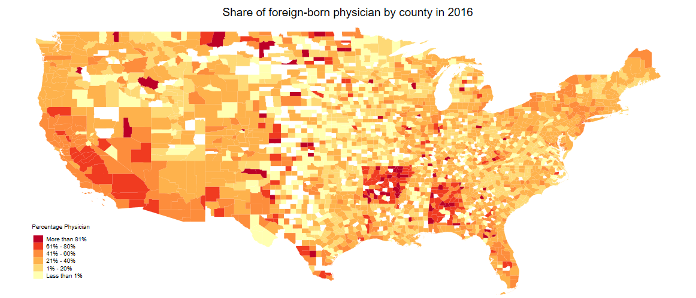
Foreign-trained physicians in under-served areas
(source: Kaushal and Rigzin, 2020)
Notes:
Souce: Kaushal, Kaestner, and Rigzin

Slide 25
Pressures on the government to lower immigration restrictions
AMA has asked the government to exclude foreign medical workers from any future bans; requested the government to provide 40,000 unused green cards to foreign-medical workers
Farm owners are putting pressures on the government to allow foreign workers
Corporate sector

Slide 26
Policy signals on immigration remain mixed
Positive policies:
USCIS has relaxed the conditions of H2A visas for legal seasonal agriculture workers
All employer petitioners of H-2A visas who have valid temporary labor certification are allowed to hire foreign-workers who are currently in the US
It would be a positive step if AMA request is accepted

Slide 27
Mixed signals
Restrict immigration
suspend issuance of new green cards for 60 days.
Using emergency measures to restrict entry
Public charge announcement – Feb 24, 2020

Slide 28
Effect of lockdown
Economy has cratered
Immigration has come to a halt
Short term effect: fall in seasonal workers (farm labor), business travelers, student travelers, remittances.
Long term effect: rising nativism; pressure on countries to restrict immigration
Growing instances of racism and xenophobia

Slide 29
Economic impacts
Economies/industries dependent on migrant workers will suffer
Enormous consequences for post-COVID recovery
Move towards de-globalization
Rising nativism

Slide 30
Federal response to date
3 main COVID-19 relief packages passed so far:
Coronavirus Preparedness & Response Supplemental Appropriations Act (March 6)
Families First Coronavirus Response Act (March 18)
Coronavirus Aid, Relief, and Economic Security (CARES) Act (March 27)
Families First Act & CARES Act = various forms of income support for families, including:
COVID-19 testing for the uninsured (Families First)
Paid sick and family leave (Families First)
Food assistance (Families First)
Unemployment insurance (CARES Act)
Emergency cash stimulus payment (aka ‘recovery rebate’) (CARES Act)

Slide 31
Value of new income supports available
COVID-19 paid sick days and emergency paid leave: (FAQs by Family Values at Work)
Up to 80 hours (up to $511/day) sick leave
Potentially up to 10 weeks paid leave at 2/3 pay (up to $200/day)
Unemployment insurance (UI): 3 new expansions (thank you NELP for info!)
Pandemic Emergency Unemployment Compensation (PEUC): if you are receiving UI, the normal length of time you can receive it is for 26 weeks…PEUC offers an extension of 13 more weeks of UI payments if you are still out of work by the time your 26 weeks run out
Pandemic Unemployment Assistance (PUA): creates UI access for those usually left out of benefits access: self-employed, independent contractors, freelancers, part-time workers, and those who did not have a long employment history (*gig workers should technically qualify for regular UI, but could also potentially be eligible here)
Pandemic Unemployment Compensation (PUC): an additional $600 per week on top of any other UI benefit received, through end July 2020
***BUT UI access remains an issue…benefit values vary by state and state application systems are overwhelmed in some areas…half of those eligible for UI currently receiving…and 13 states have not yet established their PUA systems

Slide 32
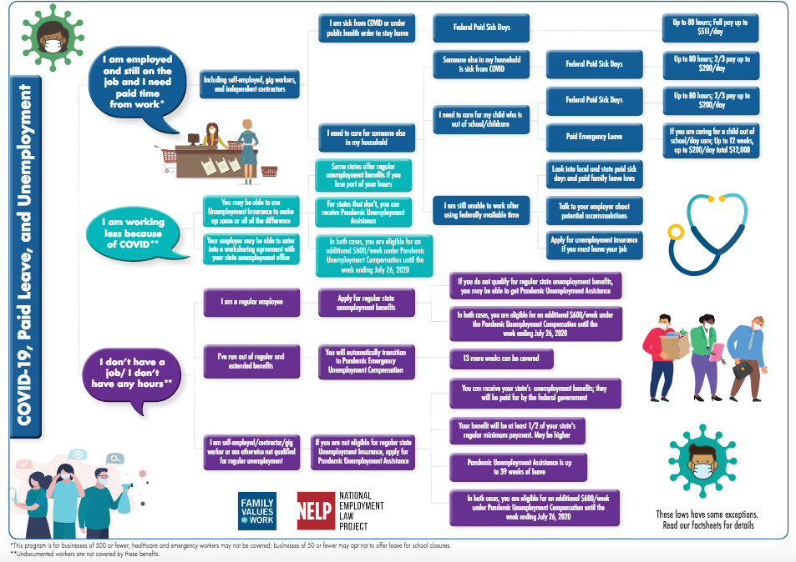
How to know if you can access paid sick days/paid leave or unemployment insurance
BUT
**
Undocumented workers face some restrictions
**

Slide 33
Immigrant worker and family eligibility
COVID-19 paid sick days and emergency paid leave
If you have work authorization, you should be able to access these benefits (actual take-up rates remain a question: may be unaware of eligibility; may be less likely to feel they can take them up (e.g. chilling effect); employers may not encourage/enable take up)
Undocumented workers may be able to access: payments come from employer and therefore can be paid out regardless of immigration status
Unemployment insurance (UI)
Eligibility for UI depends on immigration status at 2 points:
when you apply for/receive benefits (need work auth & likely an SSN)
when you had been in work prior to losing your job (*in most states, can be lawful permanent resident, refugee, asylee, DACA recipients, and other certain categories…some states have different regulations)
Undocumented workers unlikely to be able to access; work authorization required to access regular UI (awaiting Dept of Labor clarification if new UI to operate differently)
**Helpful resource: Family Values at Work “Know Your Rights” Paid Leave & Unemployment Insurance Fact Sheet (in English & Spanish) **

Slide 34
How federal relief interacts with public charge
See: https://protectingimmigrantfamilies.org/immigrant-eligibility-for-public-programs-during-covid-19/ for more
Relief Effort | Implications for ‘public charge’
Free COVID-19 testing (if uninsured) | USCIS confirmed COVID--19 testing/prevention/treatment will NOT be used against immigrants re: public charge
Emergency supplemental SNAP (accessible only for certain non-citizens; US citizen family members can receive even if some are ineligible) Pandemic-EBT (P-EBT) gives us to $125/mo in EBT benefits to purchase food as replacement for missed free school meals Additional funding for WIC (infants/young children nutrition), TEFAP (Emergency Food Asst), and home-delivered meals | a) SNAP can be counted towards public charge b) Pandemic-EBT (P-EBT) NOT to be counted c) WIC, TEFAP, home-delivered meals are NOT to be counted
Unemployment Insurance (regular & expansions) | UI NOT counted towards public charge
Emergency Cash Payment (’Recovery Rebate’) | Is technically a tax credit & these are NOT counted **BUT many immigrant families not eligible to receive**

Slide 35
CARES Act emergency cash payment
One-time payment of $1,200 per adult and $500 per child aged 16 and under
Eligibility & How to Receive:
Household income is below:
$75,000 (single tax filer)
$112,500 (if file as head of household – e.g. single parent w kids)
$150,000 (if joint filers – e.g. married couple)
Partial credit available for a set of households above these income thresholds
If filed recent taxes (2019 or 2018), will receive automatically; if receive certain public programs (e.g. Social Security, SSI, VA, etc) and below income threshold, will receive automatically
If did not file taxes, must apply online
Must have Social Security Number

Slide 36
…BUT 30 million individuals left out (1/2 of which are those in immigrant families)
CARES Act has number of restrictions that severely limit access to cash payment
Who’s Left Out:
Dependents aged 17 and over who are still claimed by their families for tax purposes:
10 million 17-24 year olds (90% of which still in high school and college)
5 million older adults (many of which have serious health issues or disabilities)
15 million individuals in immigrant families where head of household or spouse files taxes with an Individual Taxpayer Identification Number (ITIN), rather than a Social Security Number

Slide 37
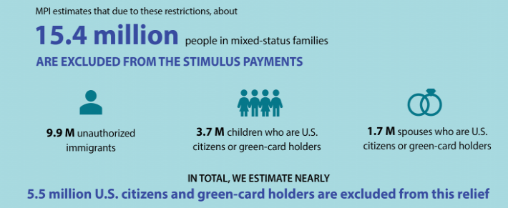
Impact of CARES Act cash exclusion on immigrant families
Migration Policy Institute, May 2020

Slide 38
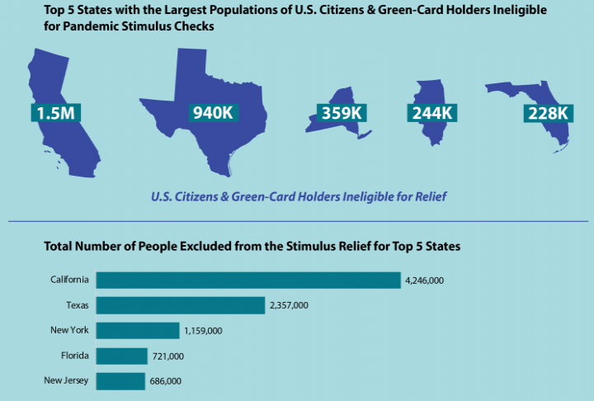
Migration Policy Institute, May 2020

Slide 39
Good practices
California, New York – Cash support to undocumented Immigrants
New Jersey & Nevada, temporary license to recognize non-US medical licenses
Washington DC
Some countries offer migrants same access to healthcare
Portugal (Asylum to all applicants)
Italy (discussing possibility of granting amnesty for undocumented)
Sweden (12 month extension of labor market integration programs for migrants)
Turkey (Recognition of professional credentials, training community members; Education through TV channels)
Germany (Acceptance of unaccompanied kids from camps in Greece)
Bosnia (offering shelter to those stranded in the woods)
Recognizing the contribution of non-citizens, including the refugees in the fight against COVID19
NO ONE SHOULD BE LEFT BEHIND
See More Stories here https://www.unhcr.org/en-us/news/stories/2020/3/5e79e2410/live-blog-refugees-covid-19-crisis.html
Notes:
https://www.unhcr.org/en-us/news/stories/2020/3/5e79e2410/live-blog-refugees-covid-19-crisis.html

Slide 40
Post-COVID
International travels would remain low
Migrant workers will be slow
Nativism will rise
Attack on globalization
Lower funding for humanitarian emergencies
Stalling of economic and social welfare development
Projected starvation and poverty by the WB

Slide 41
Post-COVID – uncertainties and questions
How will economies revive if migrant workers are not allowed to come back?
Will migrant workers travel given the risks?
health, security, livelihood
When will immigration channels be restored?
International student/scholars travels?
How would displaced persons survive among these limitations?
How should preparedness plans include migrants?
Notes:
he SARS-CoV-2 virus leading to COVID-19 affects all regardless of nationality, but migrants, also due to a lack of data, are often left out in national pandemic plans. A review of pandemic influenza preparedness plans in 21 countries of the Asia Pacific region in 2016 only found 3 countries (Thailand, Papua New Guinea and the Maldives) adequately included non-citizens beyond health control measures at borders (18 out of 21 countries, Wickramage et al., 2018). Excluding migrants’ access to entitlements or access to health care in domestic legal and policy frameworks may increase transmission risks, adverse outcomes and inhibit access to early detection, treatment and negatively affect public health management (Zenner and Wickramage, 2020).
The MGI assessments showed that one in five countries have specific measures in place to assist migrants during and after crises. These measures mainly pertain to internal displacement, refugee movements and the provision of humanitarian assistance on an equal footing to nationals and migrants. Measures on maintaining or upscaling health systems during a public health crisis are not specifically mentioned. Thirteen per cent of the countries partially include these types of measures in the sense that their strategies are inclusive of all vulnerable communities (thus informally encompassing migrants). Some countries temporarily relax immigration requirements, allowing migrants whose country of origin has been affected by a crisis to remain in the destination country beyond the usual time limit. In other cases, assistance is provided de facto to all migrants irrespective of their migration status. More than half (55 per cent) of the countries do not include any specific measures to assist migrants, but several mention that assistance is given on an ad hoc basis.
https://migrationdataportal.org/themes/migration-data-relevant-covid-19-pandemic

Slide 42
Post-COVID Opportunities
Stronger collaboration (information, expertise and resource sharing)
Activation of many community-based organizations & civil society
Technological advances that could include previously excluded groups
Ex. Education for refugee kids; telehealth in native languages etc.
Stronger Inclusive Social Welfare Systems – more empathy?
Experience and preparedness for future global crises

Slide 43
Questions?

