Slide 1
2D Shallow Water Equations
with
Overtoppable Barriers
Judah Ryoo (4th year)
Advisor: Kyle Mandli

Slide 2
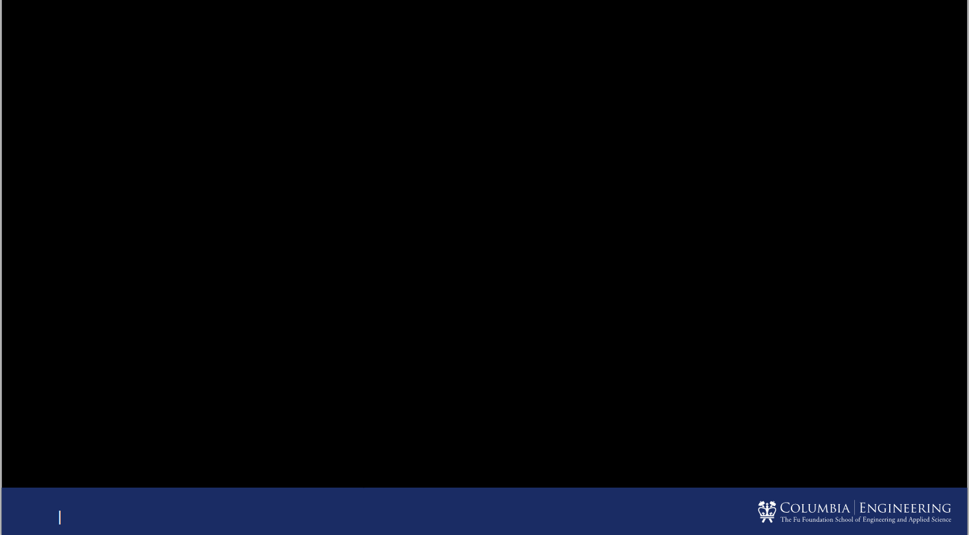
Problem Setup
Challenges:
Small cells update
Geometrical calculation

Slide 3
H-box Method for Grid-aligned Barrier

Slide 4
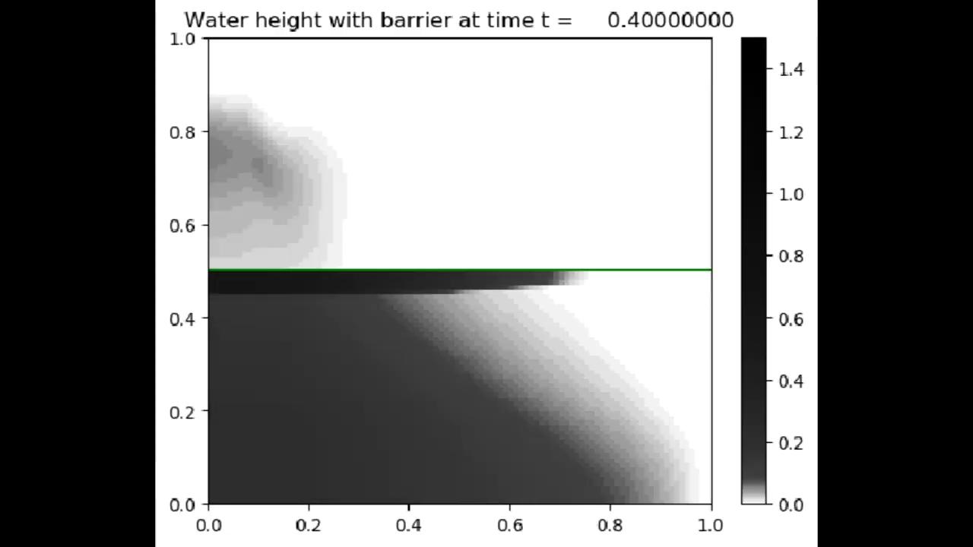

Slide 5
New Method for Grid-aligned Barrier :
State Redistribution

Slide 6
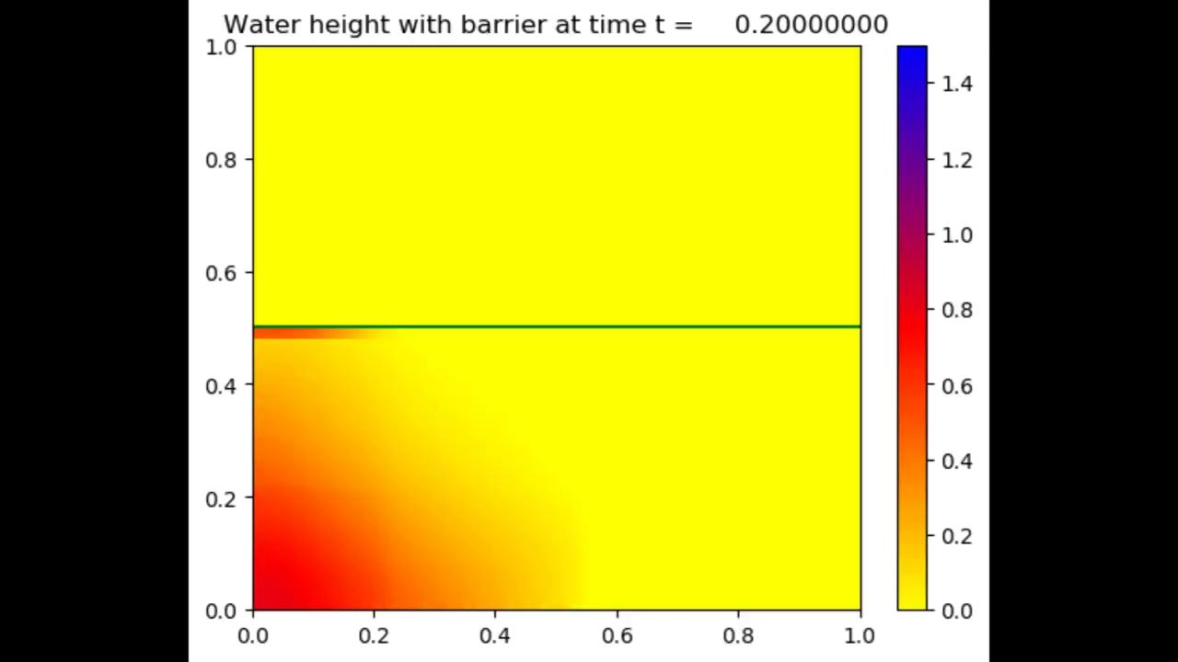

Slide 7
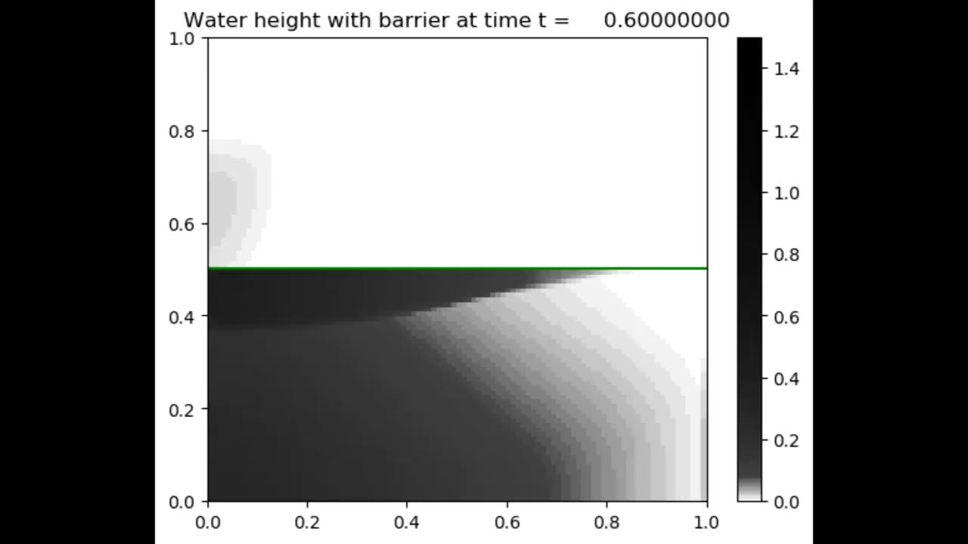

Slide 8
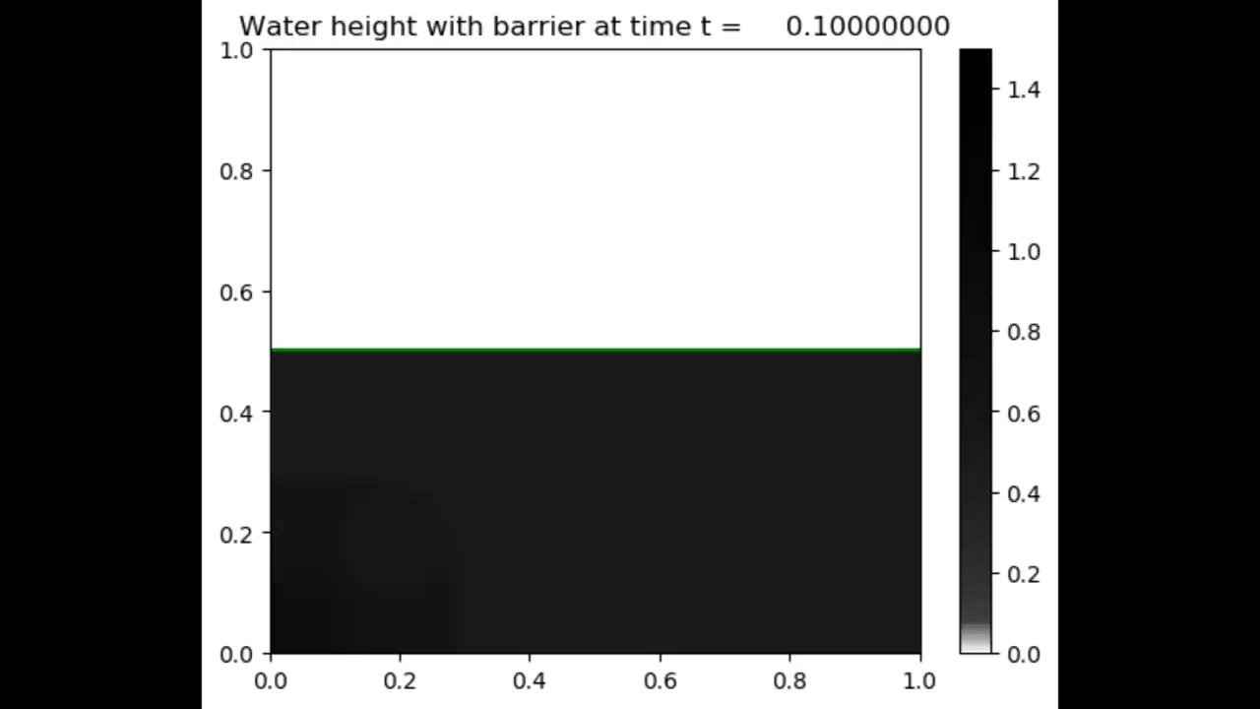

Slide 9
Angular Case : Diagonal Barrier at 45°
H-box Unigrid
𝛽
𝛾

Slide 10
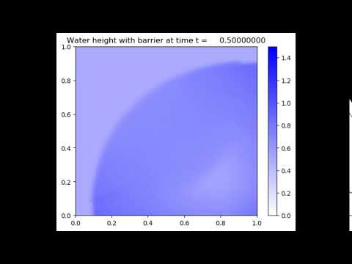
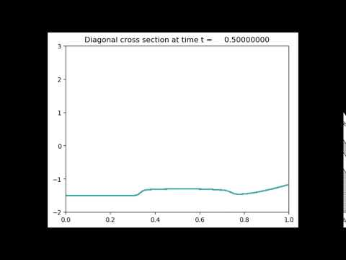
Example #1 : No wall

Slide 11
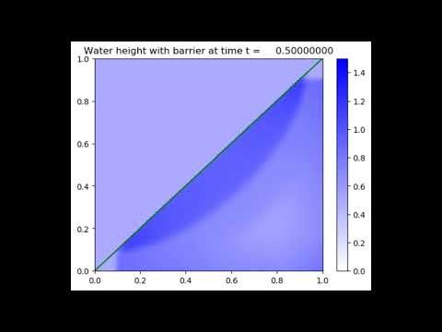
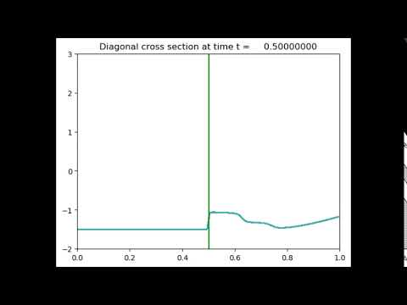
Example #2 : High untoppable wall

Slide 12
Example #3 : Overtoppable wall

Slide 13
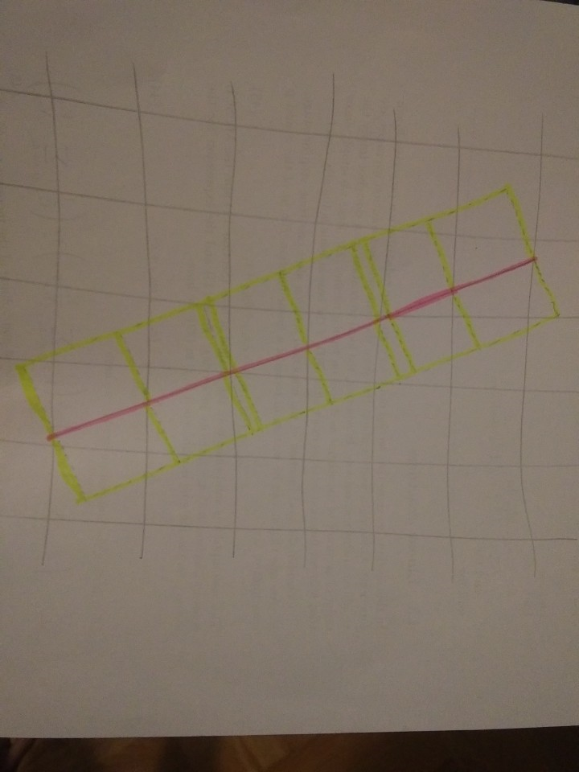
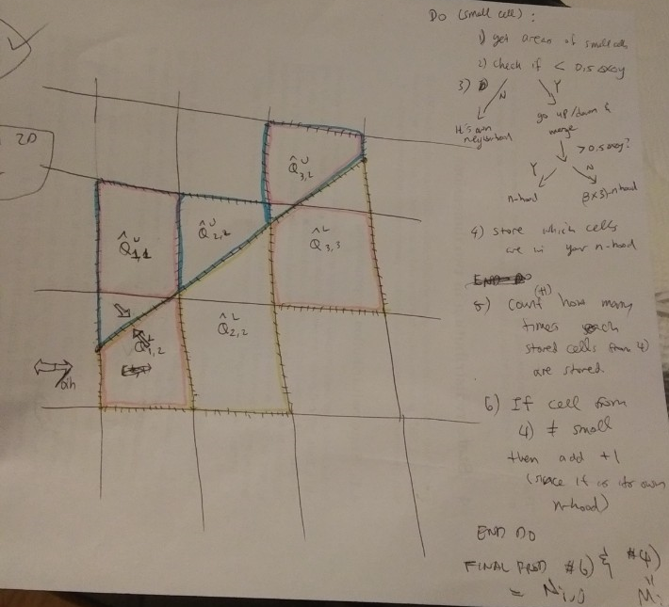
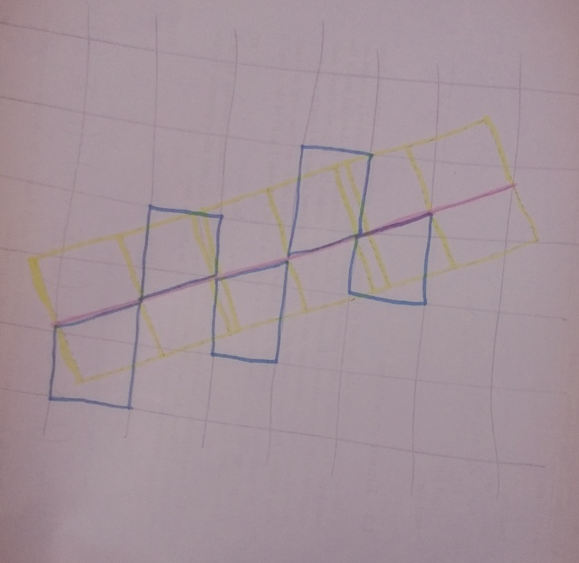
Further Work
Generalize SRD for angled barrier case
Generalize h-box unigrid for angled barrier case (other than 45°)
Try cell merging method

