Slide 1
From Juvenile Justice to Young Adult Justice: An Emerging Framework for Policy and Practice
Vincent N. Schiraldi
Senior Research Fellow
Columbia University Law School
The Justice Forum
November 30, 2015

Slide 2
Young Adult Justice
Historical Underpinnings
Emerging Research
Experiences in Other Jurisdictions
Policy Recommendations

Slide 3
Historical Underpinnings
In 1899 first juvenile court established,
helps to legally define adolescence
Relied on custom, culture or morality to determine age of criminal responsibility, ranging from 16-18
Late 20th Century 'get tough' movement questions very foundation of juvenile court
Spawns research into whether young people really are different than adults - Justice Department and MacArthur Foundation

Slide 4
Changing Life Course Markers Impact Resiliency
Today’s young adults enter into traditional, stabilizing adult roles at a later age
9% of 18-24’s were married in 2010, compared with 45% in 1960
  Live separate from children and children’s mothers
27% of young African-American men between ages of 18-24 are disconnected from work and are out of school (20% in 1960)
Non-college median earnings down from $40,000 (‘73) to $30,000 (‘07) for young whites; $34,000 to $25,000 for young African Americans
This prolonged transition to adulthood taxes ability to forgo immediate gratification and prolongs reliance on peers vs. family

Slide 5
Emerging Research in Neurobiology and Developmental Psychology
Part of the brain that modulates pleasure-seeking develops more quickly than the part supporting self-control, impulsivity has 'head start' over restraint
Adolescents are:
  less able to regulate their own behavior in emotionally charged contexts
  more sensitive to external influences like peer pressure
  less able to make judgments impacting the future
  particularly true for youth who have suffered brain trauma
  Young adults resemble juveniles more than older adults

Slide 6
Risk and Opportunity
Nationally, young Adults 13% of US population; 30% of arrests; 21% of prison admissions
78% rearrested within 3 years of release; highest of any age cohort
In NYC, four in ten adult violent felony arrests involve young adults
Once arrested, nearly 4 in 10 NYC young adults rearrested within a year - 3 times the rate of over 30’s
Relatively few start their criminal careers after 25, most age out by 25
African American young adults 9-10 times more likely to be imprisoned that young whites

Slide 7




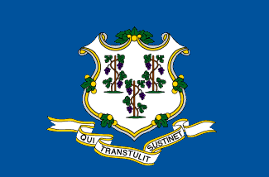
States
Florida has had a youthful offender law since 1978 that allows the courts to use alternative processing for 18-21 year olds
Michigan recently expanded the 'Holmes Youthful Trainee Act' to allow judges to sentence youth between the ages of 17-23 without having to incur a criminal conviction
New York State’s Youthful Offender Law provides for certain confidentiality protections for those who are 16-18
Maine has a facility that includes young men aged 18-25
Connecticut Governor Dannell Malloy recently proposed to raise the age of family court through 20 and add confidentiality protections for those under 25

Slide 8




Cities and Counties
San Francisco established 'Transitional Age Youth San Francisco' (TAYSF), a collaborative network of city departments, providers, and young people to provide supportive services to help young adults succeed. SF opened a young adult court this summer and has had specialized probation caseloads since 2009
Multnomah County, Oregon has specialized parole caseloads with enhanced services for young adults
New York City Department of Correction plans in-facility programs and services, alternatives to incarceration, and reentry planning for 18-22 year olds
Douglas County, Nebraska established a 'Young Adult Court,' a specialty court with judicial supervision for young adults up to age 25 who are charged with a felony

Slide 9
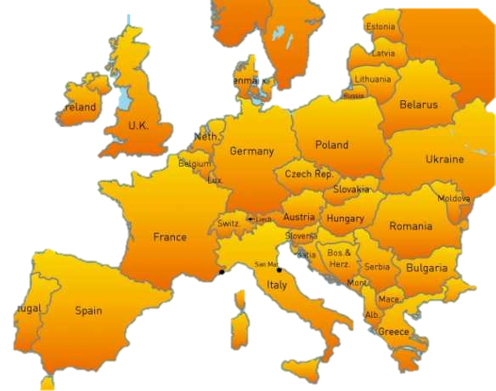
Europe Generally has a Special Approach for Young Adults
57
Percent of 35 European countries surveyed had special rules in juvenile or general penal law
49
Percent had penalty mitigation
21
Percent had no special rules

Slide 10





Countries
Germany: all 18-21 originate in the juvenile court; 2/3 stay there, mostly for more serious offenses whereas property and driving offenses go to adult court; separate facilities
Sweden: Statutorily mitigated sentences and fines; “youth service” (community service/programming) available; more probation, less imprisonment
Finland: No mandatories under age 21; enhanced good time for 18-21’s; fewer prison sentences and work/education oriented prisons
The Netherlands raised the age of family court to 23
United Kingdom: Age as a mitigating factor; maturity assessments for 18-24 year olds; separate facilities controversial; Select Committee in House of Commons

Slide 11
Policy Recommendations
Thoughts on what a more responsive system for Young Adults would look like

Slide 12
How Can We Better Meet the Needs of this Population?
Raise the age of family court to somewhere between
21 and 25
Create a
3rd system for Young Adults
Special package of programming and policies
  Specialized diversion
  Special courts
  Customized probation caseloads
  Separate facilities
  Confidentiality

Slide 13




Further Reading
Community-Based Responses to Justice-Involved Young Adults
Executive Session on Community Corrections
http://www.hks.harvard.edu/programs/criminaljustice/research-publications/executive-sessions/escommunitycorrections/publications/community-based-responses-to-justice-involved-young-adults
The Case for a Young Adult Criminal Justice System
Tracy Velázquez
https://chronicleofsocialchange.org/policy-paper/the-case-for-a-young-adult-criminal-justice-system-by-tracy-velazquez/2683
From Juvenile Delinquency to Young Adult Offending
OJP National Institute of Justice
http://www.nij.gov/topics/crime/Pages/delinquency-to-adult-offending.aspx
Various Publications
Transition to Adulthood T2A
http://www.t2a.org.uk/publications

Slide 14

For more information
www.hks.harvard.edu/criminaljustice
Vincent_Schiraldi@hks.Harvard.edu

